Slide 1
Effect of a comprehensive and intersectoral reproductive adolescent health primary care model on fertility: the case of Salud Mesoamerica Initiative in Costa Rica
Pedro Bernal, A. Bancallari, MP. Zuñiga, Matías Muñoz, and P. Jara
Inter-American Development Bank
Science for Health Systems Conference
October 31st, 2025

Slide 2

Introduction
Adolescent pregnancy is both a public health and a social problem
It can have long lasting consequences and large social and economic costs
LAC region 2nd highest prevalence of teenage pregnancy worldwide
In 2010 Costa Rica
2x
higher adolescent fertility than OECD (47 Vs 25)

Slide 3



Introduction
There is evidence of effective interventions to reduce adolescent fertility
Education (sexual health education, peer support)
Health (improved availability of contraception, provider training, adolescent friendly services)
Social protection (cash-transfer programs)
But, little evidence on how to integrate them in health & education systems
We evaluate the effect of a comprehensive care of model for reproductive adolescent health in Costa Rica on adolescent fertility.
Model was designed and implemented under Salud Mesoamerica Initiative.

Slide 4
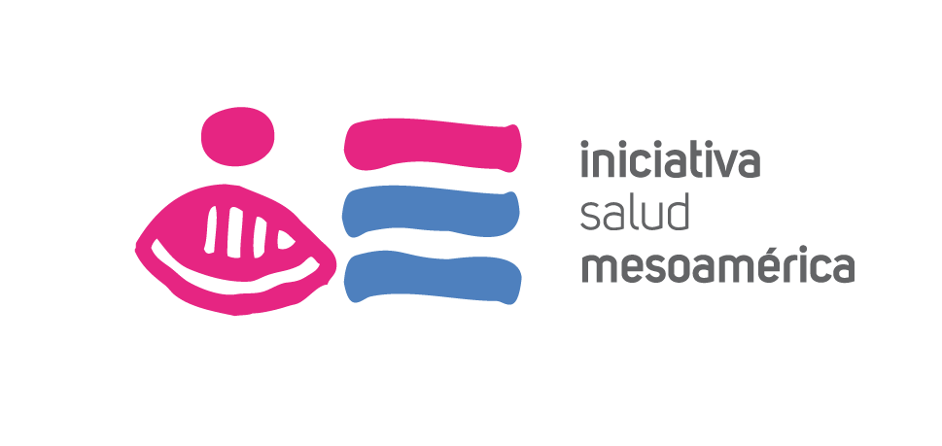




Background
Salud Mesoamerica Initiative (SMI)
Public-private partnership aiming to improve reproductive, maternal and child health in Mesoamerica's poorest 20%.
Results-based financing mechanisms for Ministries of Health (MoHs)
Technical assistance for MoHs to address performance gaps based on systems thinking
Systems learning mechanisms
Government & providers as partners
Costa Rica
In Costa Rica focus was on reducing adolescent fertility in underserved areas.
Persistent challenge, overall fertility rate had a higher rate of decline than adolescent fertility during 1980-2010
Strong primary care system, but adolescents had been an underserved population
SMI supported the MoH in desgining and implementing a comprehensive care model for reproductive adolescent health

Slide 5
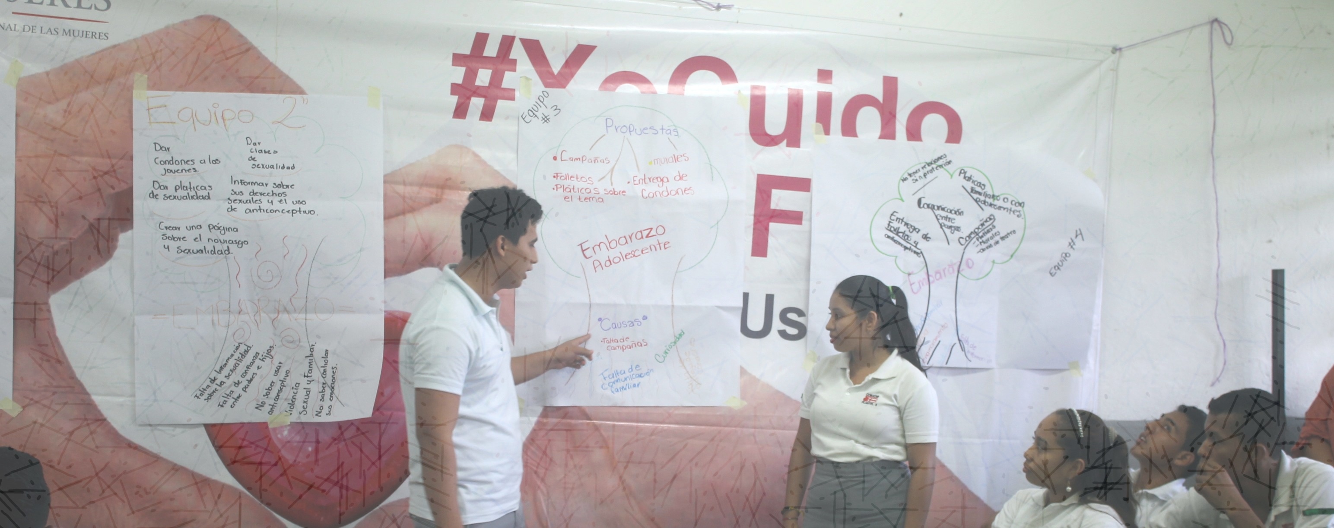

Slide 6





Comprehensive care model
Preventive care
Physical examination
Adolescent comprehensive care visit
Risk Assessment
Brief counseling
Contraception if they chose to

Slide 7


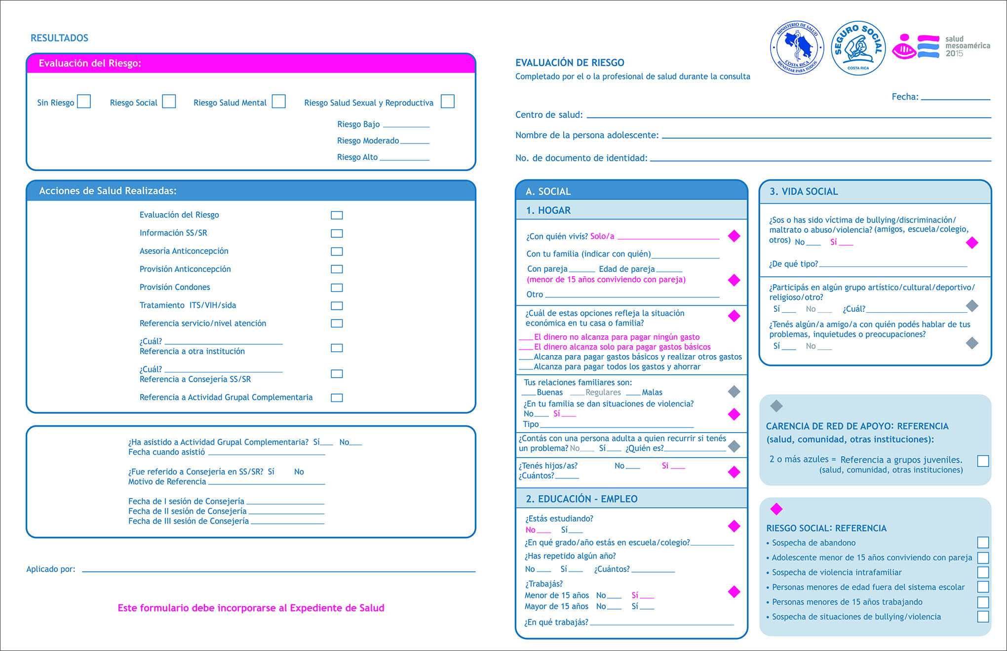


Comprehensive care model
Preventive care
Risk Assessment & key services
Sexual and reproductive risks
Physical examination
No risk/low → Schedule next visit
Medium → Contraception counseling & prescription
Adolescent comprehensive care visit
Risk Assessment
High → Contraception counseling & prescription + referral to additional services
Brief counseling
Mental and social risks
Mental → Psychological services + referral to additional services
Contraception if they chose to
Social → Referral to additional services

Slide 8






Primary care service adaptation
Increased consultation time (30 vs. 15 min)
Service schedules
adolescent-specific
Personnel training
communicating with adolescents
Contraception availability
Long-lasting reversible
Adolescent comprehensive care visit
Provided at the local level by Basic Teams for Comprehensive Health Care (EBAIS)
Privacy
for consultations
Adolescent autonomy
parents did not need to attend
Free of charge funded by the Costa Rican Social Security Fund (CCSS)

Slide 9




Intersectoral approach
Ministry of Education
Linking adolescents to health system
Educational activities
Ministry of Health
Oversight
Model design & clinical guidelines
Adolescent comprehensive care visit
Directorate of Education & Nutrition
(CEN-CINAI)
Child-care and nutritional services for pregnant adolescents
Child Welfare Agency (PANI)
Support for adolescents at risk
Peer support program
Scholarships for adolescent mothers
Costa Rican Social Security Fund
Health service provision & financing

Slide 10
Intersectoral approach
Ministry of Education
Linking adolescents to health system
Educational activities
Ministry of Health
Oversight
Model design & clinical guidelines
Referrals
Adolescent comprehensive care visit
Referrals
Referrals
Directorate of Education & Nutrition
(CEN-CINAI)
Child-care and nutritional services for pregnant women
Child Welfare Agency (PANI)
Support for adolescents at risk
Peer support program
Scholarships for adolescent mothers
Costa Rican Social Security Fund
Health service provision & financing
Referrals

Slide 11

Intersectoral approach
Adolescent nominal information system (SINA)
Ministry of Education
Linking adolescents to health system
Educational activities
Ministry of Health
Oversight
Model design & clinical guidelines
Referrals
Adolescent comprehensive care visit
Referrals
Referrals
Directorate of Education & Nutrition
(CEN-CINAI)
Child-care and nutritional services for pregnant women
Child Welfare Agency (PANI)
Support for adolescents at risk
Peer support program
Scholarships for adolescent mothers
Costa Rican Social Security Fund
Health service provision & financing
Referrals

Slide 12





Intersectoral coordination
Adolescent nominal information system (SINA)
Regional coordination units (RCUs)
Region
MoE
CCSS
PANI
MoH
CEN-CINAI
Local coordination units (LCUs)
Local coordination units (LCUs)
Health area
MoE
CCSS
PANI
MoH
CEN-CINAI
MoE
CCSS
PANI
MoH
CEN-CINAI
Community
Schools
Primary care teams
(EBAIS)
Schools
Primary care teams
(EBAIS)
Schools
Primary care teams
(EBAIS)
Schools
Primary care teams
(EBAIS)

Slide 13


SMI Phases
Step-wise approach
Phase 1
Preparation
Phase 2
Implementation
2012
2013
2014
2015
2016
2017
2018
System strengthening
Comprehensive care model design
Updating clinical guidelines
Development of adolescent friendly protocols
Nominal information system design
Development of risk assessment tool
Personnel training
Adaptation of primary care services
Procurement of contraceptive methods & inputs
Implementation & operation
Outreach activities
Operation of:
Comprehensive care visit
Nominal information system
Referrals
LCUs and RCUs

Slide 14
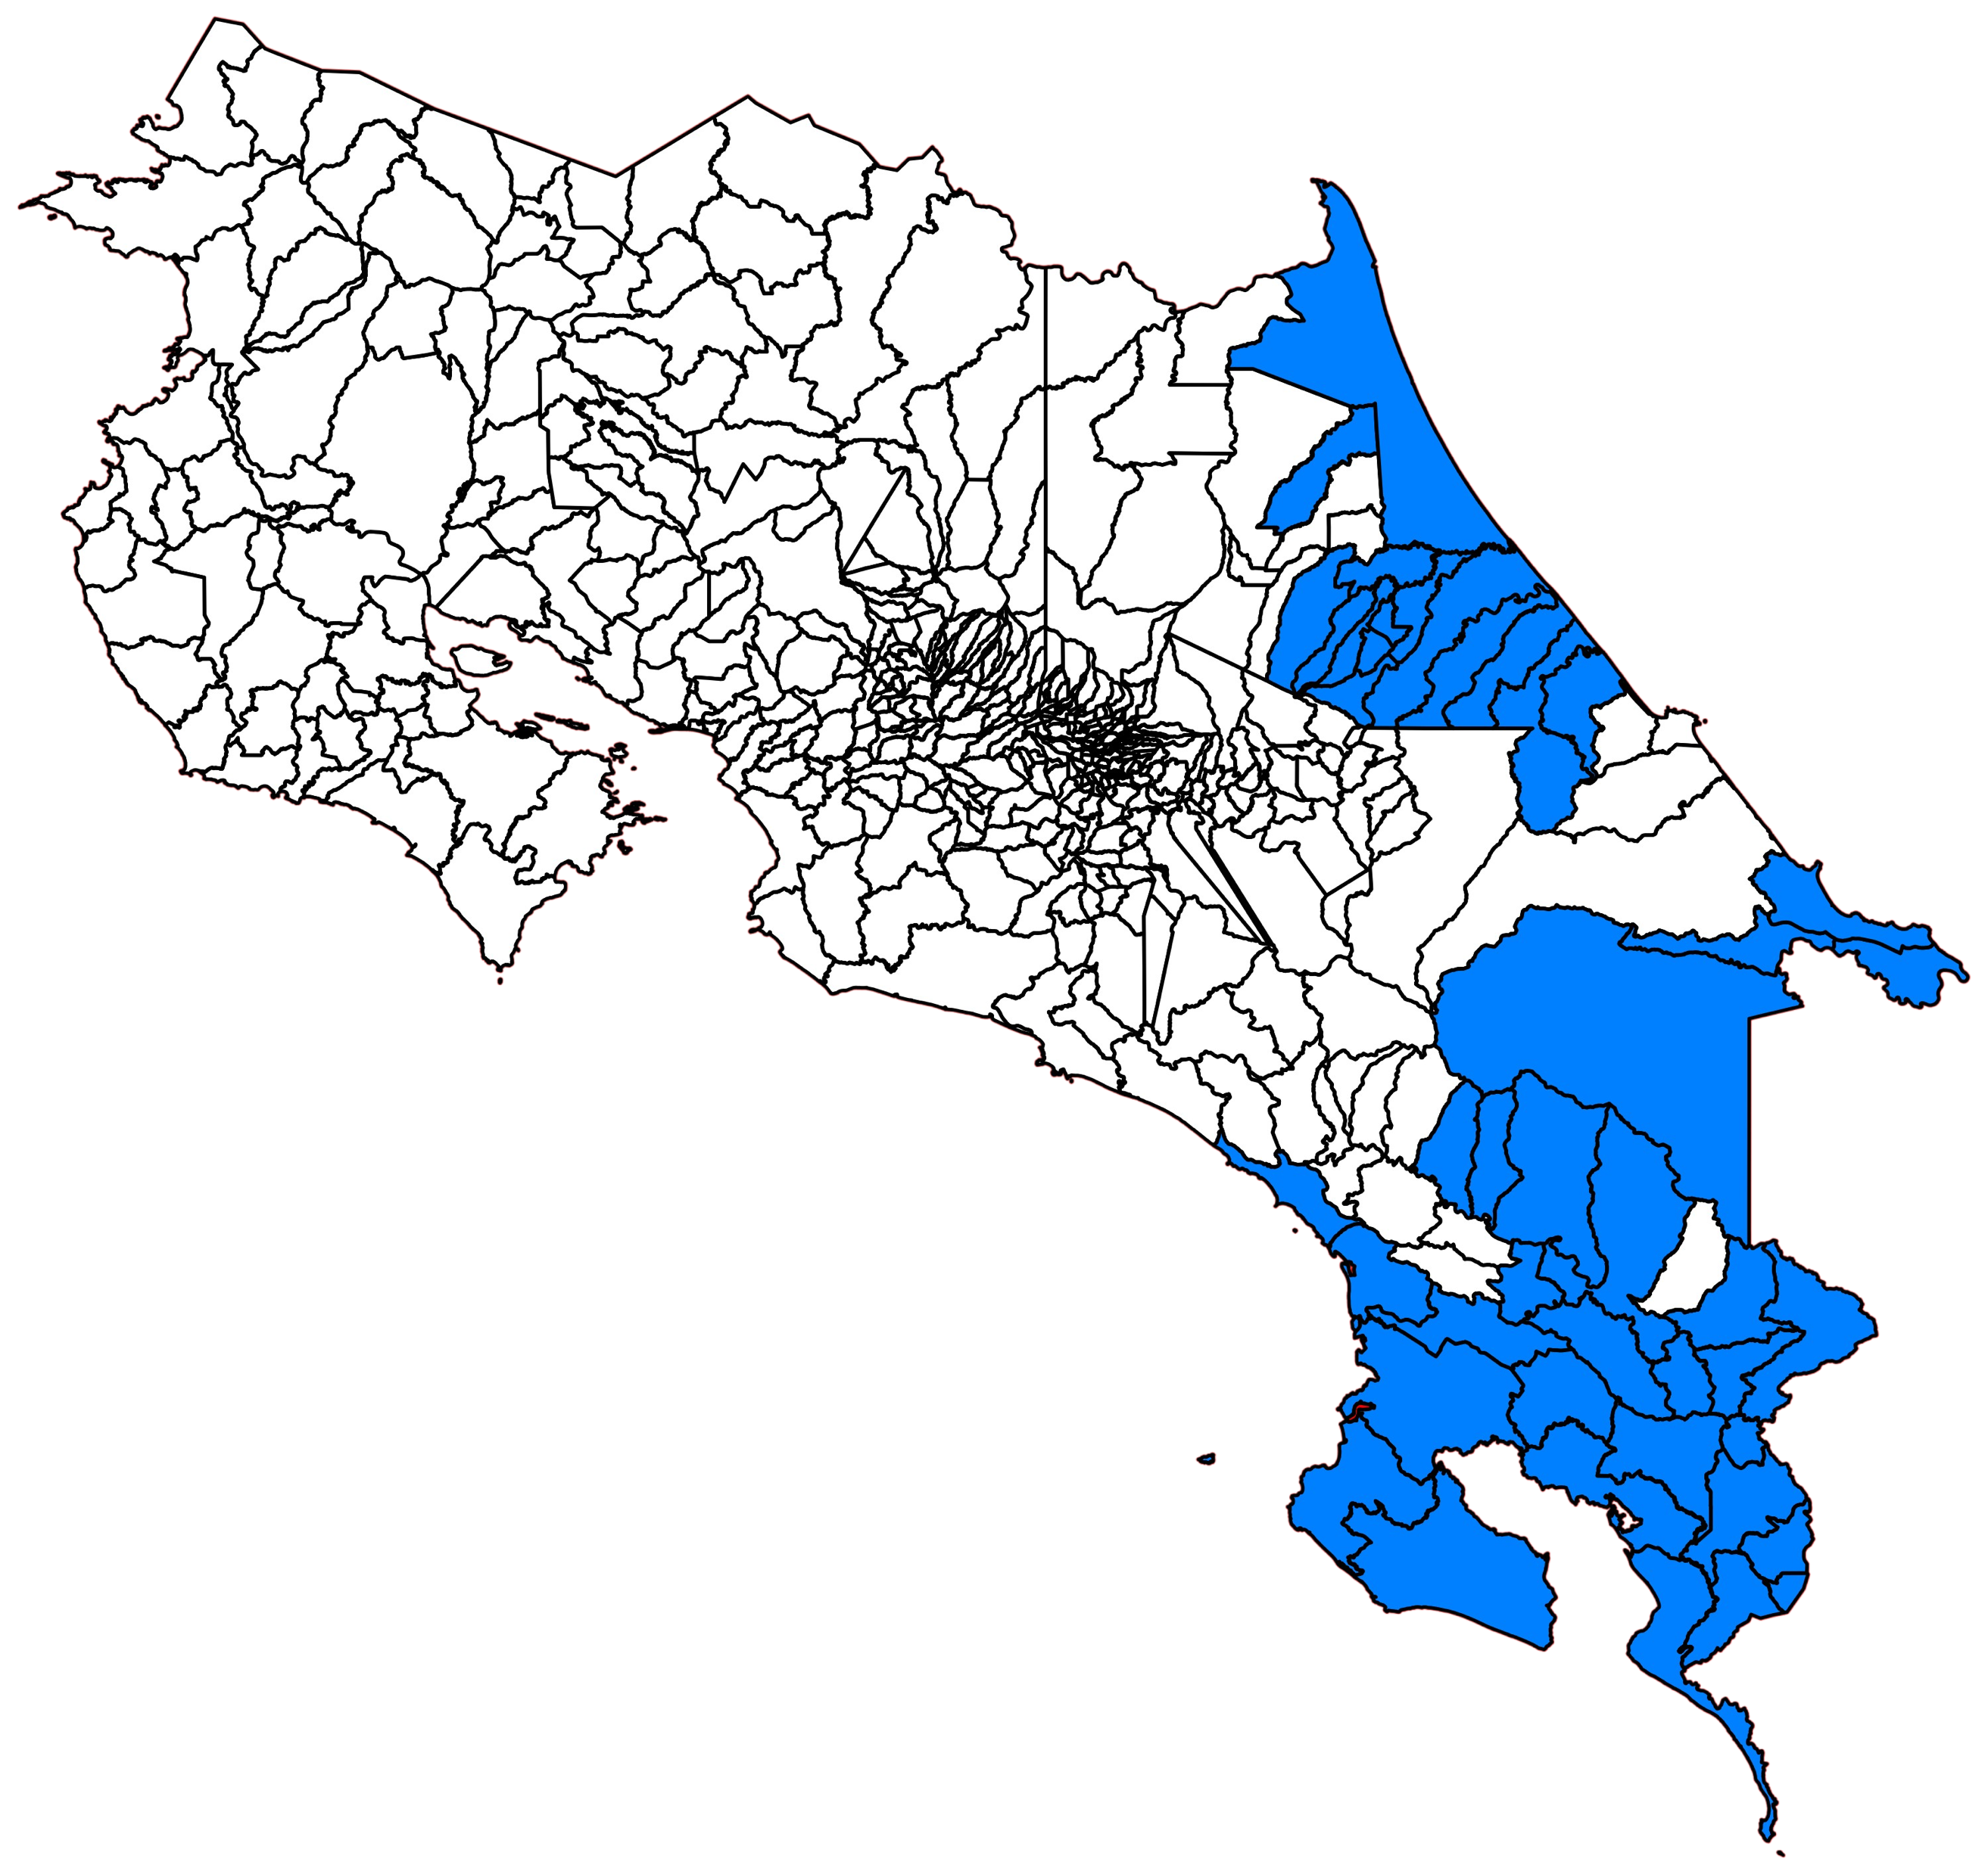
Setting
SMI targeted the poorest districts in the country
Model was implemented only in targeted districts
Targeting based on social development index (IDS<45.5)
Costa Rica
44
Targeted districts fully intervened
2
Regions
Huetar Atlántica and Brunca
11
124
Primary care teams
(EBAIS)
Health areas
88,937
Adolescents
Age 10 to 19
Targeted districts

Slide 15
Methods and data
Outcome of interest
Adolescent fertility rates age 10 to 19 at the district level
Births by women’s age based on vital records
Adolescents age 10 to 19 from estimates of the Institute of Statistics of Costa Rica (INEC)
Time series from 2000 to 2019
Implementation indicators
Anonimized data from adolescent nominal information system (SINA) from 2015 to 2018
Build indicators of take-up of key services: comprehensive visit, risk assessment, contraception receipt

Slide 16
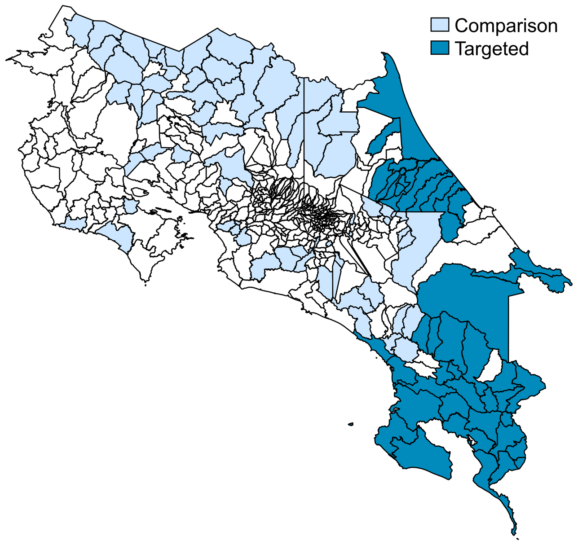
Methods and data
Difference-in-difference strategy
Compares targeted (44) with comparison districts (67) pre & post intervention
Comparison districts: social development index (IDS) <45.5 outside targeted regions
Identifies the effect of the comprehensive care model under SMI in its distinct phases
Multiple validity & robustness checks for the strategy
Pre-trends test, alternative comparison groups, falsification tests, pre-trend robust estimation

Slide 17
Results
Take-up of key services of the intervention
Percent of adolescents that…
…attended a comprehensive care visit
…had a risk assessment
…received contraceptives
N=
N=
88,937
45,500
88,937
43,437
45,500
N=
43,437
88,937
43,437
45,500
Notes: Statistics based on in adolescent nominal information system (SINA) for the 44 districts where the ISM was fully implemented. All values include adolescents aged between 10 and 19 years old, for every year spanning 2015-2018. Percentages are based on the adolescent population in targeted districts, That is adolescents age 10 to 19 is the average from populations projections from 2015 to 2018.

Slide 18
Results
Contraception reception by risk classification
% of adolescents by risk classification
% of adolescents that received contraception within each risk classification
Mental or social
High
Medium
No risk
Low
N=34,507
N= 19,669
6,456
3,285
3.765
Notes: Statistics based on in adolescent nominal information system (SINA) for the 44 districts where the ISM was fully implemented. All values include adolescents aged between 10 and 19 years old, for every year spanning 2015-2018. All figures are based on the number of adolescents that were assessed at least once for risk during the period of 2015-2018, that is 34,507. All percentages on the graph to the right are computed using as denominator the total corresponding to each sample. Statistics for adolescents with only social or mental risks are not displayed.

Slide 19
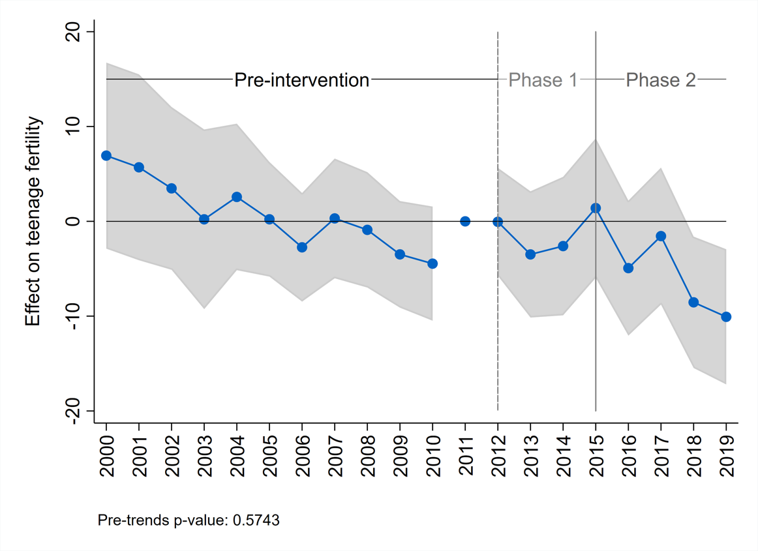
Results
Adolescent fertility
Effect on adolescent fertility
Difference-in-difference estimates by year
Preparation
Implementation
With SMI Costa Rica reduced adolescent fertility by 11.3% in the poorest districts
Pre-trends p-value=[0.57]
Avg. effect
-2.17
p-value=[0.36]
Avg. effect
-5.14*
p-value=[0.07]
Notes: This figure plots the coefficients of the interaction between each year and an indicator for treatment status. The shaded area around each coefficient is the 95% confidence interval. The reference year is 2011, the last pre-intervention year. Since it is the reference year, it is normalized to zero and no confidence intervals can be calculated for this year. The comparison group is composed of districts with similar poverty levels outside the treated regions. The pre-trends p-value refers to an F-test of joint significance of all pre-treatment interactions. Adolescents’ fertility refers to that of women 10 to 19 years old.

Slide 20
Conclusions
The comprehensive care adolescent reproductive care model was effective in reducing adolescent fertility
The model was effective in providing health services for vulnerable and at risk adolescents.
Focus on the poorest by design
Higher receipt of contraceptive services among those at higher sexual and reproductive risk
Reduction in fertility even among adolescents aged 10 to 14.
Inputs Vs Integration
Effects only occur during the implementation phase rather than the preparation phase
This suggests that the integration of distinct elements of the model is what mattered

Slide 21
Conclusions
Contribution of distinct elements of the model
Intersectoral coordination: LCU & RCUs were instrumental for results (Valverde, 2020)
Results-focus
“the [results-based] evaluation was fundamental as there was a challenge and commitment at the country level to do well [while] most of the money was provided by the country, it hurt more to invest it badly”
Minister of Health
For more information: Pedro Bernal (pbernallara@iadb.org)

