Slide 1
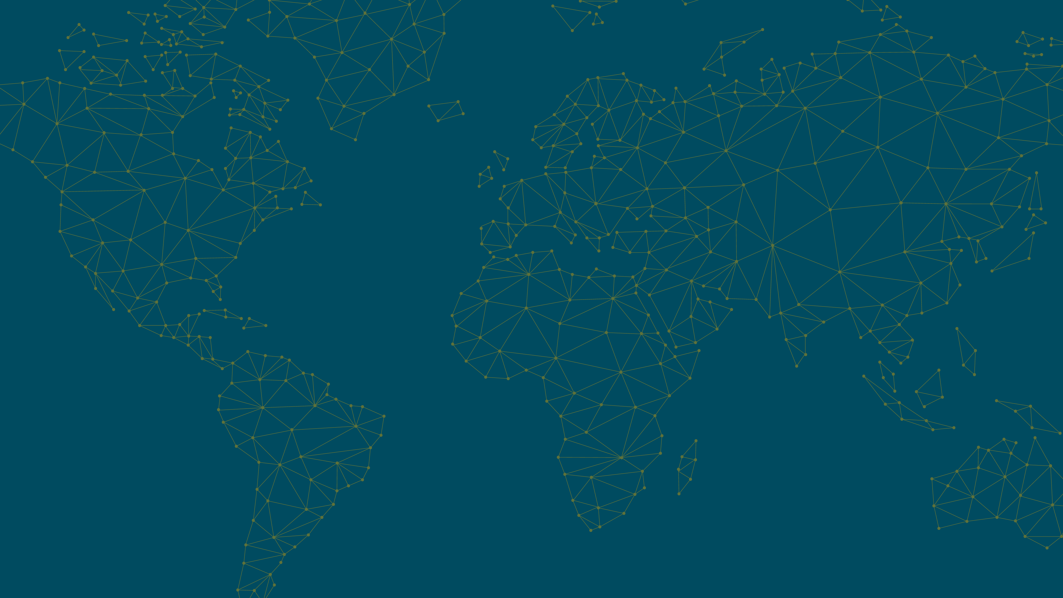

Delays in access to medicines globally, 1982-2024
Olivier Wouters, Jouni Kuha
Conflicts of interest: None.

Slide 2

Background
Over 80% of the world’s people live in low- and middle-income countries
Large burden of both chronic and infectious diseases
Safe and effective medicines exist for most of these diseases
Launch delays prevent large numbers of people from accessing potentially life-saving treatment
Notes:
Severe consequences for health inequalities globally
chronic conditions requiring lifelong treatment

Slide 3
Little data on launch delays in poorer countries…
Launch delays have been extensively studied in high-income countries
Little is known about how long it takes for new medicines to reach poorer countries
Earlier studies used decades-old data, with the most recent looking at drugs launched up to 2002 (Cockburn et al 2016; Veniers et al 2011; Borrell 2006; Kyle 2007)

Slide 4
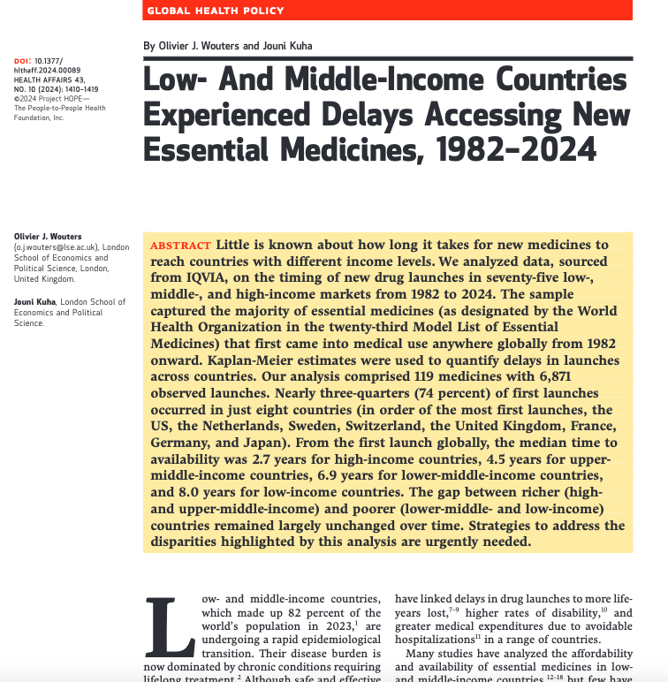

Slide 5
Objective
To understand how long it takes for essential medicines to reach countries with different income levels
Notes:
To characterize the diffusion of new medicines across the globe

Slide 6
Data on launch delays
We acquired data on timing of new drug launches in 90 countries from IQVIA
Launch was defined by IQVIA as the month and year in which the first sale took place
Data covered launches from January 1982 through April 2024 (for most countries)
Notes:
The main source was New Product Intelligence (being decommissioned at the end of this year) and the methodology behind that involves gathering pack classification reports (PCRs, also called “Form 9s”) from local IQVIA offices based in individual countries. The sources used by the local offices include local manufacturers, retailers, wholesalers, and national databases.
You’re correct that MIDAS doesn’t cover certain channels of distribution, such as those used for vaccination schemes and malaria, but for all of the products we did get a date, you can consider that correct. We also did a fair bit of secondary research to check anything that looked odd.

Slide 7
Study sample
502 medicines on the WHO Model List of Essential Medicines (2023)
337 medicines excluded (launched prior to 1982)
165 medicines that first came into medical use from 1982 onward
46 medicines excluded (used to treat Ebola, HIV/AIDS, malaria, NTDs, or tuberculosis)
119 medicines included in analysis
(34 of these had alternatives)

Slide 8
Study sample
502 medicines on the WHO Model List of Essential Medicines (2023)
337 medicines excluded (launched prior to 1982)
165 medicines that first came into medical use from 1982 onward
46 medicines excluded (used to treat Ebola, HIV/AIDS, malaria, NTDs, or tuberculosis)
119 medicines included in analysis
(34 of these had alternatives)

Slide 9
Study sample
502 medicines on the WHO Model List of Essential Medicines (2023)
337 medicines excluded (launched prior to 1982)
165 medicines that first came into medical use from 1982 onward
46 medicines excluded (used to treat Ebola, HIV/AIDS, malaria, NTDs, or tuberculosis)
119 medicines included in analysis
(34 of these had alternatives)

Slide 10
Study sample
502 medicines on the WHO Model List of Essential Medicines (2023)
337 medicines excluded (launched prior to 1982)
165 medicines that first came into medical use from 1982 onward
46 medicines excluded (used to treat Ebola, HIV/AIDS, malaria, NTDs, or tuberculosis)
119 medicines included in analysis
(34 of these had alternatives)

Slide 11
Study sample
502 medicines on the WHO Model List of Essential Medicines (2023)
337 medicines excluded (launched prior to 1982)
165 medicines that first came into medical use from 1982 onward
46 medicines excluded (used to treat Ebola, HIV/AIDS, malaria, NTDs, or tuberculosis)
119 medicines included in analysis
(34 of these had alternatives)

Slide 12
Study sample
502 medicines on the WHO Model List of Essential Medicines (2023)
337 medicines excluded (launched prior to 1982)
165 medicines that first came into medical use from 1982 onward
46 medicines excluded (used to treat Ebola, HIV/AIDS, malaria, NTDs, or tuberculosis)
119 medicines included in analysis
(34 of these had alternatives)
Notes:
We don’t provide alternatives (leader of group listed – named product) – almost always a lead products, a few exceptions
Lead group pre 1982 – not in our sample; any member of alternative group pre-1982, not in sample
Medicines really means group

Slide 13
Statistical analysis
Kaplan-Meier estimates were used to quantify delays in launches across countries
Looked at differences across (1) country income levels; (2) geographic regions; (3) disease areas; and (4) product launch decades
Robustness checks
Notes:
Outcome of interest was the time (in months) from when a drug was first launched anywhere among 90 countries to when it was launched in a particular market
Time to availability of any product in a therapeutic cluster
Because launch times may be different for different categories of countries or medicines
Log-rank test (standard approach – like a t-test to see if curves are different); slight variation in that we calculated p-values using permutation test (because of hierarchical/multi-level/clustered nature of the data – e.g. same drug launched in many countries, single country many drugs – outlined in paper)

Slide 14
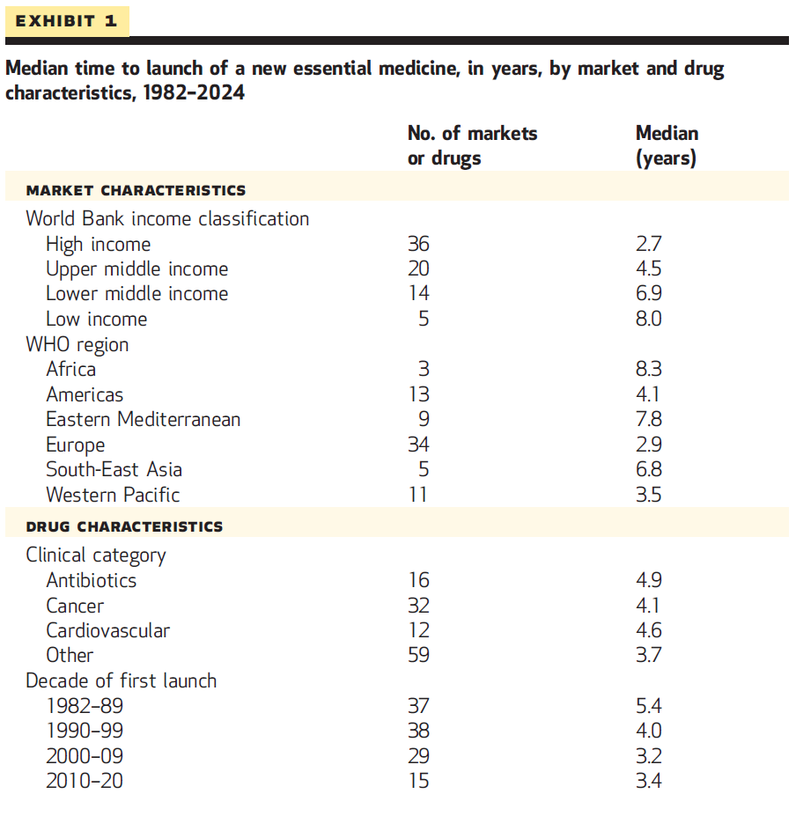
Notes:
From the first launch globally, the median time to availability was under 3 yrs for high-income countries, compared to roughly 7 yrs for lower-middle-income countries and 8 yrs for low-income countries.

Slide 15
From the first launch globally, the median time to availability was just under 3 years for high-income countries …

Slide 16
… 4.5 years for upper-middle-income countries …

Slide 17
… versus roughly 7 years for lower-middle-income countries and 8 years for low-income countries

Slide 18
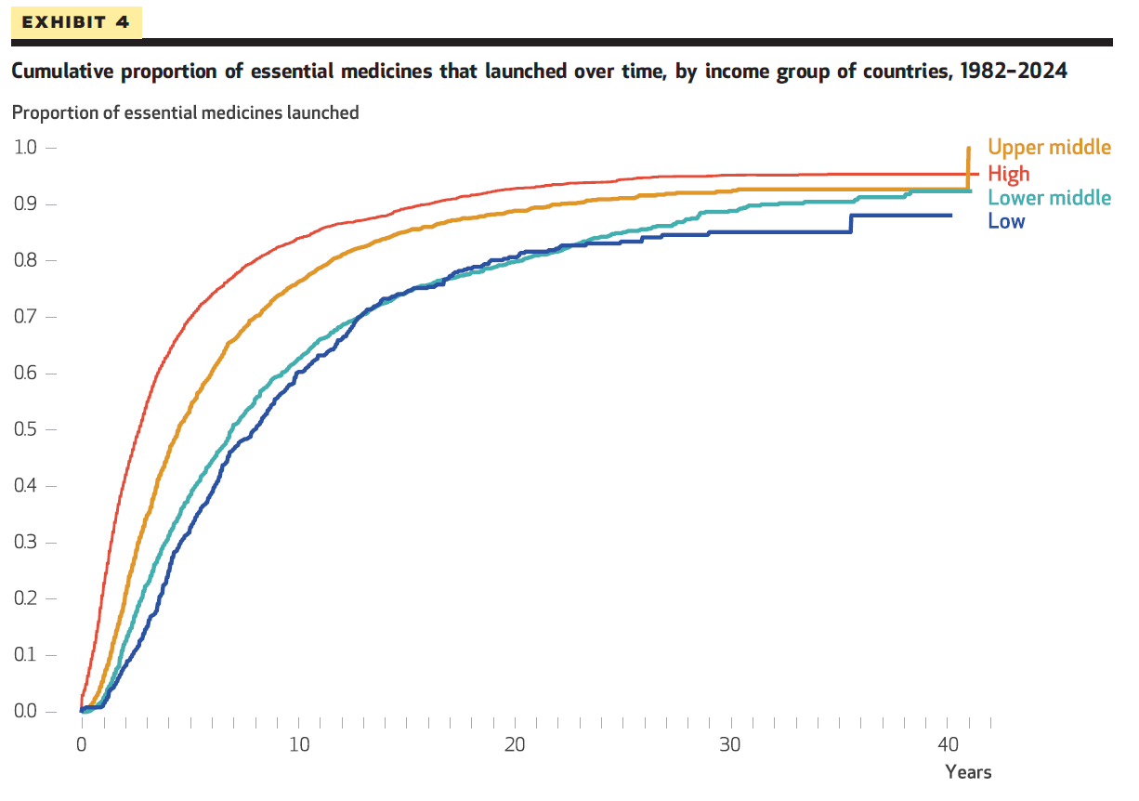
Notes:
This is something that can happen in a K-M estimate when there is an observed event at a late time where the risk set has become small.
Even just looking at the plot, I can guess what happened here. By year 41, there is only one observation left in the risk set for upper-middle countries, i.e. only one drug-country observation which has not been either observed launched or censored by then. Given the settings of our data, this is about the maximum possible, so it is not surprising that the risk set is small by then.
What then happens is that that one remaining drug gets launched at that last possible moment. The estimated hazard of launch in year 41 (or, more precisely, the corresponding month) is 1/1=1. In other words, the estimate says that anything that has not been launched by then will be launched at that time, and the curve jumps to 1.
This is obviously a very noisy estimate and we do not think that this is what would really happen, but it is how the K-M estimate is supposed to behave.
I was curious to find this observation, and there it is: vecuronium bromide (a muscle relaxant) was first launched in September 1982, and released in Chile in Sep 2023, 492 months later.

Slide 19
Notes:
Complements of K-M curves

Slide 20
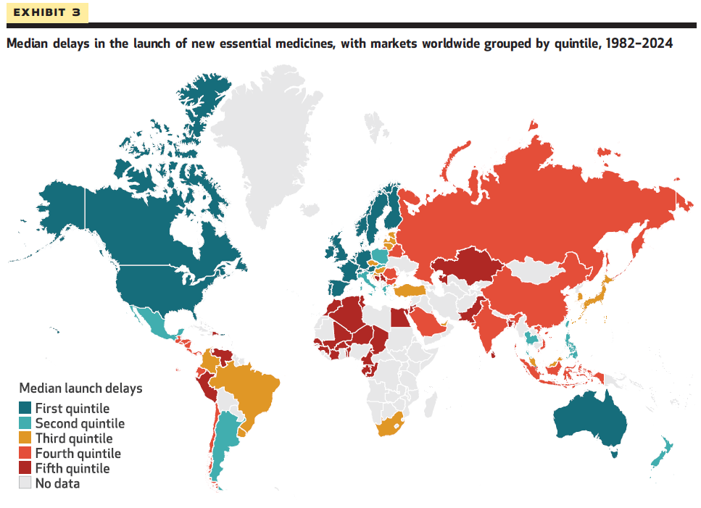
Notes:
1st quintile = 2.3 years or less
2nd quintile = 2.4-3.3 years
3rd quintile = 3.4-4.5 years
4th quintile = 4.6-6.5 years
5th quintile = 6.6 years or more

Slide 22
We didn’t observe significant differences across disease areas…

Slide 23
The data allowed us to examine how the picture of launch delays changed over time between older and newer medicines

Slide 24
More recently launched medicines spread more quickly than older ones …

Slide 25
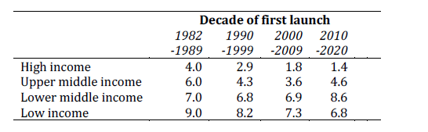
Notes:
More recently released medicines
Divided up launches even further

Slide 26
The good news is that drugs launched in 2010-2020 reached countries at most income levels quicker than drugs launched in 1982-1999

Slide 27
The bad news is that the gap between richer and poorer countries has remained relatively unchanged over time

Slide 28
Limitations
Restricted geographic coverage
Lack of data on drugs used to treat certain infectious diseases
Differences in how launch dates were defined across countries

Slide 29
Potential solutions
Governments in low- and middle-income countries could band together to harmonize regulatory processes (e.g., African Medicines Agency)
Drug companies could strike deals with the Medicines Patent Pool around the time of global launch
Notes:
To speed up the global availability of medicines
African Medicines Agency
MPP (voluntary licensing) is a powerful solution – one that can both promote global health while being economically viable for drug companies
New report by MPP -- https://medicinespatentpool.org/news-publications-post/voluntary-licensing-right-for-health-smart-for-business-report

Slide 30
Conclusion
We observed vast inequities in global access to medicines
Governments and companies urgently need to devise strategies to address these disparities
Product launch does not necessarily mean that patients gain broad access to a therapy
Notes:
It is also worth noting that although the launch of a product is an important indicator of how quickly a medicine diffuses internationally, it does not necessarily mean that patients gain broad access to the therapy.

Slide 31
Thank you!

