Slide 1
Influence of Health System Engagement and Health Security on Vaccine Decisions: Evidence from Italy, Mexico, the United Kingdom, and the United States
Sindhu Ravishankar
PhD Candidate, Department of Global Health
The George Washington University Milken Institute School of Public Health

Slide 2
Background
Vaccines are an essential public health tool but potential benefits of are reduced due to vaccine hesitancy: “delay in acceptance or refusal of vaccines despite availability of vaccination services” (WHO)
In 2012 the WHO’s Strategic Advisory Group of Experts on Immunization (SAGE) introduced the 3C model of Vaccine Hesitancy: Confidence, Complacency, Convenience
Vaccine hesitancy was recognized by the WHO as one of the top 1 global health threats in 2019.
Demographic drivers of vaccine uptake and confidence have been well-documented in diverse contexts.
However, the role of health systems in improving vaccine uptake and confidence has been less discussed, particularly in the post-pandemic period

Slide 3
Objective
To examine demographic, health, and health system determinants of vaccine confidence and uptake of four vaccines for adult respondents or their children:
COVID-19
Influenza
Human Papillomavirus (HPV)
Measles, Mumps, and Rubella (MMR)

Slide 4
Methods
Data source: People’s Voice Survey- validated population-representative phone survey on people’s perspectives on and utilization of their health system
Four countries: Italy, Mexico, USA, UK
Surveys conducted from Dec 2022 to April 2023 among adults aged 18 or older
Respondents with at least one child between the age 1-18 also reported on the vaccination status for their youngest child
Sampling:
  Italy & Mexico: random digit dialing; UK & US: selected from existing panels
  Sampling stratified by state or region group created based on the median household income in the state/region
  Final samples were weighted based on demographic characteristics

Slide 5
Methods : Outcomes of Interest
Uptake of adult vaccines:
  COVID-19 (0-4+doses at time of survey)
  Influenza (last year, yes/no)
Uptake of child vaccinations
  MMR (Ages 2-6)
  HPV (ages 13-18, girls only in Mexico)
  COVID-19 (ages 1-18)
Vaccine Confidence: Agreement with three statements: 1) vaccines are safe, 2) vaccines are important, 3) vaccines are effective
COVID-19 Vaccine Intent : Plans to receive all recommended doses

Slide 6
Methods
Predictors
Health system engagement
  ≥3 health care visits in the past year.
  Have a regular source of care (usual provider)
  ≥3 preventive services (BP, cholesterol/glucose, dental, or eye exams).
Health Security: Confidence in one’s ability to get and afford quality care if seriously ill
Demographic and Health-Related Characteristics
Age, education, income, gender, sub-national region, minority status (Mexico, USA, and UK only), political affiliation (UK, US only), chronic illness, prior COVID-19, trust in science, trust in public health agency)

Slide 7
Higher number of health care visits
Individual may be offered the vaccine during one of the health care visits.
Individual more likely to obtain health information from health care providers (on importance of vaccines, where to get vaccinated, or a reminder to get vaccinated).
Has a usual source of care
Usual source of care serves as medical home. Patient is more likely to receive reminders and information on vaccination.
Individual more likely to receive continuous care with a provider that knows their medical history.
Individual more likely to develop trust in the health system.
Increased vaccine access, uptake, and confidence
Received at least 3 other preventive services in the last year
Individual more likely to have access to a competent provider who orders necessary tests and screenings on an annual basis.
Individual more likely to receive health information, to be reminded to get vaccinated, or to be offered the vaccine while getting other preventive services.
Individual more likely to develop trust in the health system.
Health secure: Confident in ability to get and afford quality care
Reflects the overall level of accessibility and quality of health services in the individual’s community.
Individual trusts the health system and may be more likely to adhere to health care providers’ recommendations.

Slide 8
Methods : Analysis
Weighted descriptive statistics by country
Regression models with robust standard errors to explore associations between predictors of interest and vaccine outcomes, controlling for demographic and health covariates
  Adults: Country-specific logistic and linear regression models for Flu and COVID-19 vaccine outcomes
  Children: Pooled logistic regressions with country fixed effects for MMR, HPV, and COVID-19 vaccine outcomes.
  Coefficients reported as average marginal effects on risk difference and risk ratio scales
Complete case analysis; Sensitivity analysis excluding income and political affiliation

Slide 9
Results: Respondent Characteristics
5,180 respondents surveyed (Italy 878; Mexico 902; UK 1,339; US 1,481)
One-third of respondents had at least one child aged 1-18
Mean age: 42 in Mexico to 52 in Italy
Gender: Between 47.5%-49.1% male; between 50.9%-52.5% female
Between 23% of respondents in Mexico and 51% in the UK had a chronic illness.
Between 30% in Mexico and 70% in the UK had experienced COVID-19 illness
.
Trust in the national public health agency was 16.6% in Italy, 27.7% in the USA, 28.7% in Mexico, and 30.5% in the UK.
Trust in scientists was between 32.4% (Mexico) to 47.3% (UK)

Slide 10
Results: Descriptive

Slide 11
Vaccination Uptake - Adults
On average across the four countries, 46.5% had received a flu vaccine in the last year and 64.0% had received at least three doses of a COVID-19 vaccine.

Slide 12
Vaccination Uptake – Children
Across the four countries, 43.0% of children aged 1-18 had at least one dose of a COVID-19 vaccine, 57.9% of those aged 13-18 had received the HPV vaccine, and 88.0% of those aged 2-6 had the MMR vaccine.

Slide 13
Vaccine Confidence
Vaccine confidence ranged from 66.3% in the USA to 86.9% in Mexico.
COVID-19 vaccination intent ranged from 44.2% in the USA to 85.9% in Mexico.
Notes:
.

Slide 14
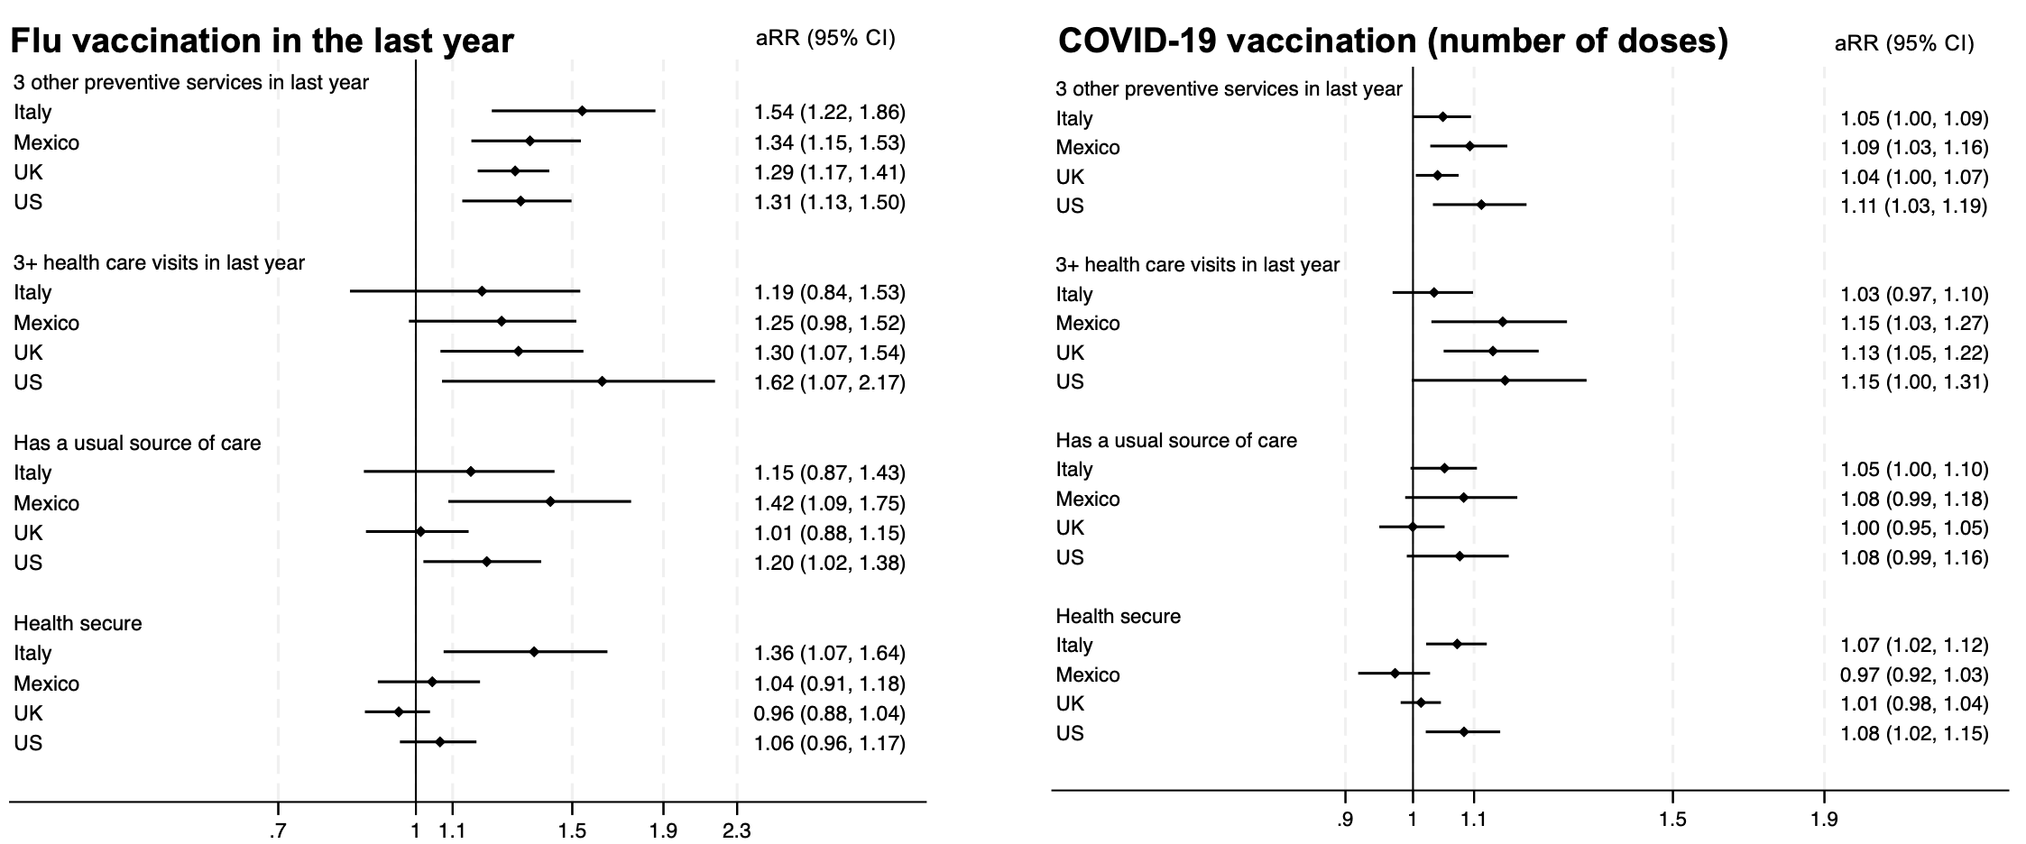
Associations between health system engagement and health security and vaccine uptake: Adults
Having received ≥3 preventive health services in the last year associated with COVID-19 and flu vaccination in all four countries.
Having 3+ health care visits in the last year was associated with greater uptake COVID-19 and flu vaccines in all countries except Italy.
Having a usual source of care had strong associations with flu vaccination (but not COVID-19).
Health security improved adult vaccination uptake in Italy (flu and COVID-19) and the USA (COVID-19).
Adjusted associations are stronger for flu than for the COVID-19 vaccine

Slide 15
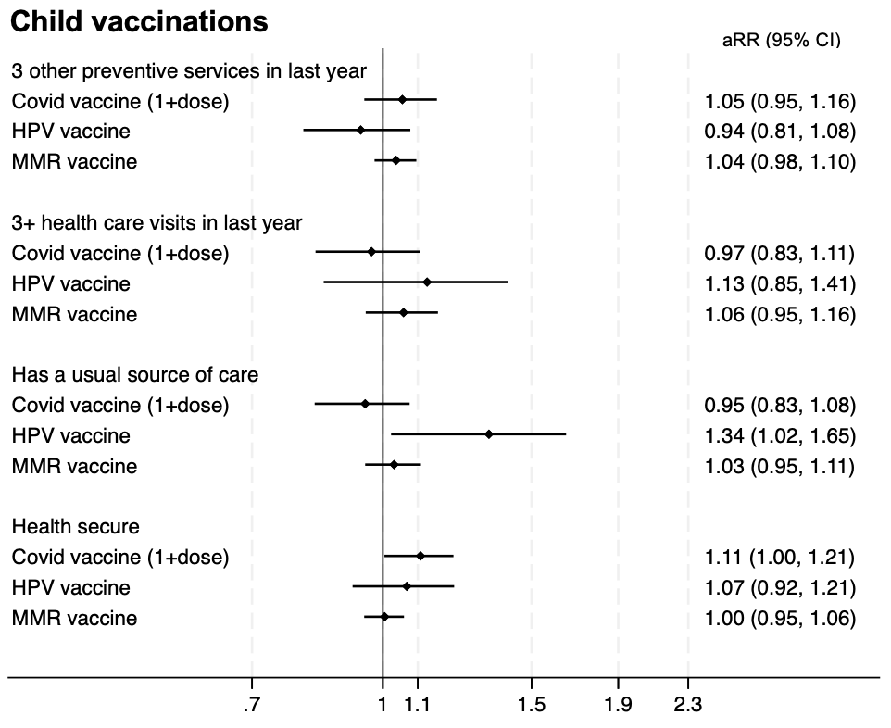
Associations between health system engagement and health security and vaccine uptake: Children
Health security had a statistically significant association with COVID-19 vaccination (aRR=1.11)
Having a usual source of care was associated with HPV vaccine uptake (aRR=1.34)

Slide 16
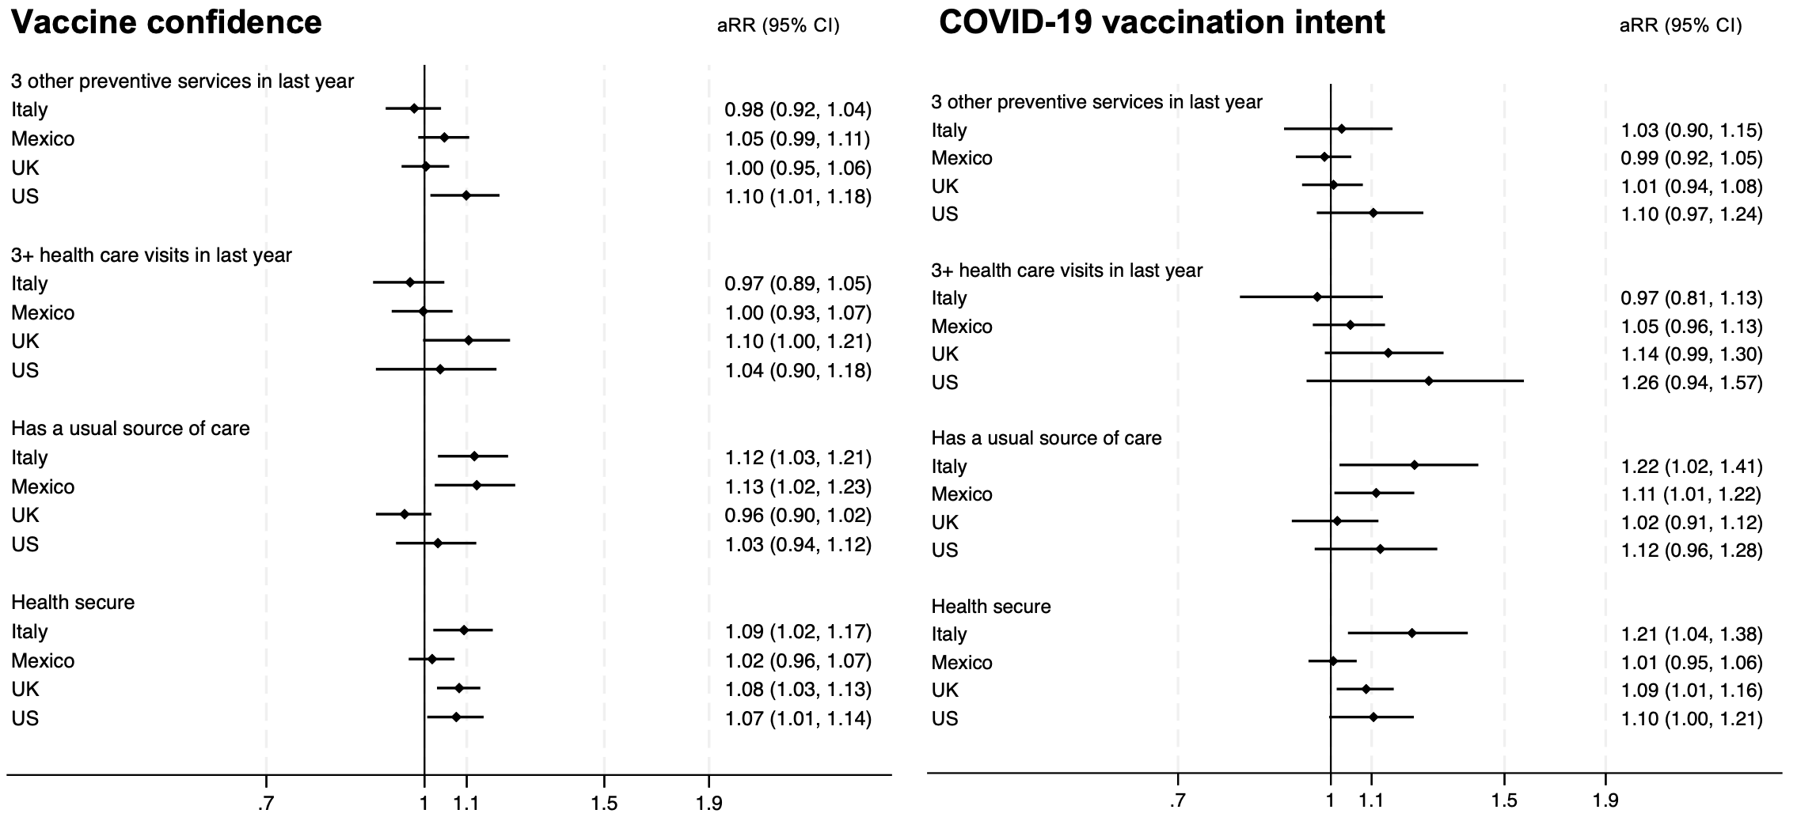
Associations between health system engagement and health security and vaccine confidence and intent
Health security is associated with both vaccine confidence measures in all countries except Mexico
Having a usual source of care is associated with improved vaccine confidence and COVID-19 vaccine intent in Italy and Mexico

Slide 17
Demographic and health-related factors were associated with vaccine uptake
Being aged 65+ was positively associated with COVID-19 vaccination in all countries and with flu vaccination in all countries except Mexico
Trust in scientists was a strong determinant of COVID-19 vaccination for adults in all countries and for child COVID-19 vaccination.
The probability of MMR vaccination was 16 percentage points higher (95% CI 2, 30) among children of respondents who reported trusting their national public health agency.
Trust in science and trust in public health agency were strong predictors of child COVID-19 vaccination.
Trusting the national public health agency also positively influenced adult flu and COVID-19 vaccination in the US and the UK
Trust in scientists and the national public health agency were among the strongest determinants of vaccine confidence, though with varying effect sizes across the four countries.
Political affiliation (measured in the UK and the US) influenced vaccine uptake, vaccine confidence, and COVID-19 vaccination intent.

Slide 18
Limitations
We assumed the reported healthcare experience in the last year to be representative of healthcare received in recent years.
Self-reported vaccine uptake may be influenced by social desirability bias.
Health system engagement of parents may not fully capture the engagement relevant to children (e.g., through school-based programs)
Vaccine policies differ between countries and may have impacted inter-country comparisons (e.g., differences in the timeline for introducing HPV vaccination; vaccination requirements for school enrollment).
Variations in health system characteristics, such as between publicly funded systems (UK and Italy) and multi-payer systems (US and Mexico), may have impacted inter-country comparisons.
Given that the same statistical models were repeated across multiple country subsamples and for multiple vaccine outcomes, there is a risk of Type I error from multiple testing.

Slide 19
Conclusion and Implications
Health system engagement and health security are positively associated with vaccine uptake, confidence, and intent, but the strength of these relationships varies by country.
  Implication: Programs and policies aimed at ensuring continuity of care by strengthening BOTH public health and primary health systems may enhance vaccine uptake.
The association between health system engagement and Flu vaccination is stronger than for COVID-19 vaccination; uptake of COVID-19 vaccines is more influenced by political and socioeconomic factors compared to Flu vaccination.
  Implication: This offers insights into the potential trajectory of COVID-19, However, sociopolitical factors exacerbating vaccine skepticism may dampen the potential effects of vaccine routinization.

Slide 20
Conclusion and Implications
Effects of health system engagement on vaccination are stronger in countries without universal health coverage (US, Mexico) than in those with it (UK, Italy).
  Implication: Strategic health system efforts to improve vaccine uptake may be particularly impactful for vaccine uptake in countries that have large private sectors, multi-payer systems, and fragmented health care delivery.
For childhood vaccines, health system engagement and health security had limited influence; Only HPV vaccine had an association with a measure of health system engagement (regular source of care); only childhood COVID-19 vaccination was associated with health security.
  Implication: Policy efforts may need to focus on addressing socioeconomic inequities in vaccine access and overcoming social, political, and informational barriers.
Health system engagement and health security had stronger associations with vaccine uptake than vaccine confidence.
  Implication: health systems may play a bigger role in modifying behaviors (complacency and convenience) rather than opinions on vaccines (confidence).

Slide 21
Contributors
Catherine Arsenault, The George Washington University Milken Institute School of Public Health
Margaret E. Kruk, Washington University in St. Louis
Todd Lewis, Washington University in St. Louis
Patrizio Armeni, SDA Bocconi School of Management
Kevin Croke, Harvard T.H. Chan School of Public Health
Svetlana V. Doubova, Mexican Institute of Social Security
Martin McKee, London School of Hygiene and Tropical Medicine
Rosanna Tarricone, SDA Bocconi School of Management
Publication: Arsenault C, Ravishankar S, Lewis T, Armeni P, Croke K, Doubova SV, McKee M, Tarricone R, Kruk ME. The role of health systems in shaping vaccine decisions: Insights from Italy, Mexico, the United Kingdom, and the United States. Vaccine. 2025 Apr 16;54:127134. doi: 10.1016/j.vaccine.2025.127134.

