Slide 1
Surviving Another Celsius: How Climate Resilience Shapes Health System Futures
Orhun Aydin
Department of Earth, Environmental and Geospatial Science
Department of Computer Science
Saint Louis University

Slide 2
Objectives
Introduce climate resilience paradigms
Discuss links between climate and health outcomes
Elaborate a new urban weather observing system in Saint Louis

Slide 3
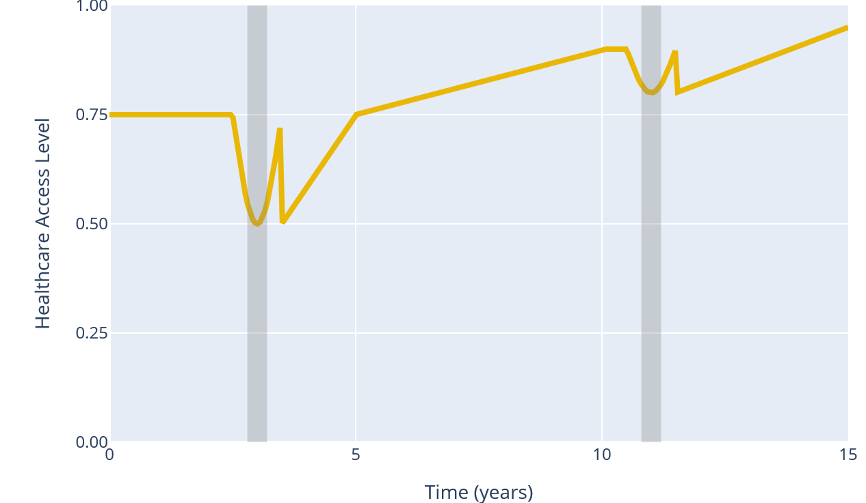
Adaptation and Resilience
Extreme Weather Event 1
Extreme Weather Event 2
Coping
Immediate Response
Adapting
Adjusting Systems
Transforming
System Redesign

Slide 4
Climate Resilience and Health

Slide 5
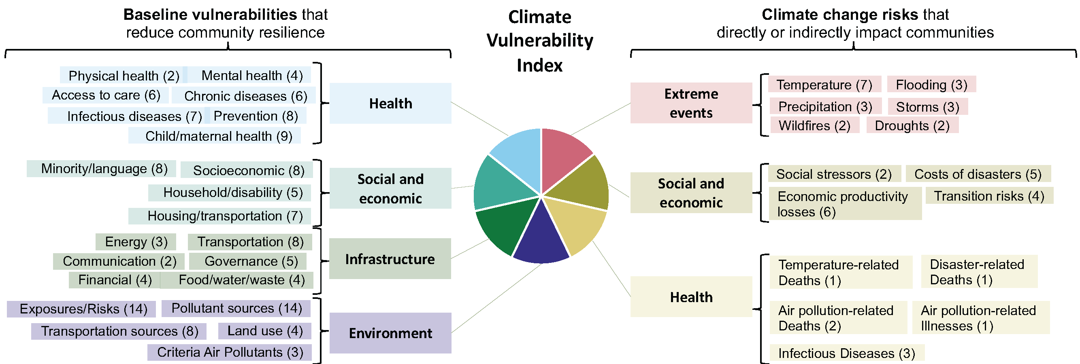
Climate Vulnerability in Health Systems
Source: https://climatevulnerabilityindex.org

Slide 6
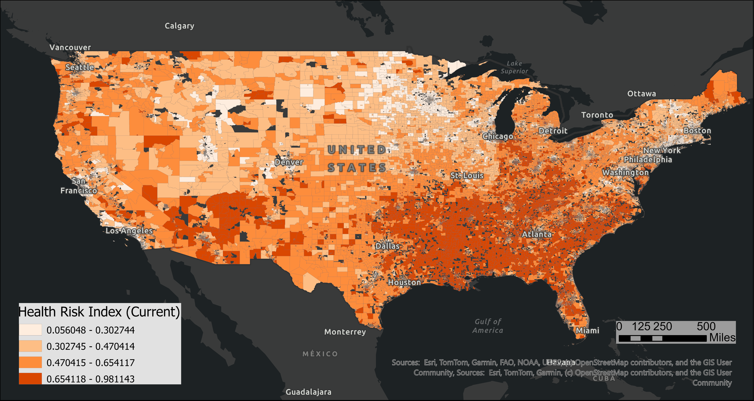

Slide 7
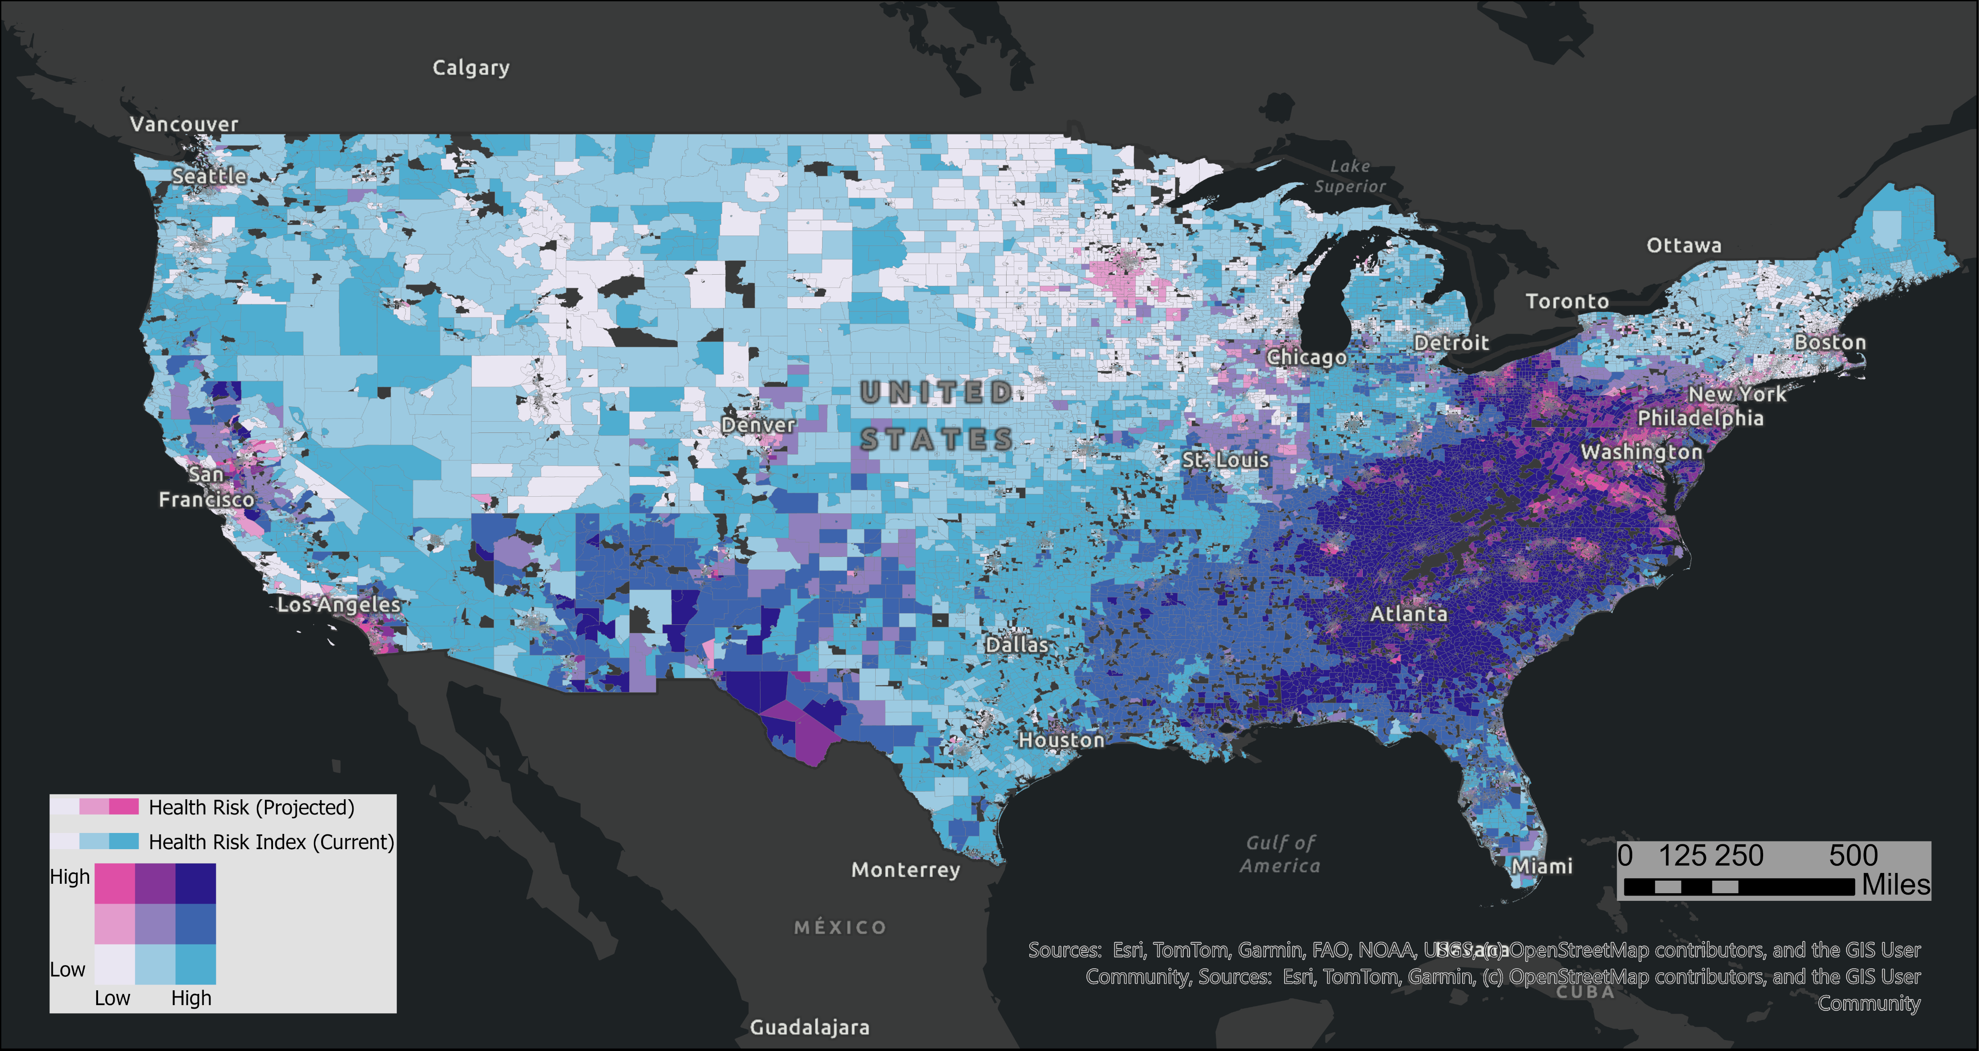

Slide 8
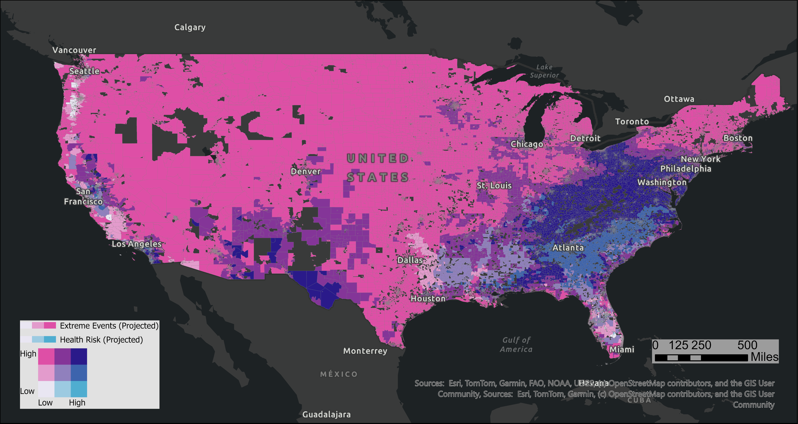

Slide 9
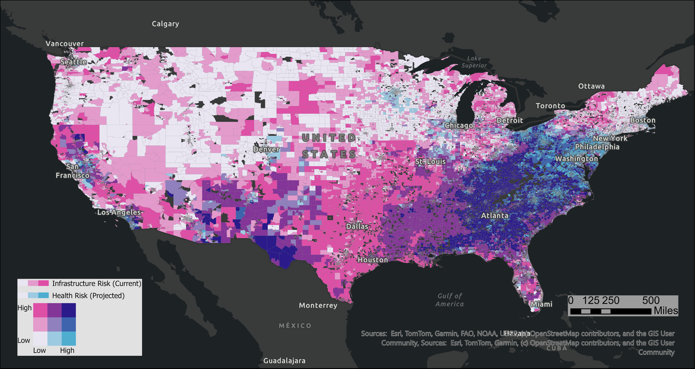

Slide 10
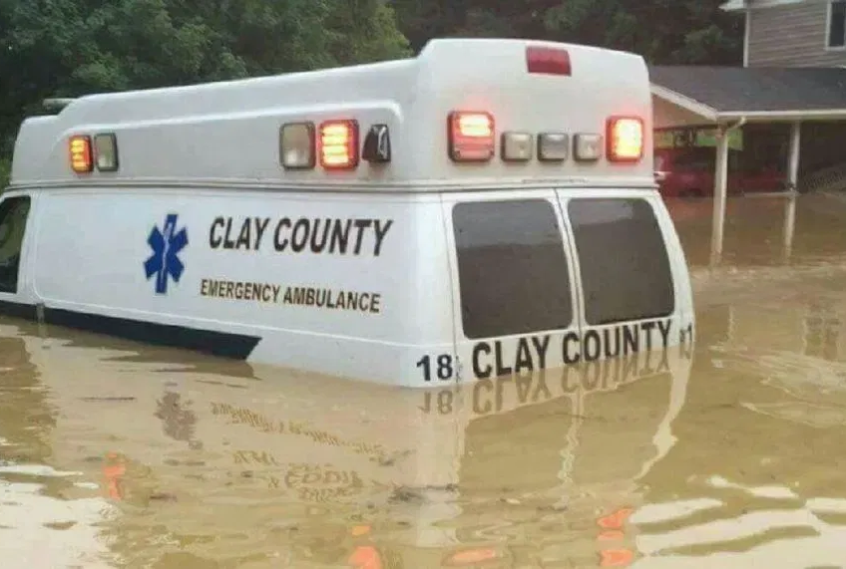
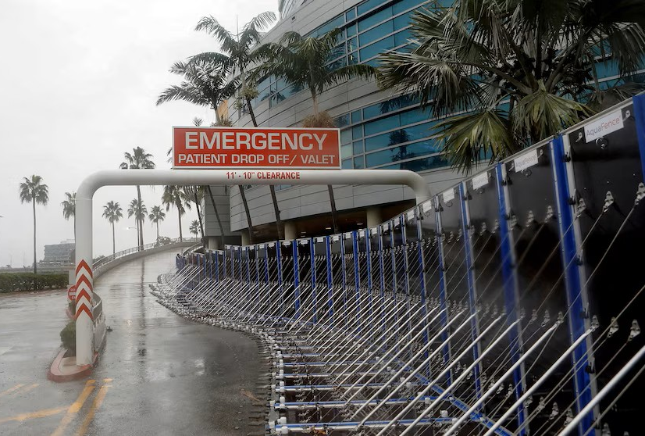
Extreme Weather and Healthcare Access

Slide 11
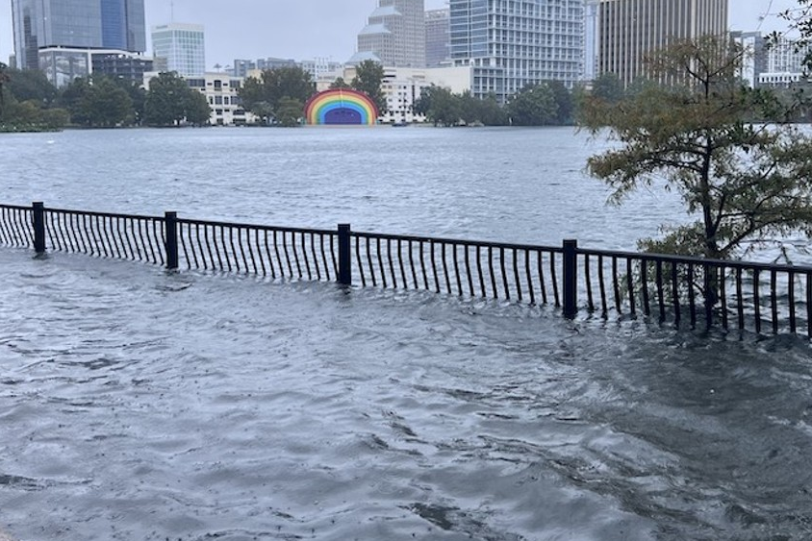
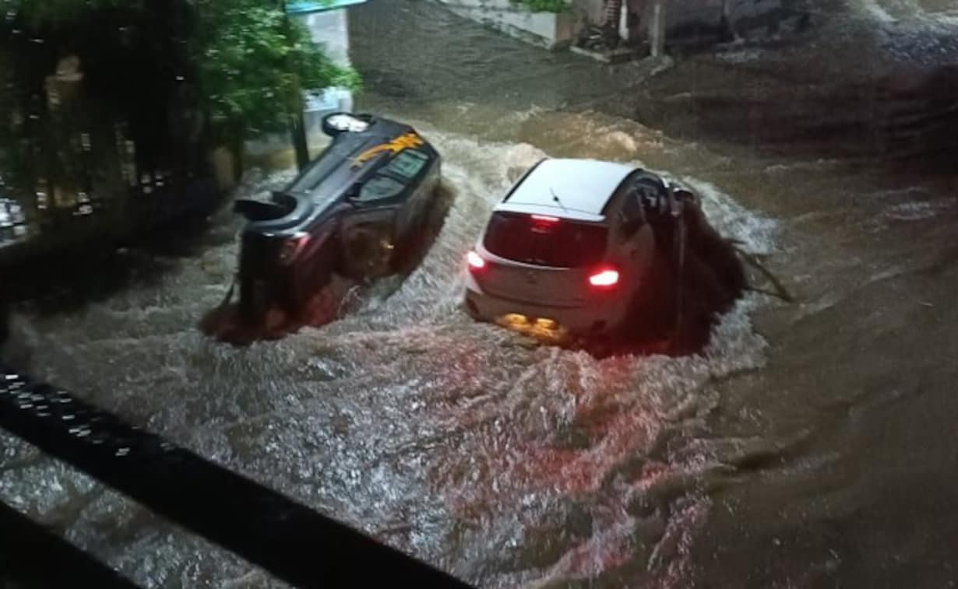
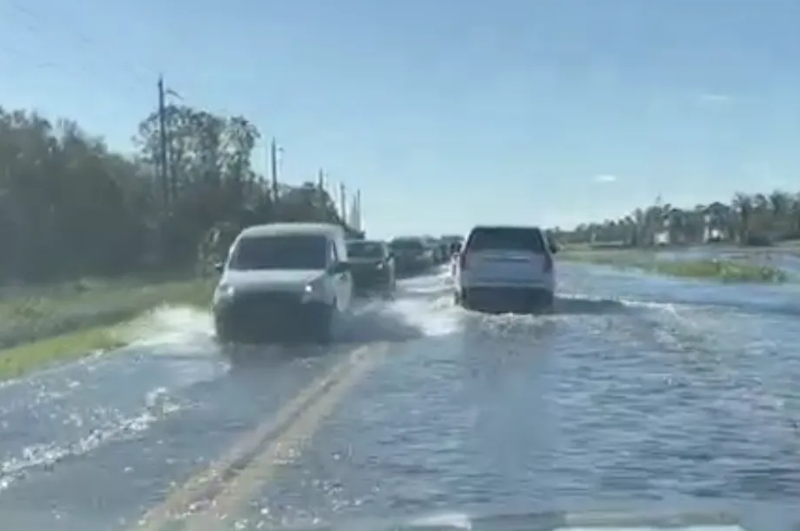
Impact of Floods on Road Network Mobility
Forecast Uncertainty
< 0.5 ft
< 1 ft
1+ ft
Severity/Inundation
Source: Aydin (2023)

Slide 12
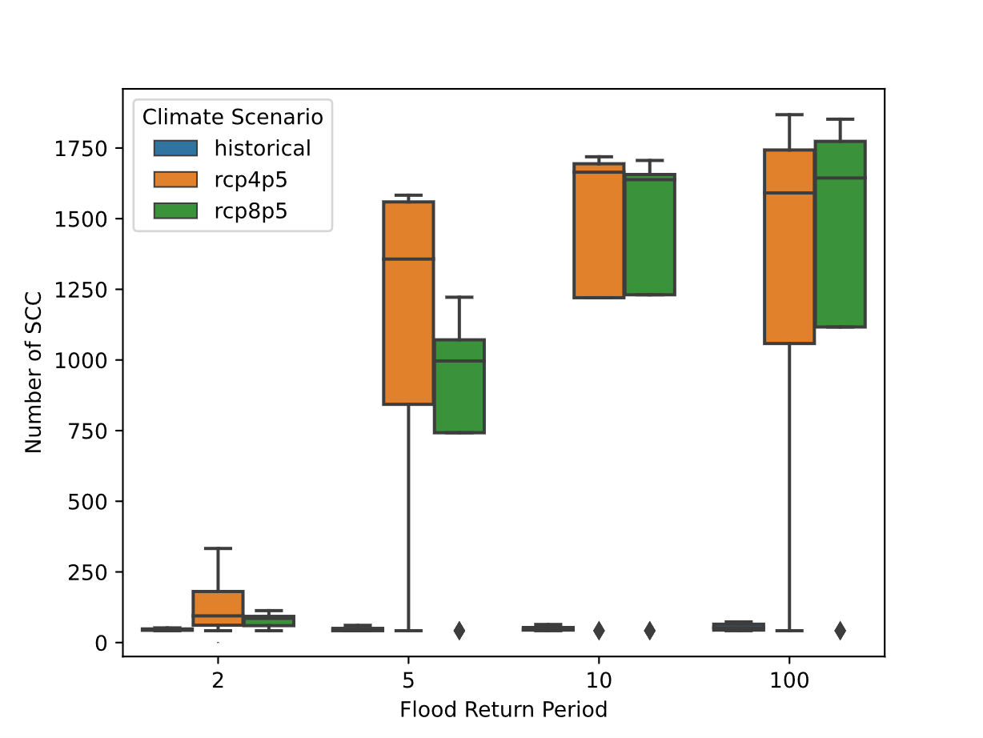
Road Network Disruption (Number of SCC)
FL road network is made up of 49 clusters of well-connected road networks
Frequent floods (2-year floods) can increase the network partition two-folds
  100 clusters due to disconnection
Source: Aydin (2023)

Slide 13
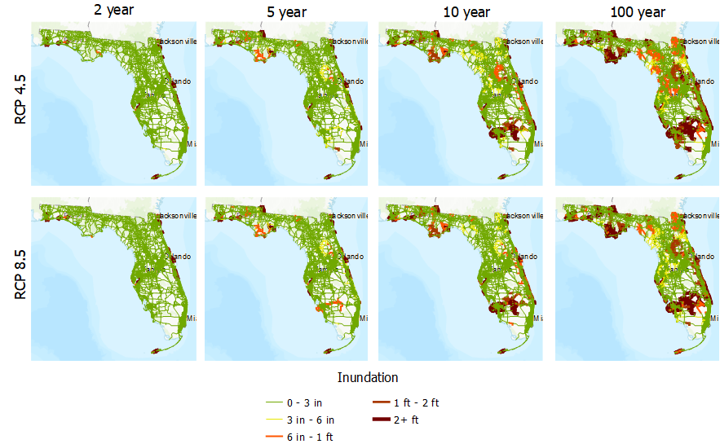
2050 Projection
Source: Aydin (2023)

Slide 14
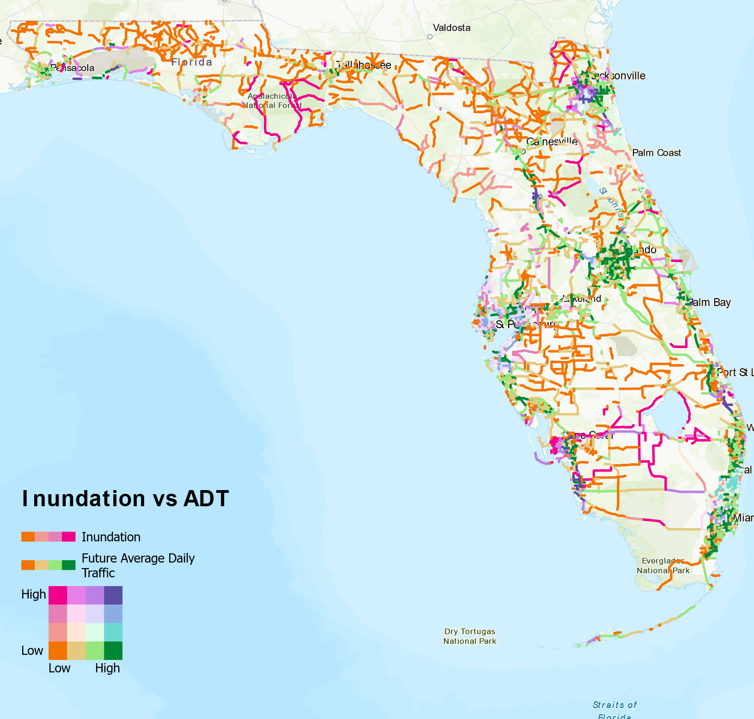
Incorporating Traffic Patterns - 2030
FDOT projections for 2030 traffic
Average inundation per all climate models for RFP 4.5
Areas of high traffic and high inundation cause bottlenecks
  Ocala
  Jacksonville
Source: Aydin (2023)

Slide 15
Building Capacity for Climate Resilience

Slide 16
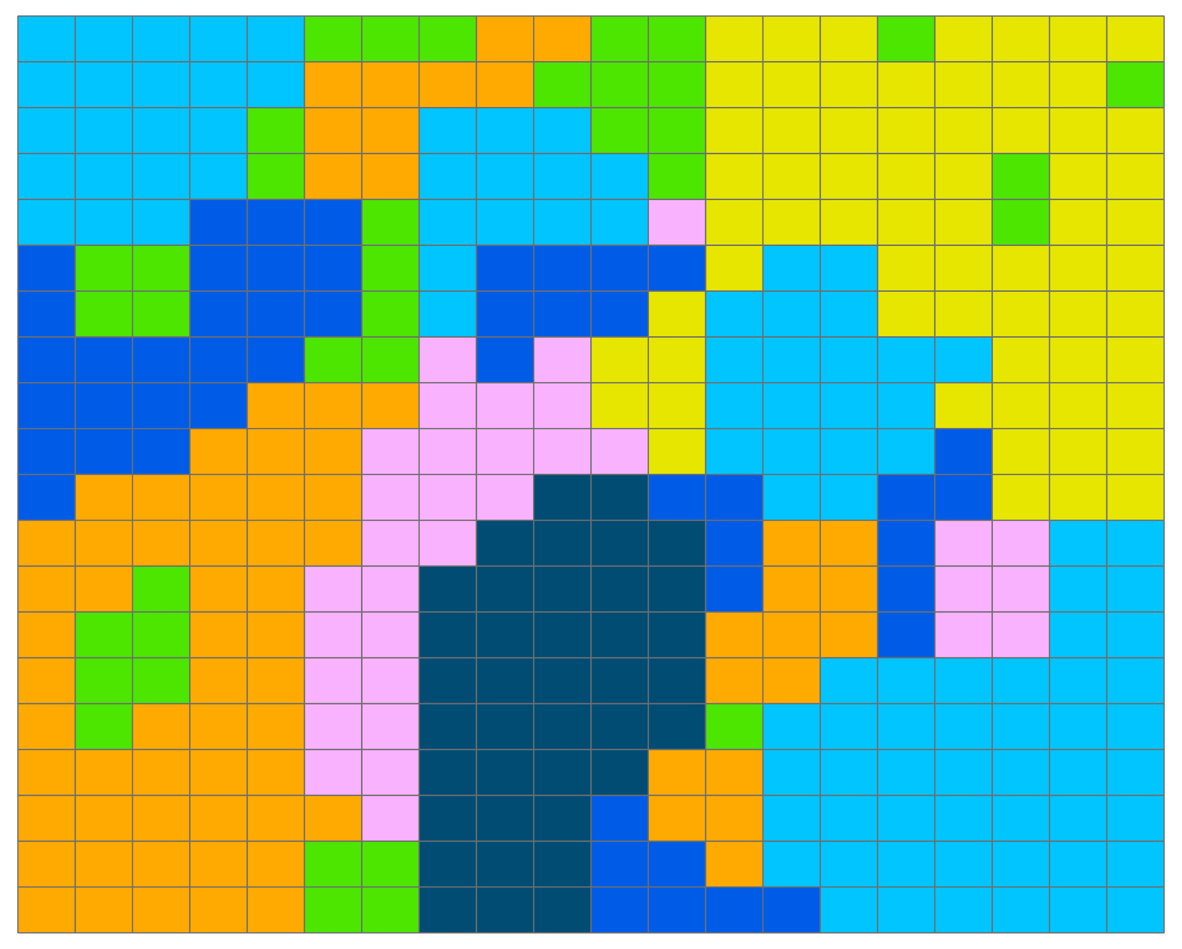
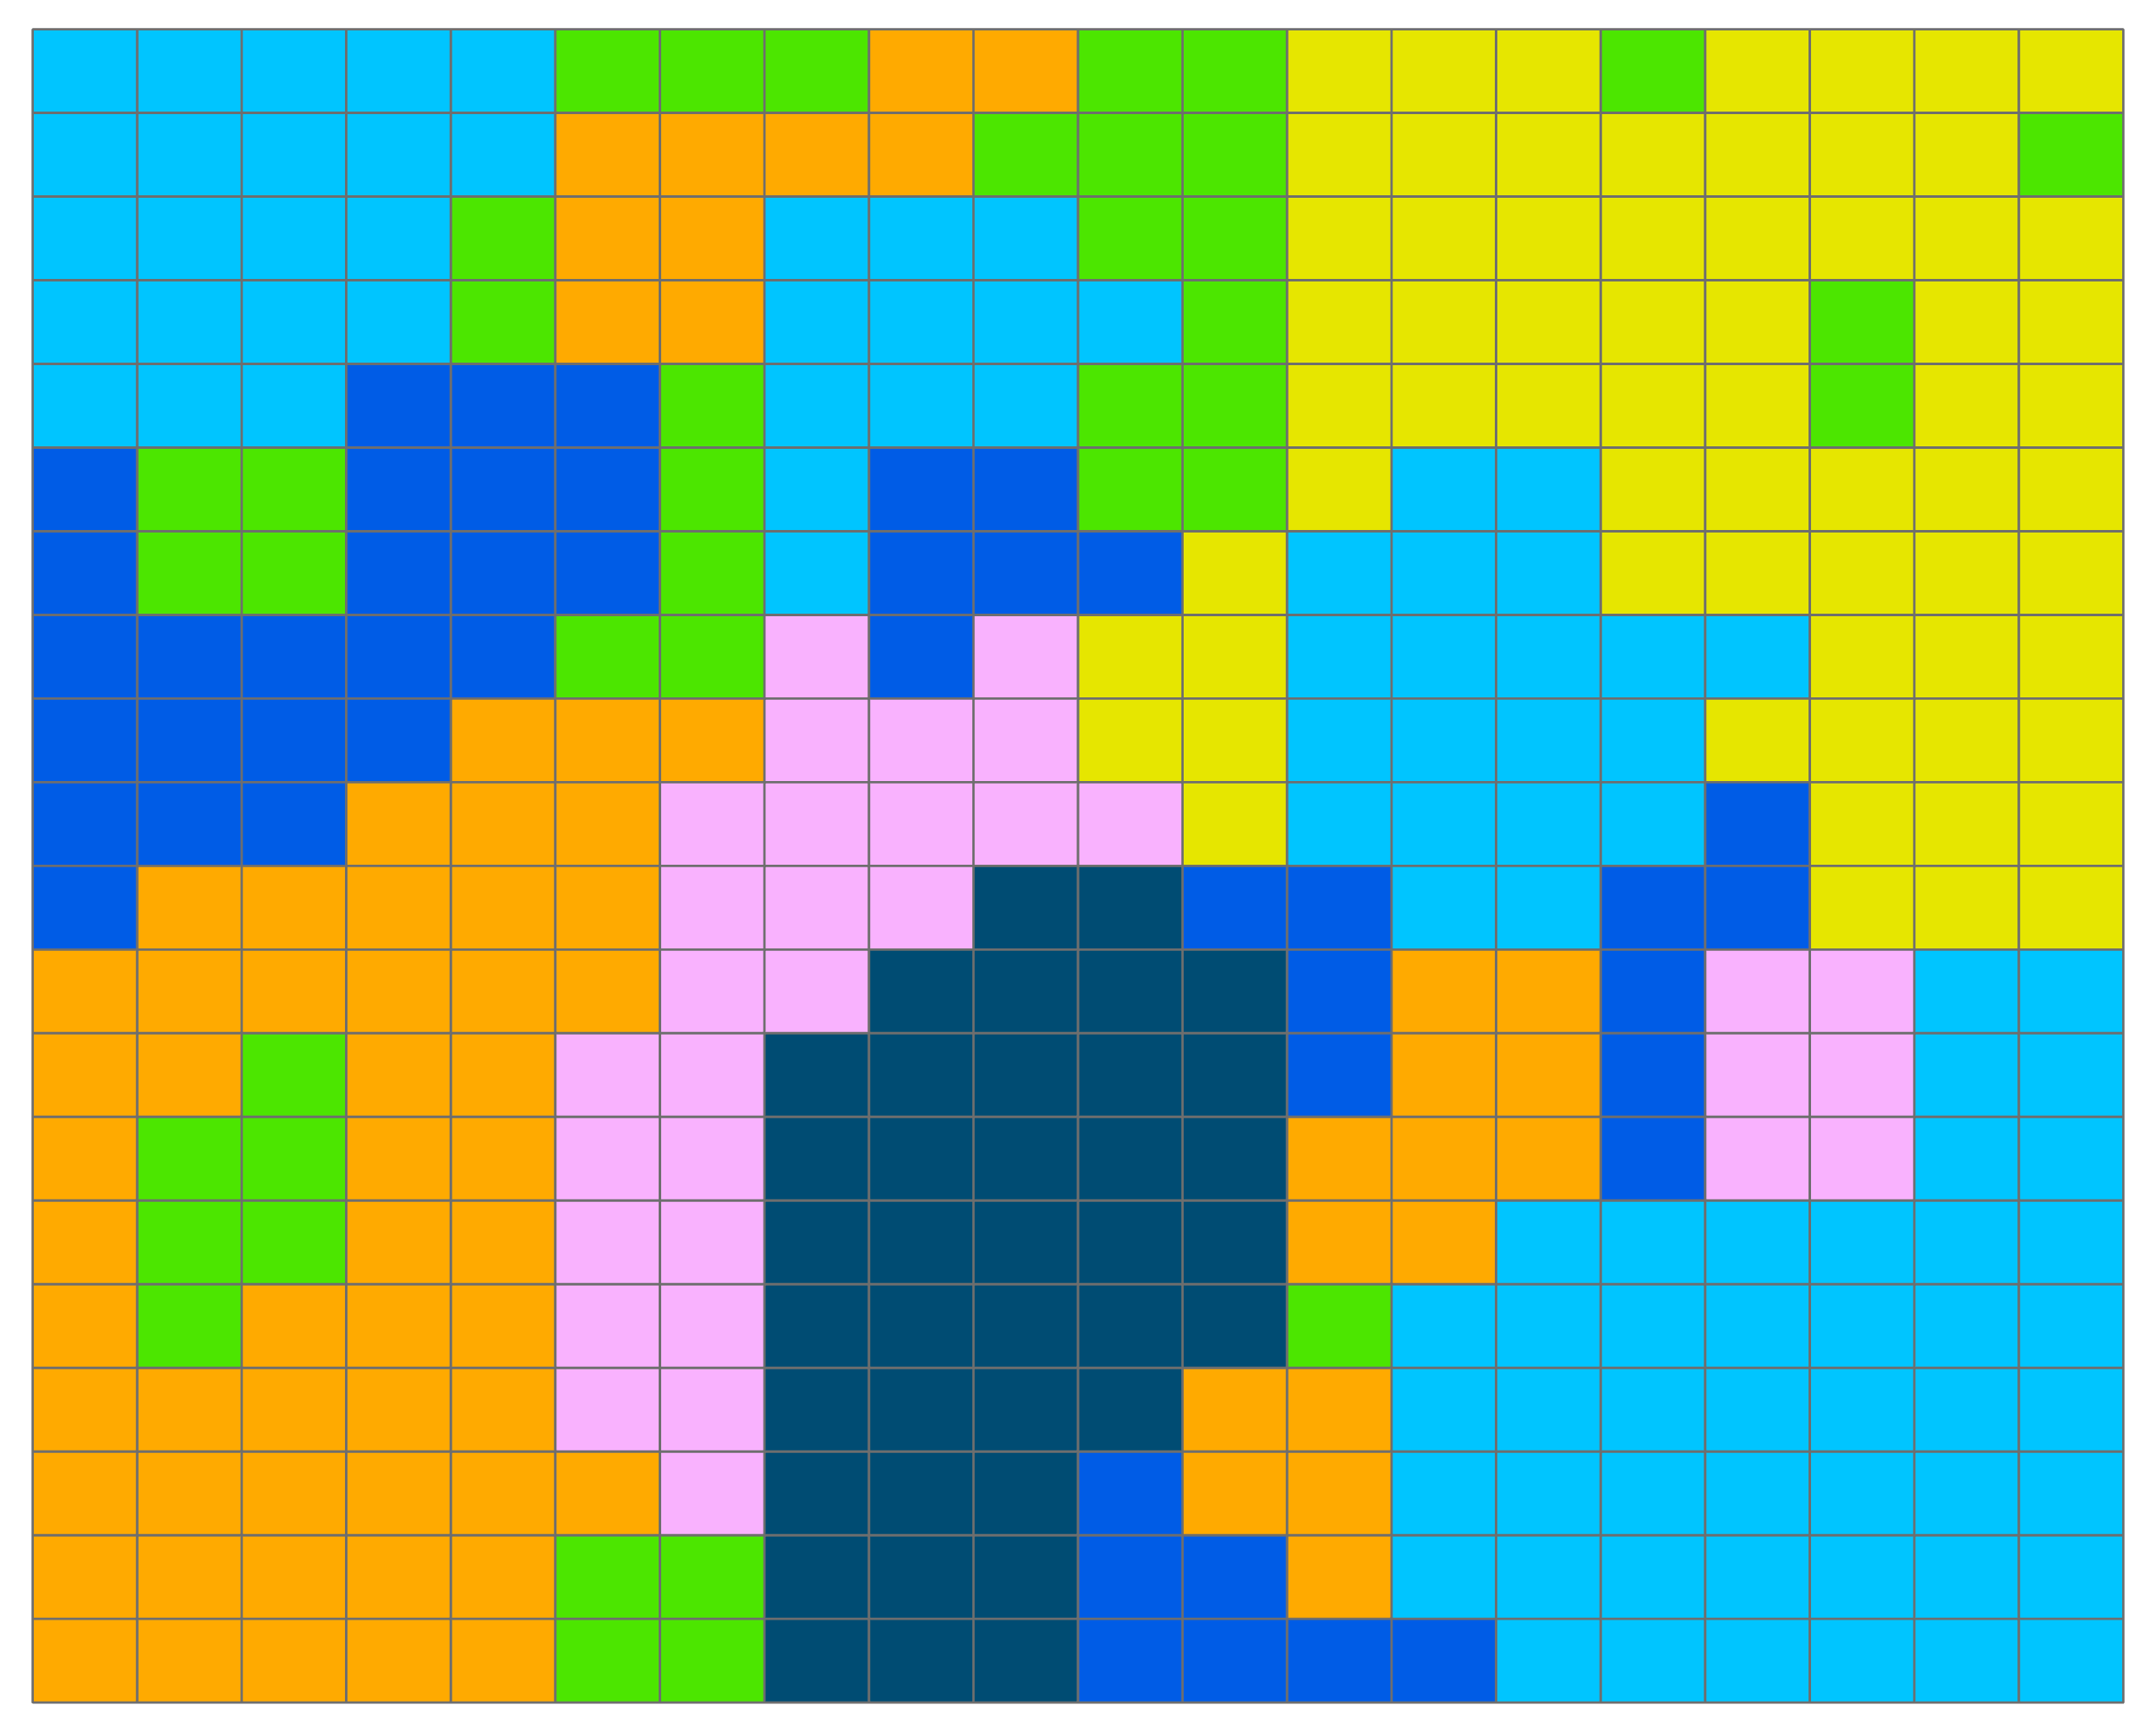
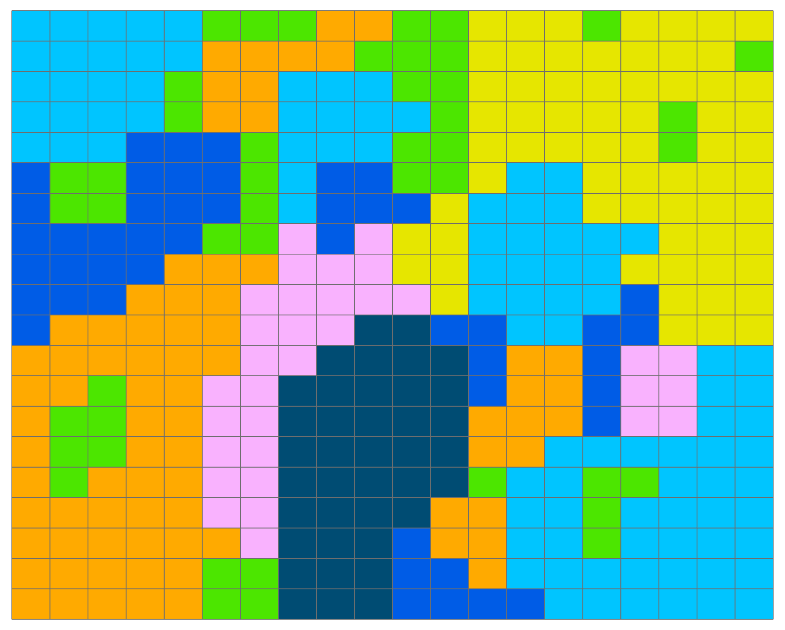




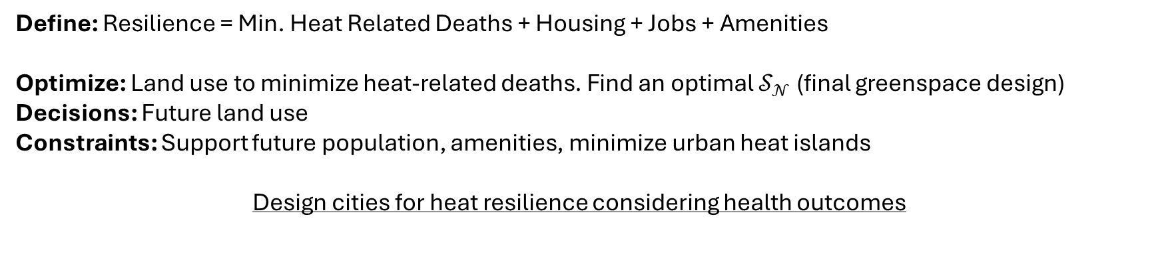

Designing Heat-Resilient Cities
$$𝒜_{1}$$
$$𝒜_{𝒩−1}$$
$$𝒮_{0}$$
$$𝒮_{k}$$
$$𝒮_{𝒩}$$
Define: Resilience = Min. Heat Related Deaths + Housing + Jobs + Amenities
Optimize: Land use to minimize heat-related deaths. Find an optimal $𝒮_{𝒩}$ (final greenspace design)
Decisions: Future land use
Constraints: Support future population, amenities, minimize urban heat islands
Design cities for heat resilience considering health outcomes
Source: Aydin (2023)

Slide 17
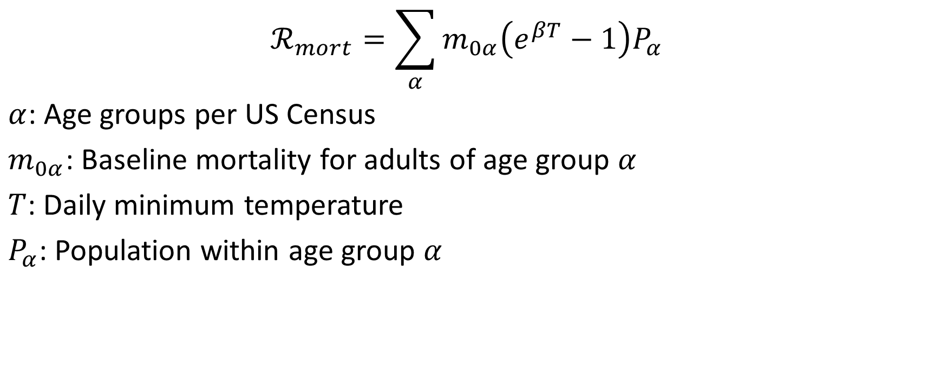

Heat Impact Model on Mortality- $ℛ_{mort}$
$$ℛ_{mort}=\sum_{α}{m_{0α}\left(e^{βT}−1\right)P_{α}}$$
$α$: Age groups per US Census
$m_{0α}$: Baseline mortality for adults of age group $α$
$T$: Daily minimum temperature
$P_{α}$: Population within age group $α$
Source: Gasparrini et al. (2015)

Slide 18
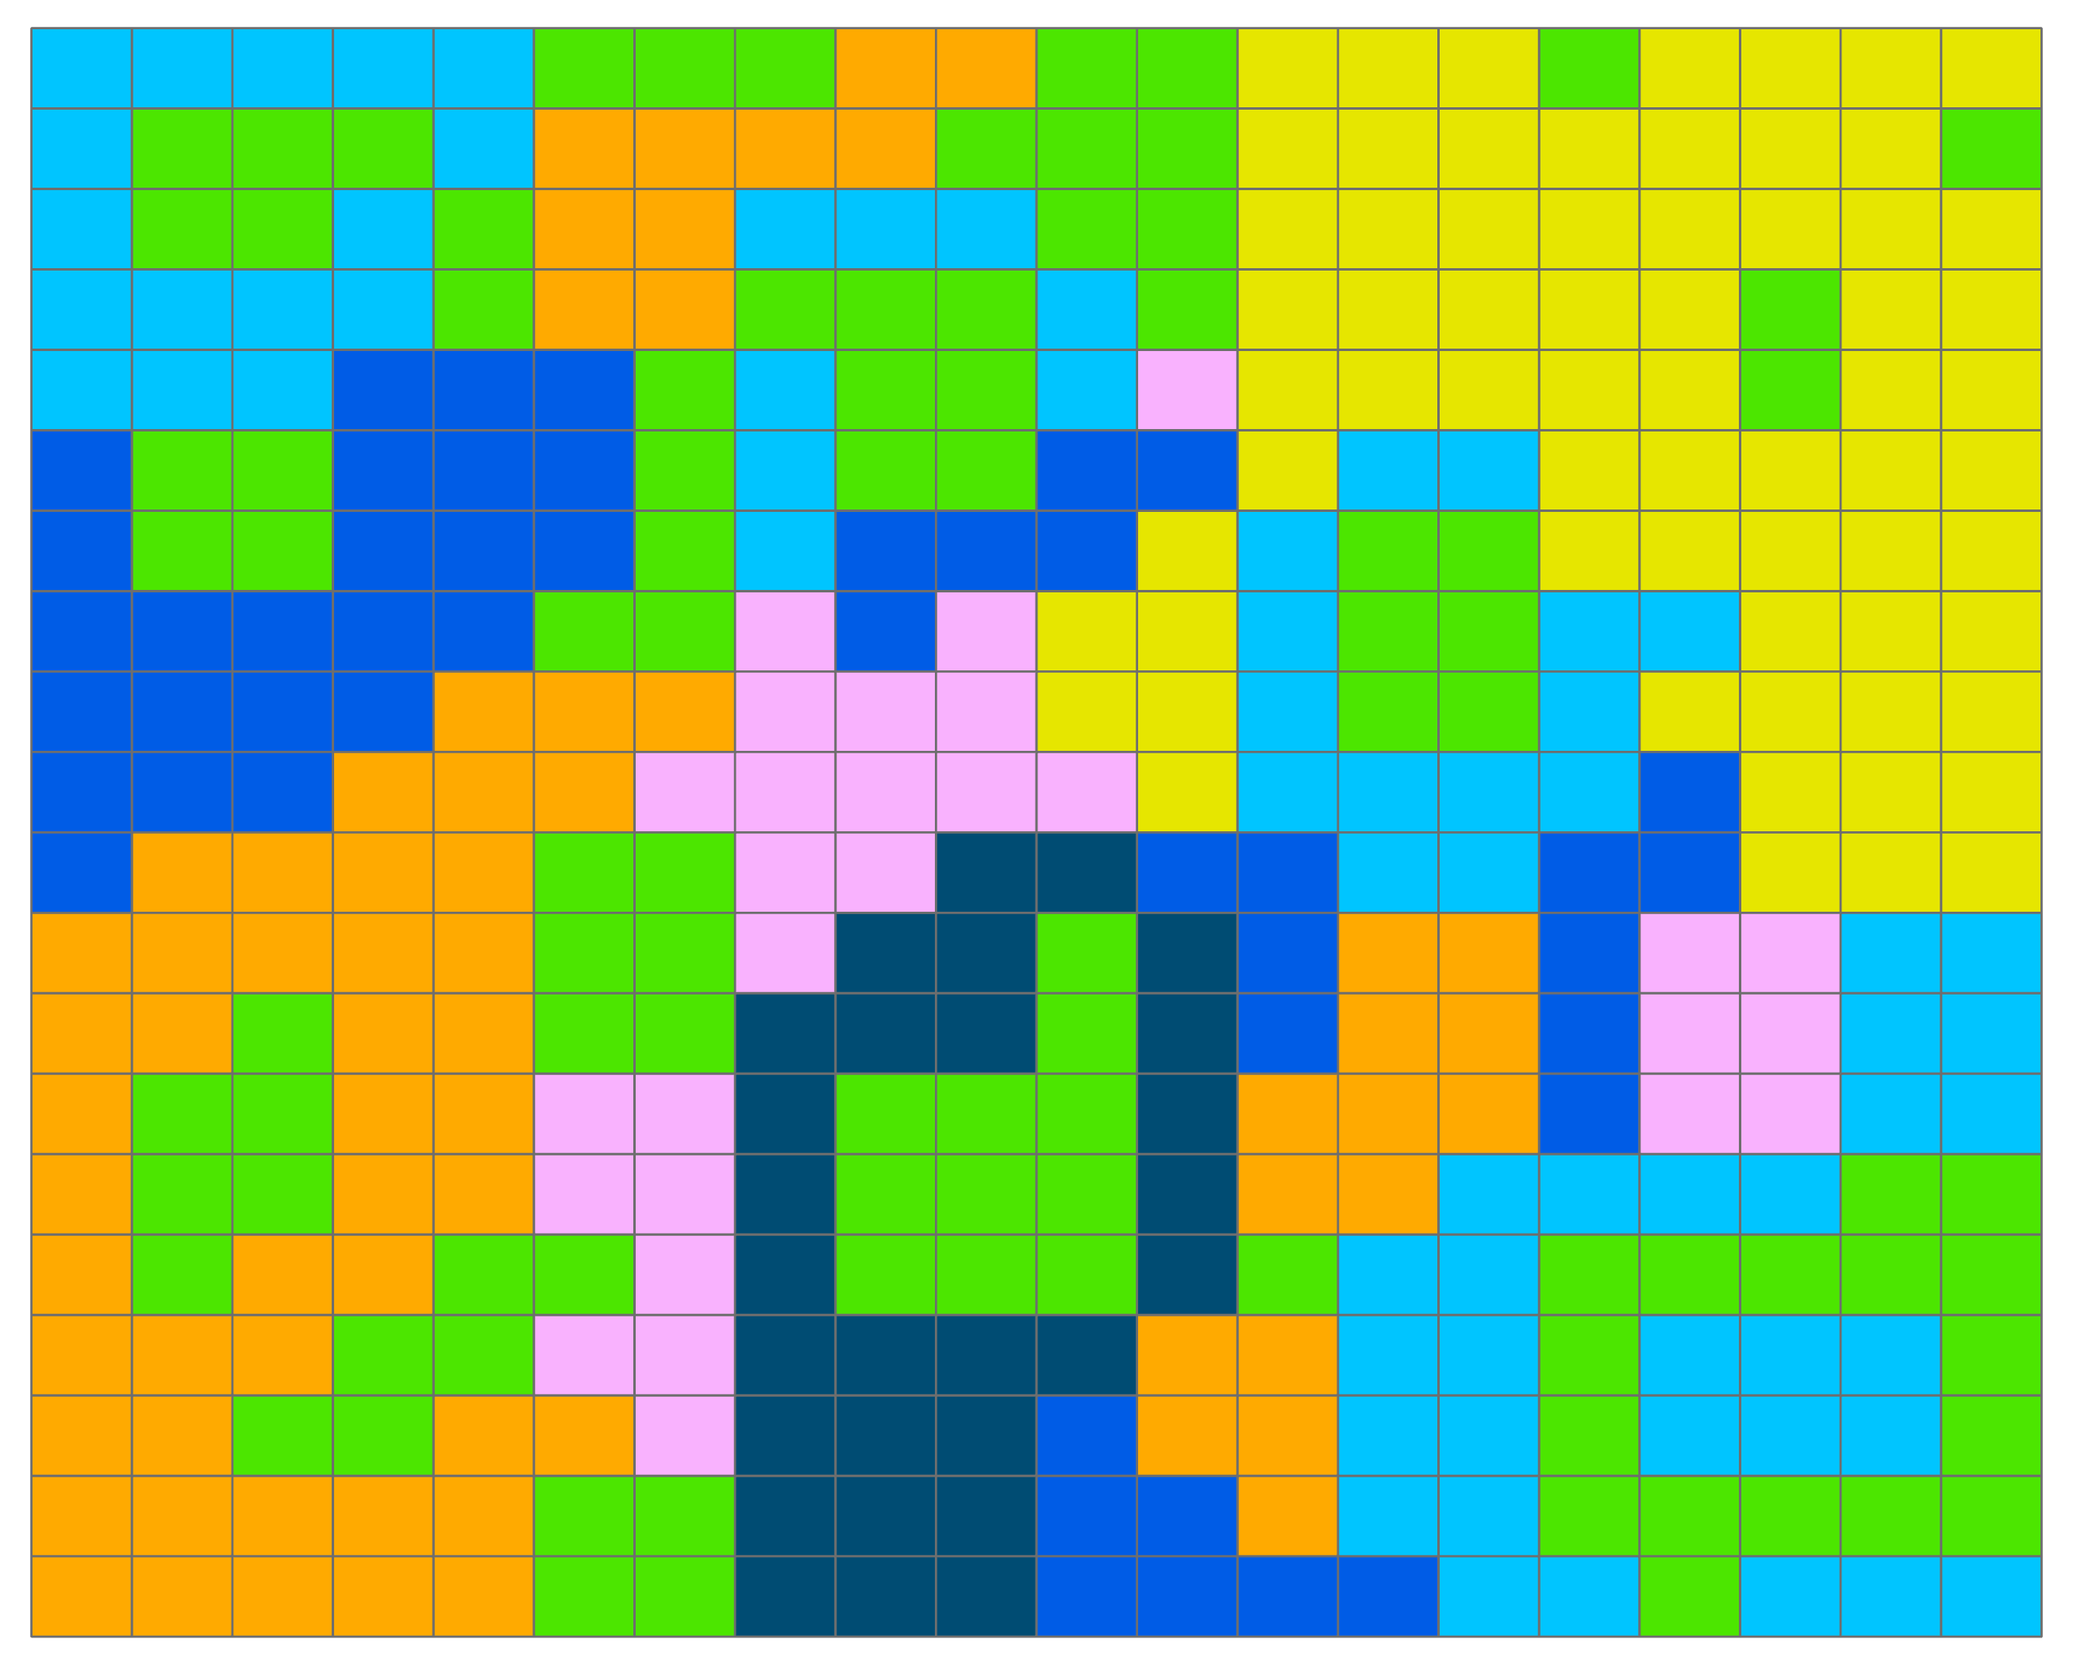
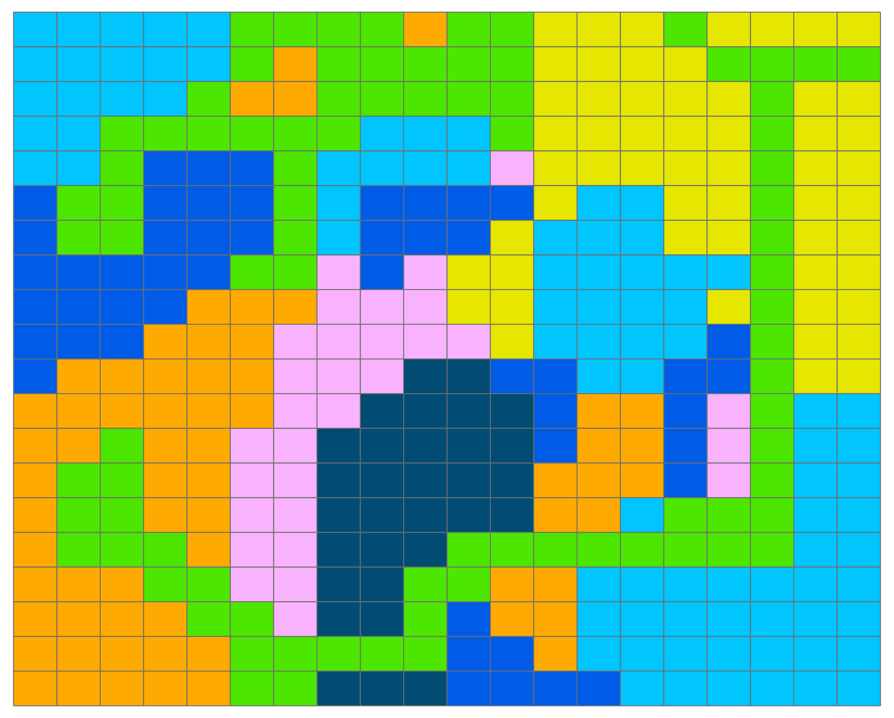
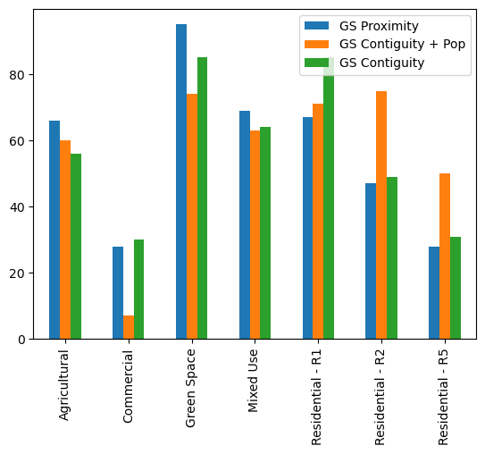
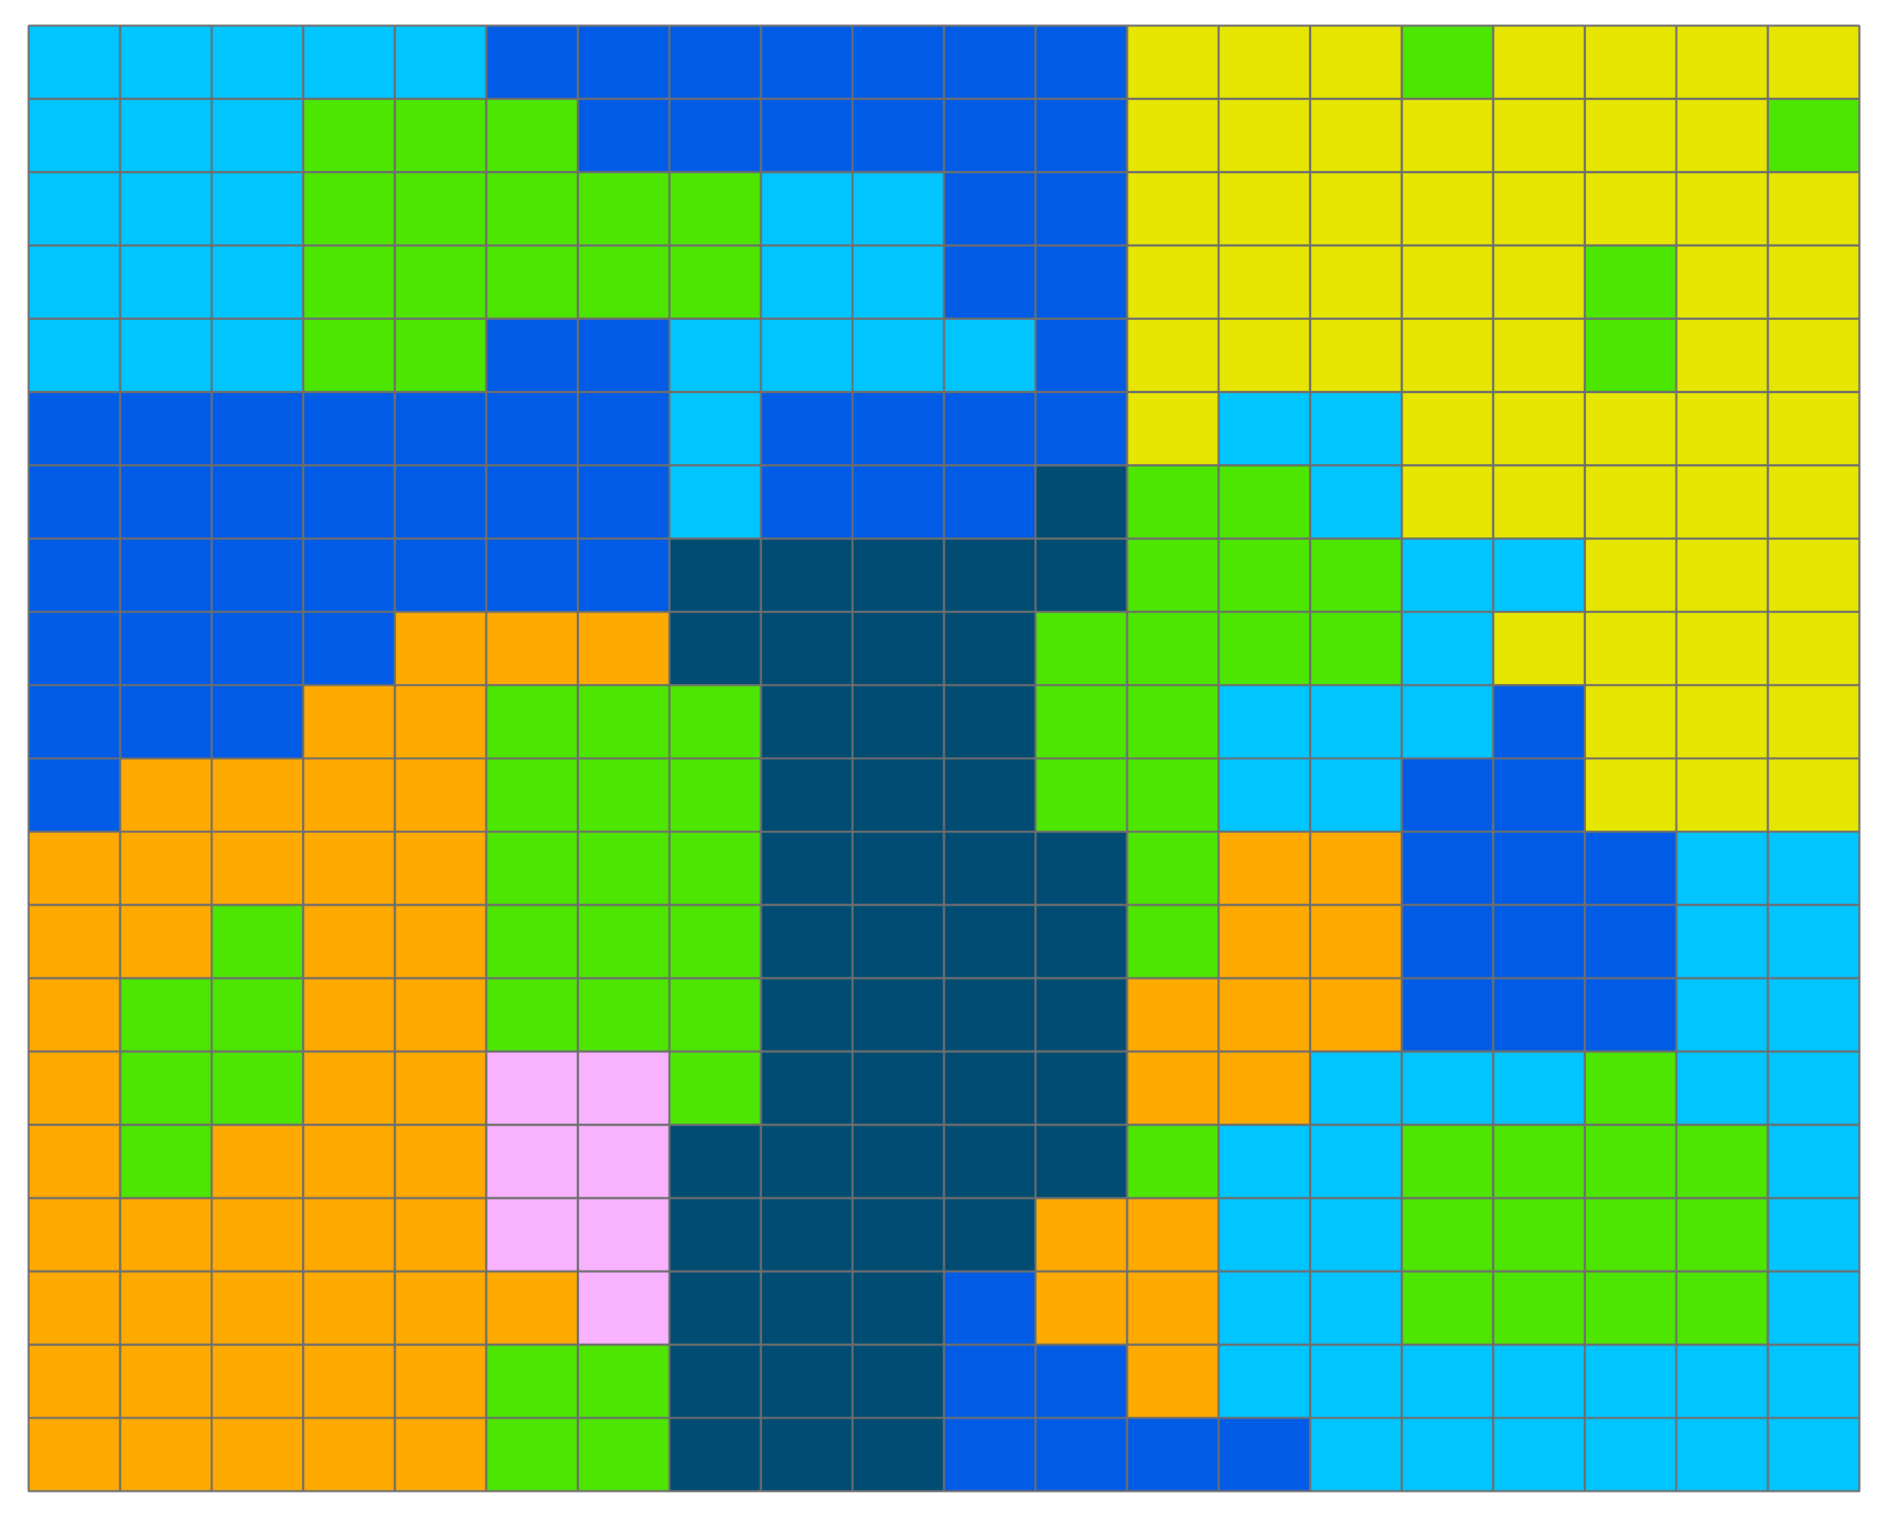
Comparison of Green Space Scenarios
Proximity to Greenspace
Contiguous Greenspaces
Greenspace per Capita
Source: Aydin (2023)

Slide 19
ADAPT-STL
Saint Louis Resilience Center

Slide 20


ADAPT-STL
Department of Energy-funded Resilience Center
Regional hub of scientific and operational research to mitigate
  Urban Heat Islands
  Urban Flooding
Interface between research, implementation, and community

Slide 21

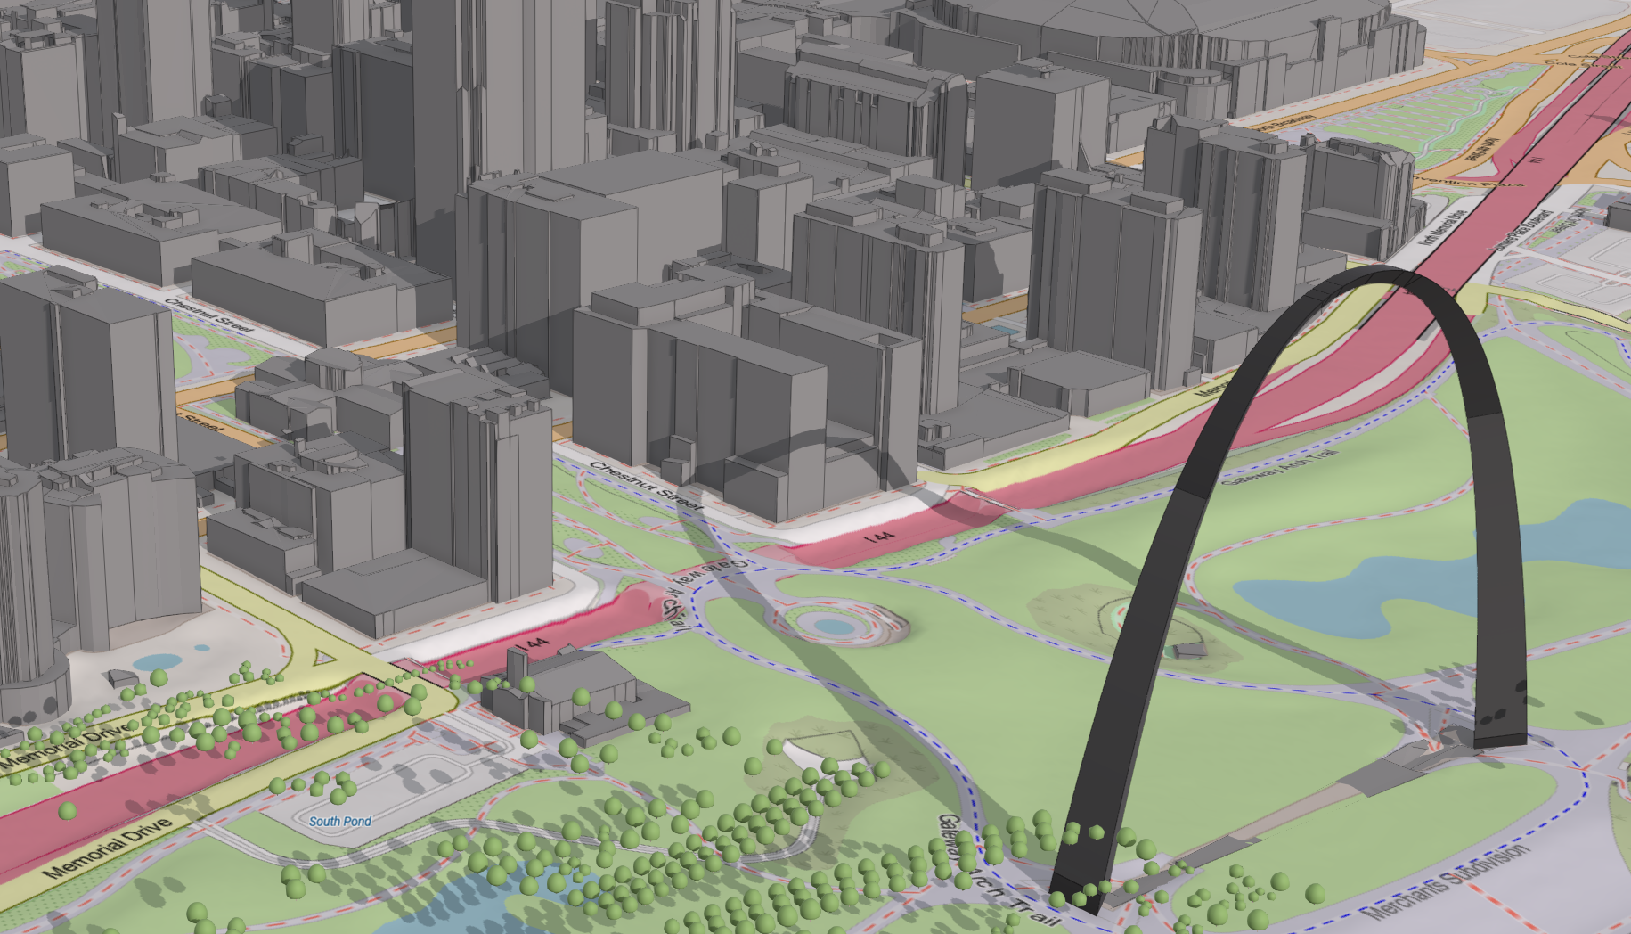



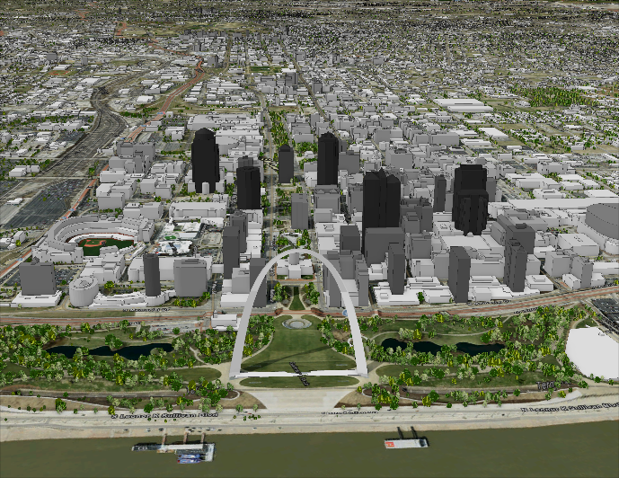
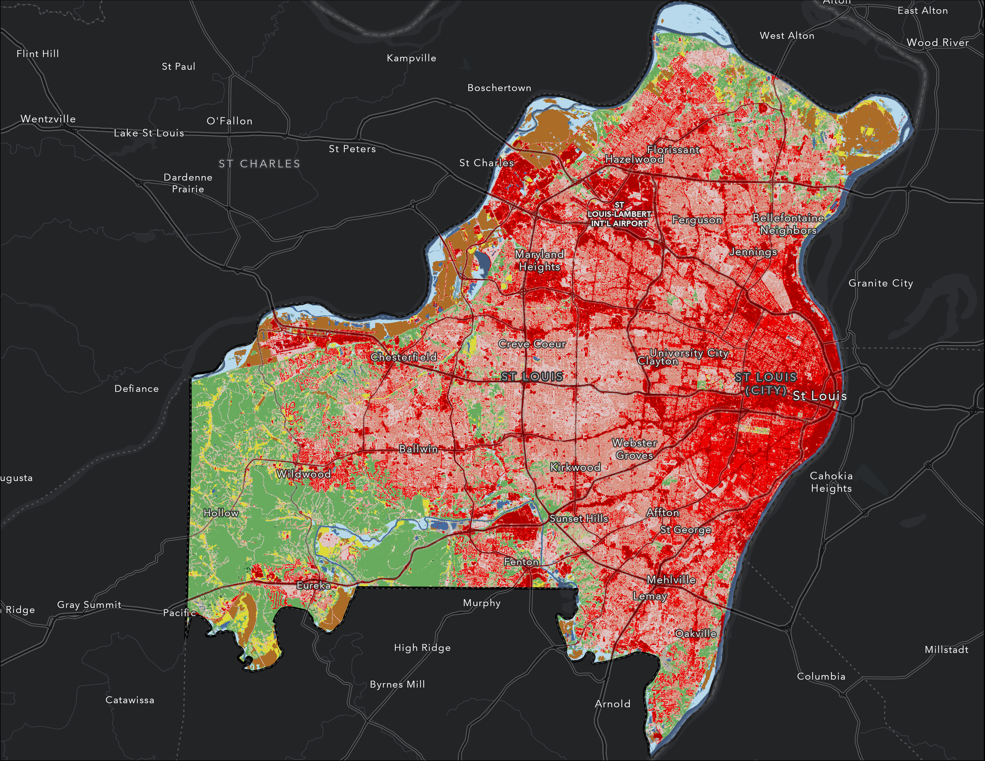
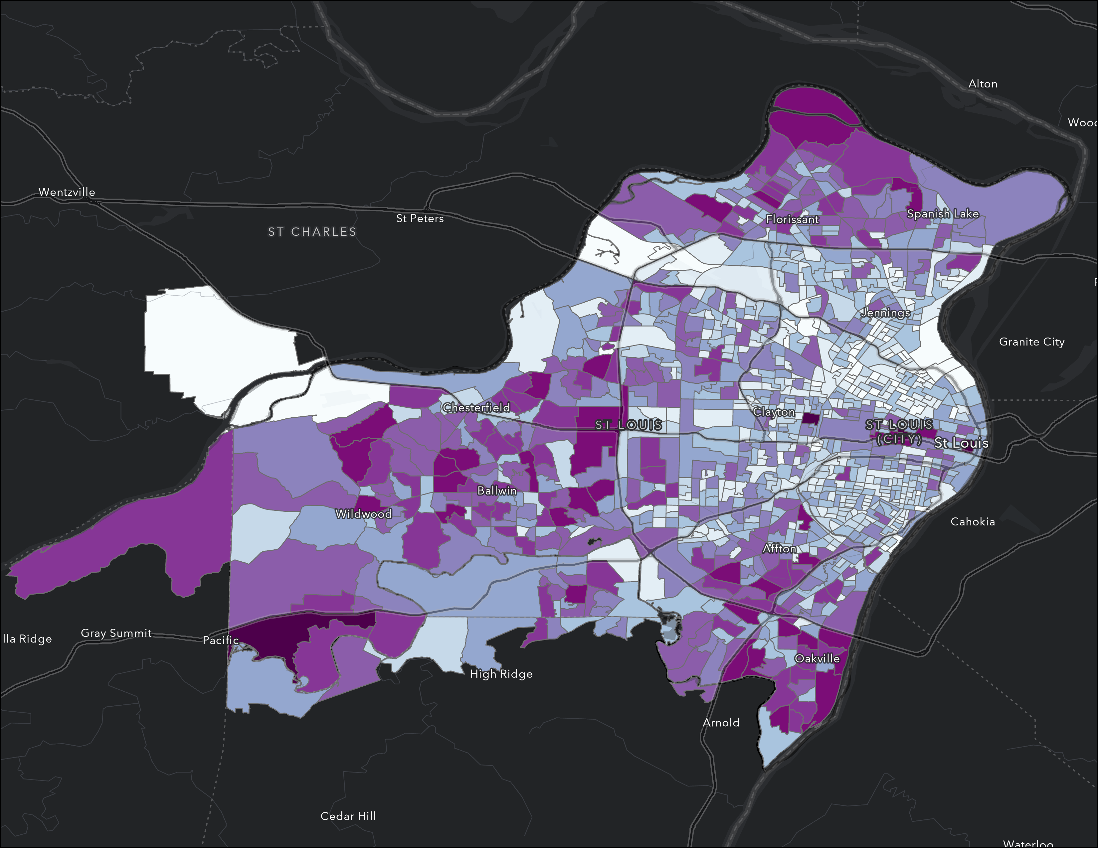
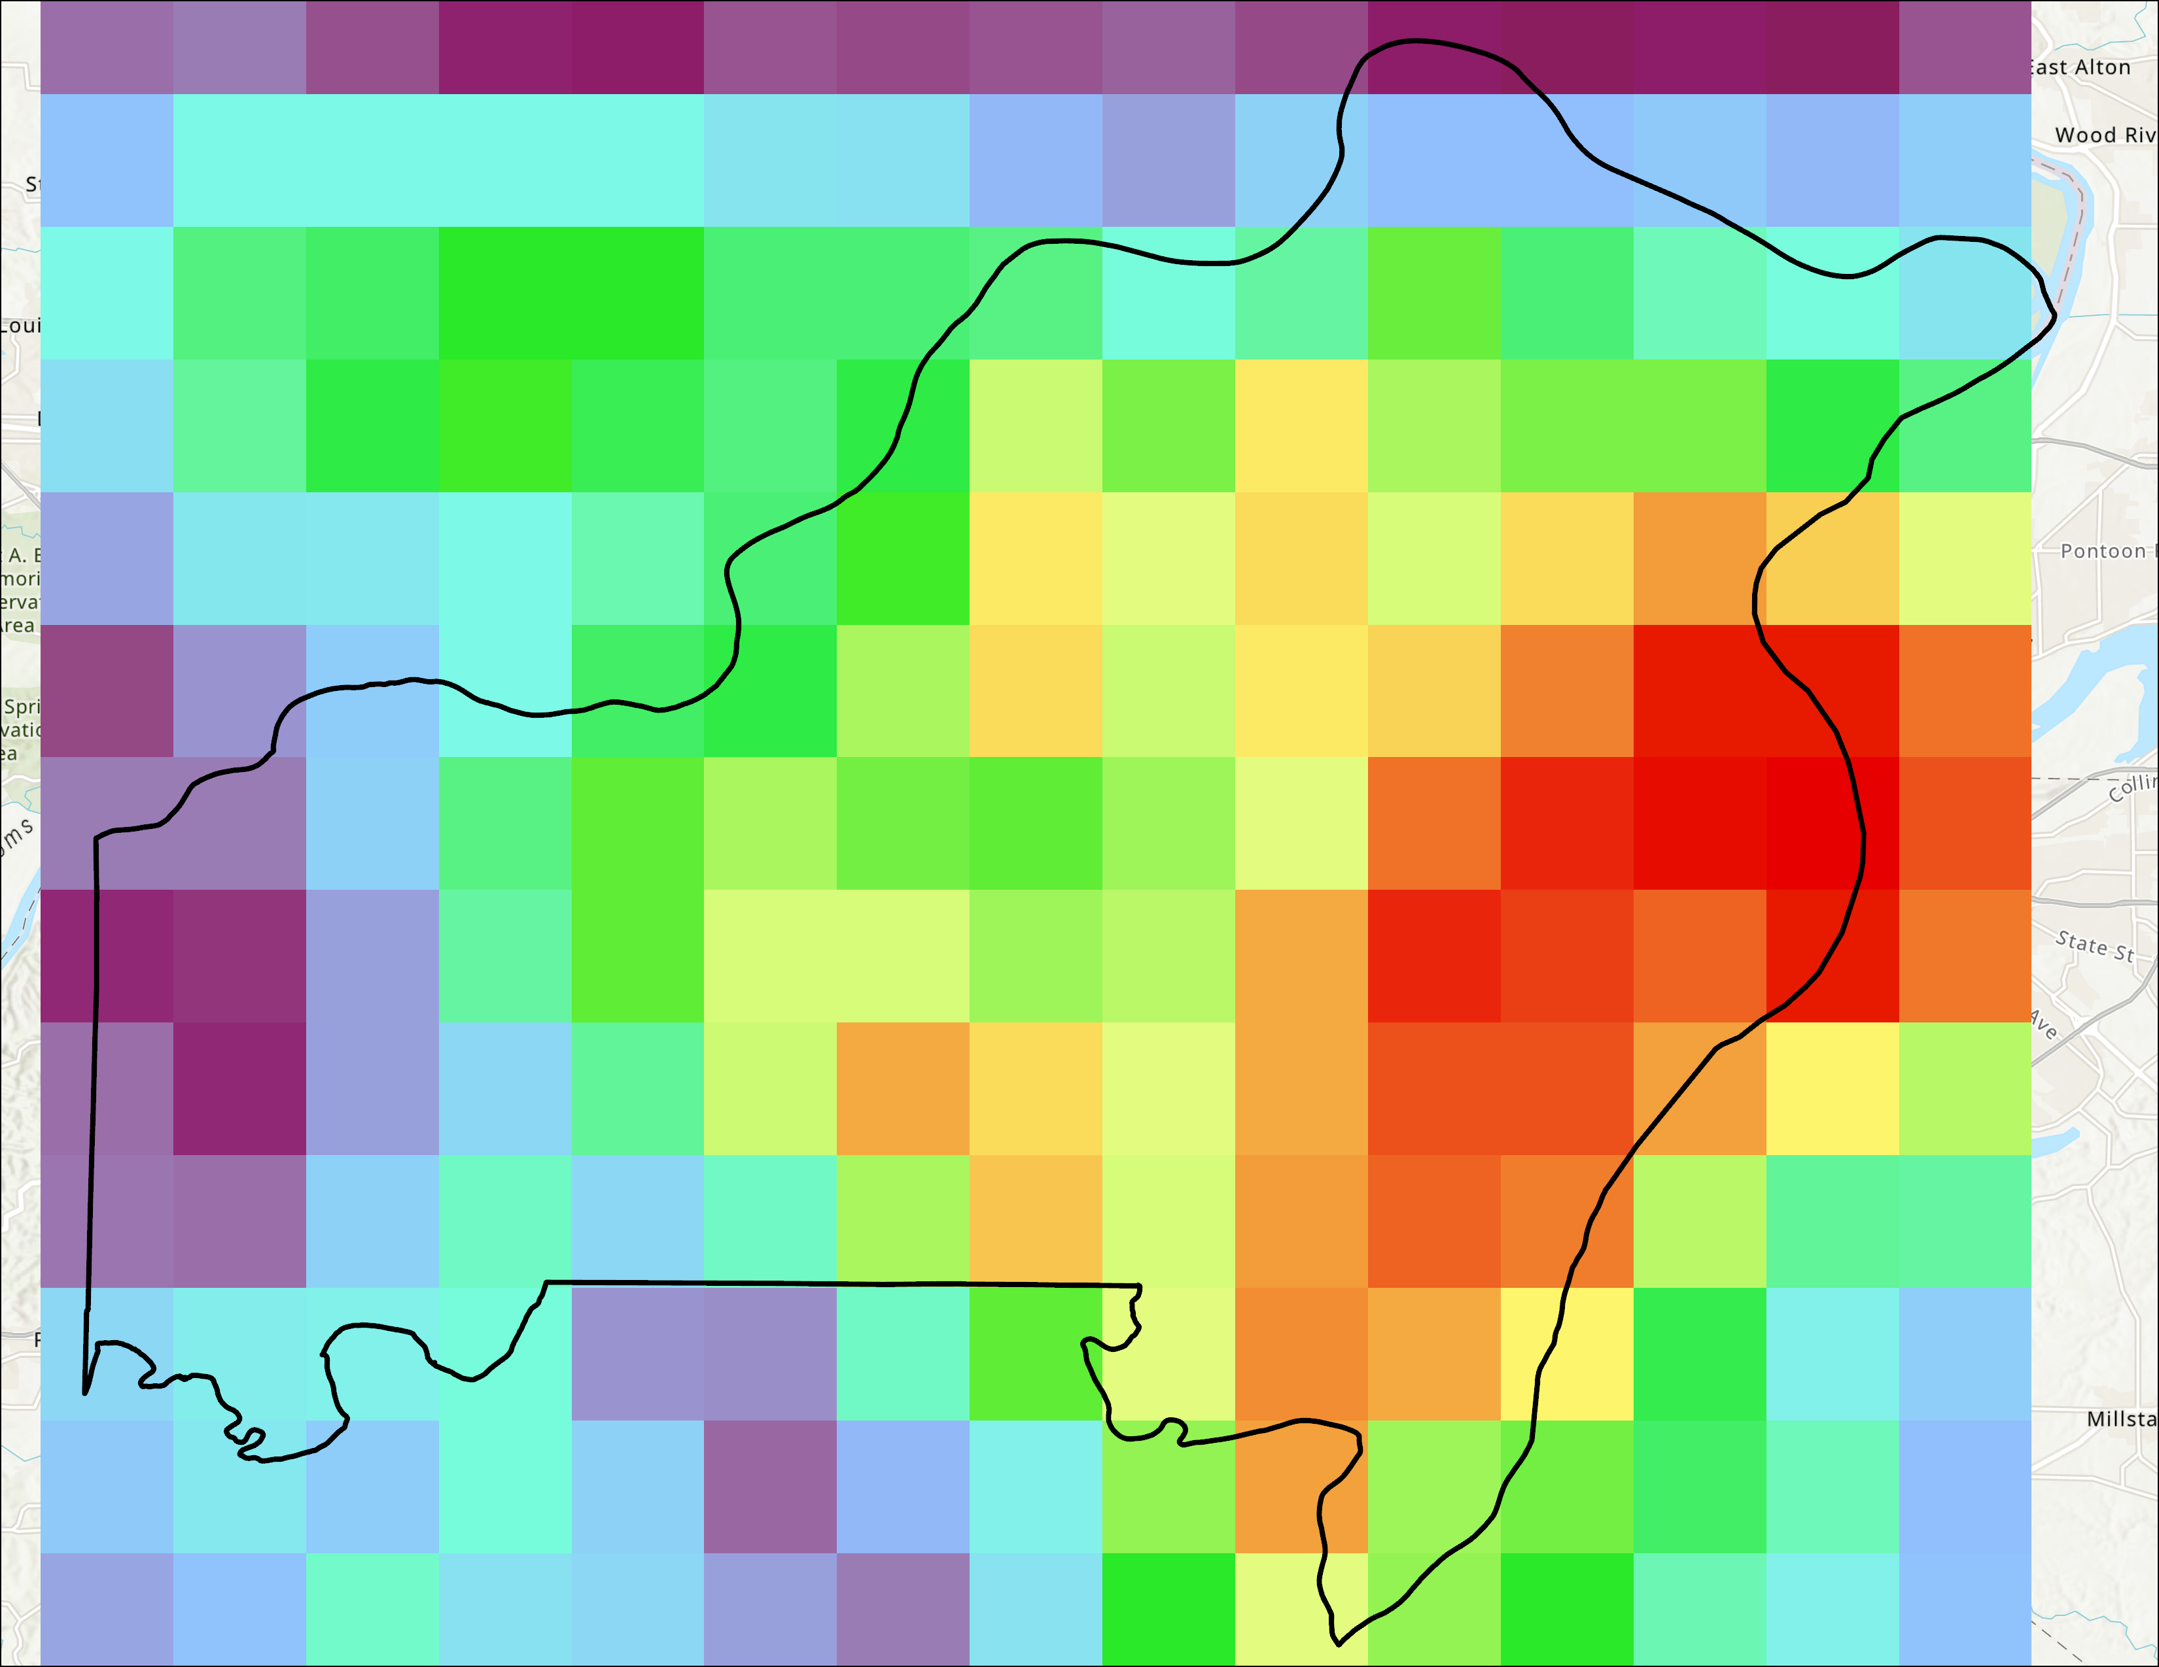
Stakeholders
Digital Twin
Infrastructure Solutions
Physical World
Green & Gray Infrastructure Plans
Community Priorities & Perceived Risks
Green Infrastructure
Gray Infrastructure
Weather Station Network
Land Use
Population
Weather

Slide 22
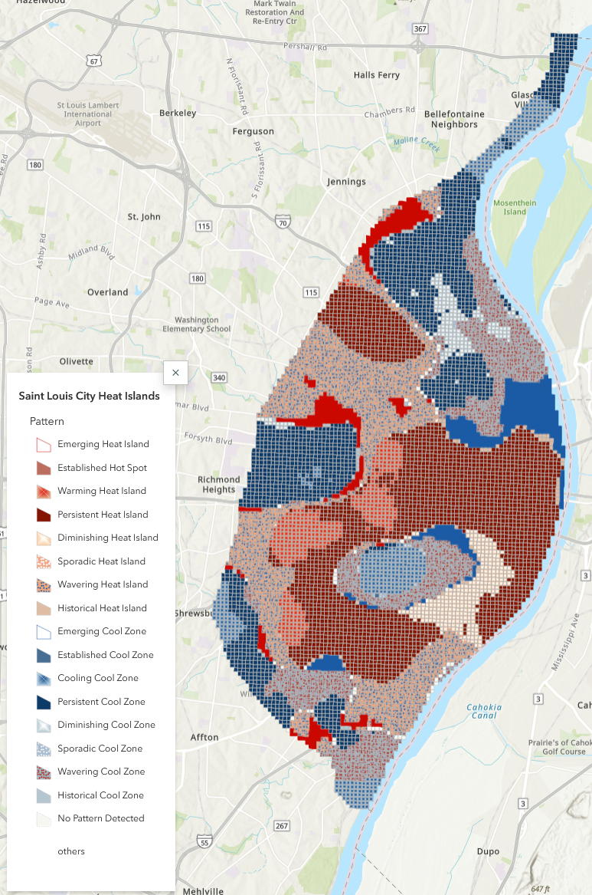
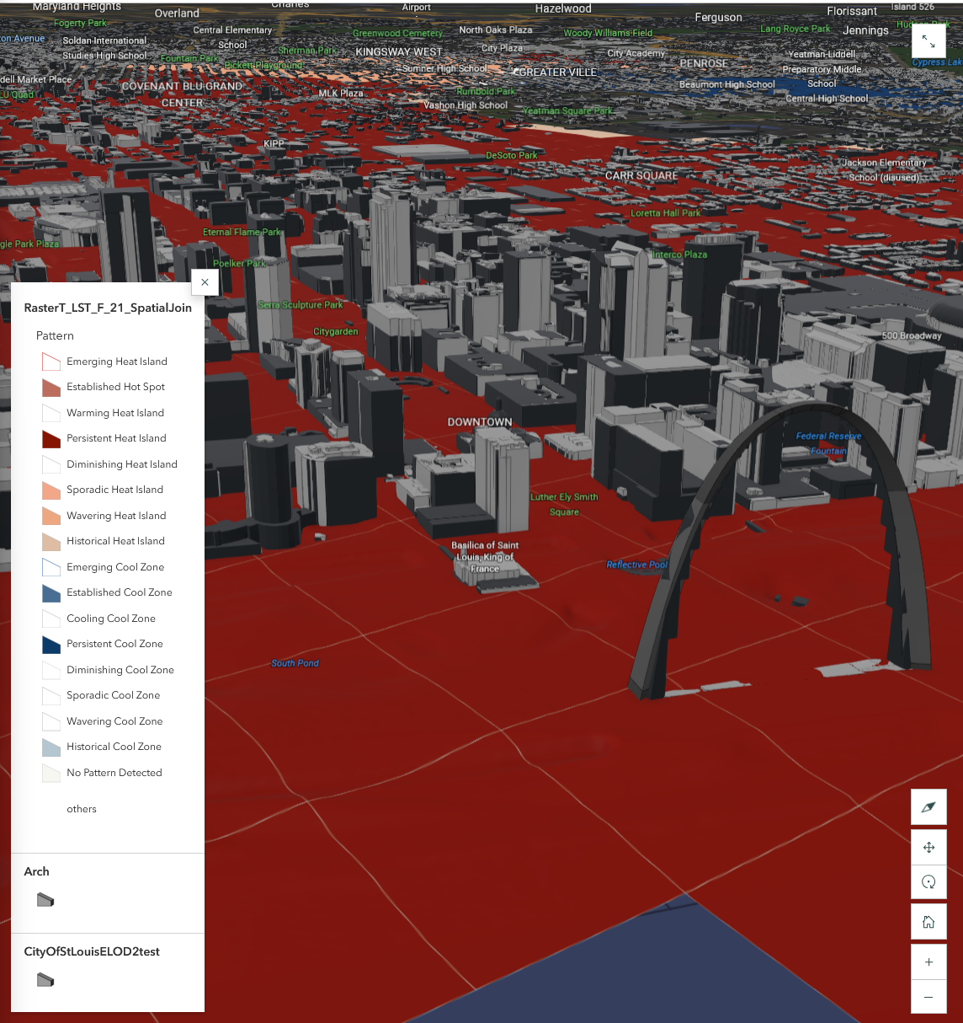
Urban Weather Digital Twin of Saint Louis

Slide 23
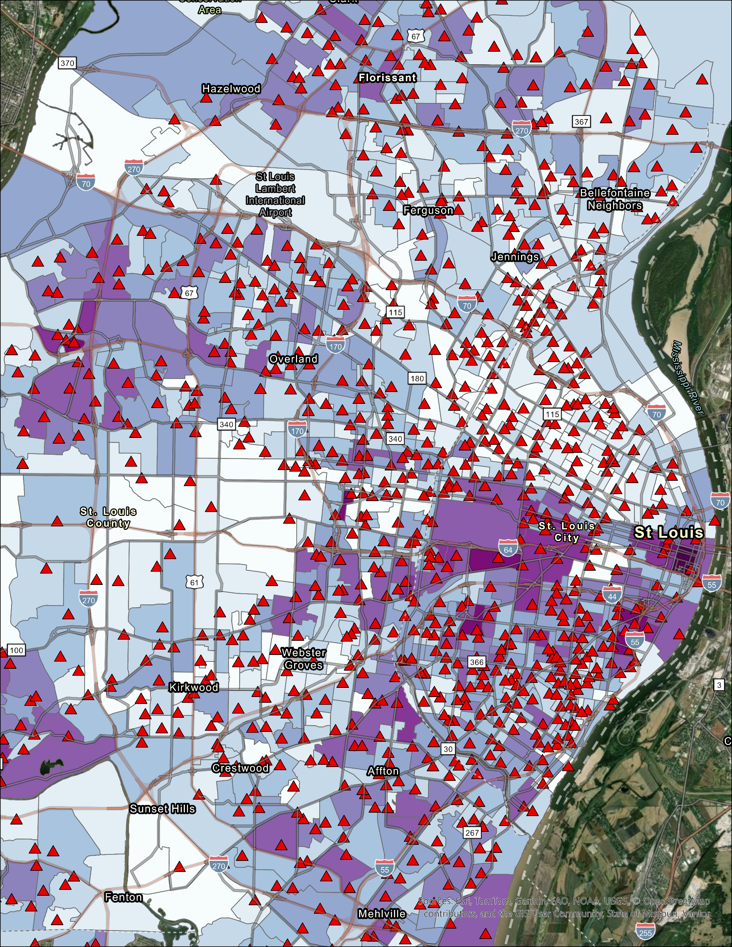
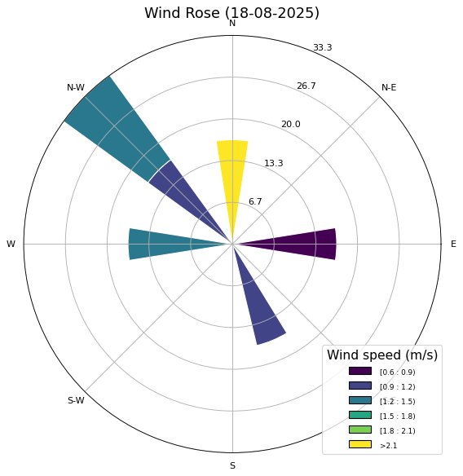
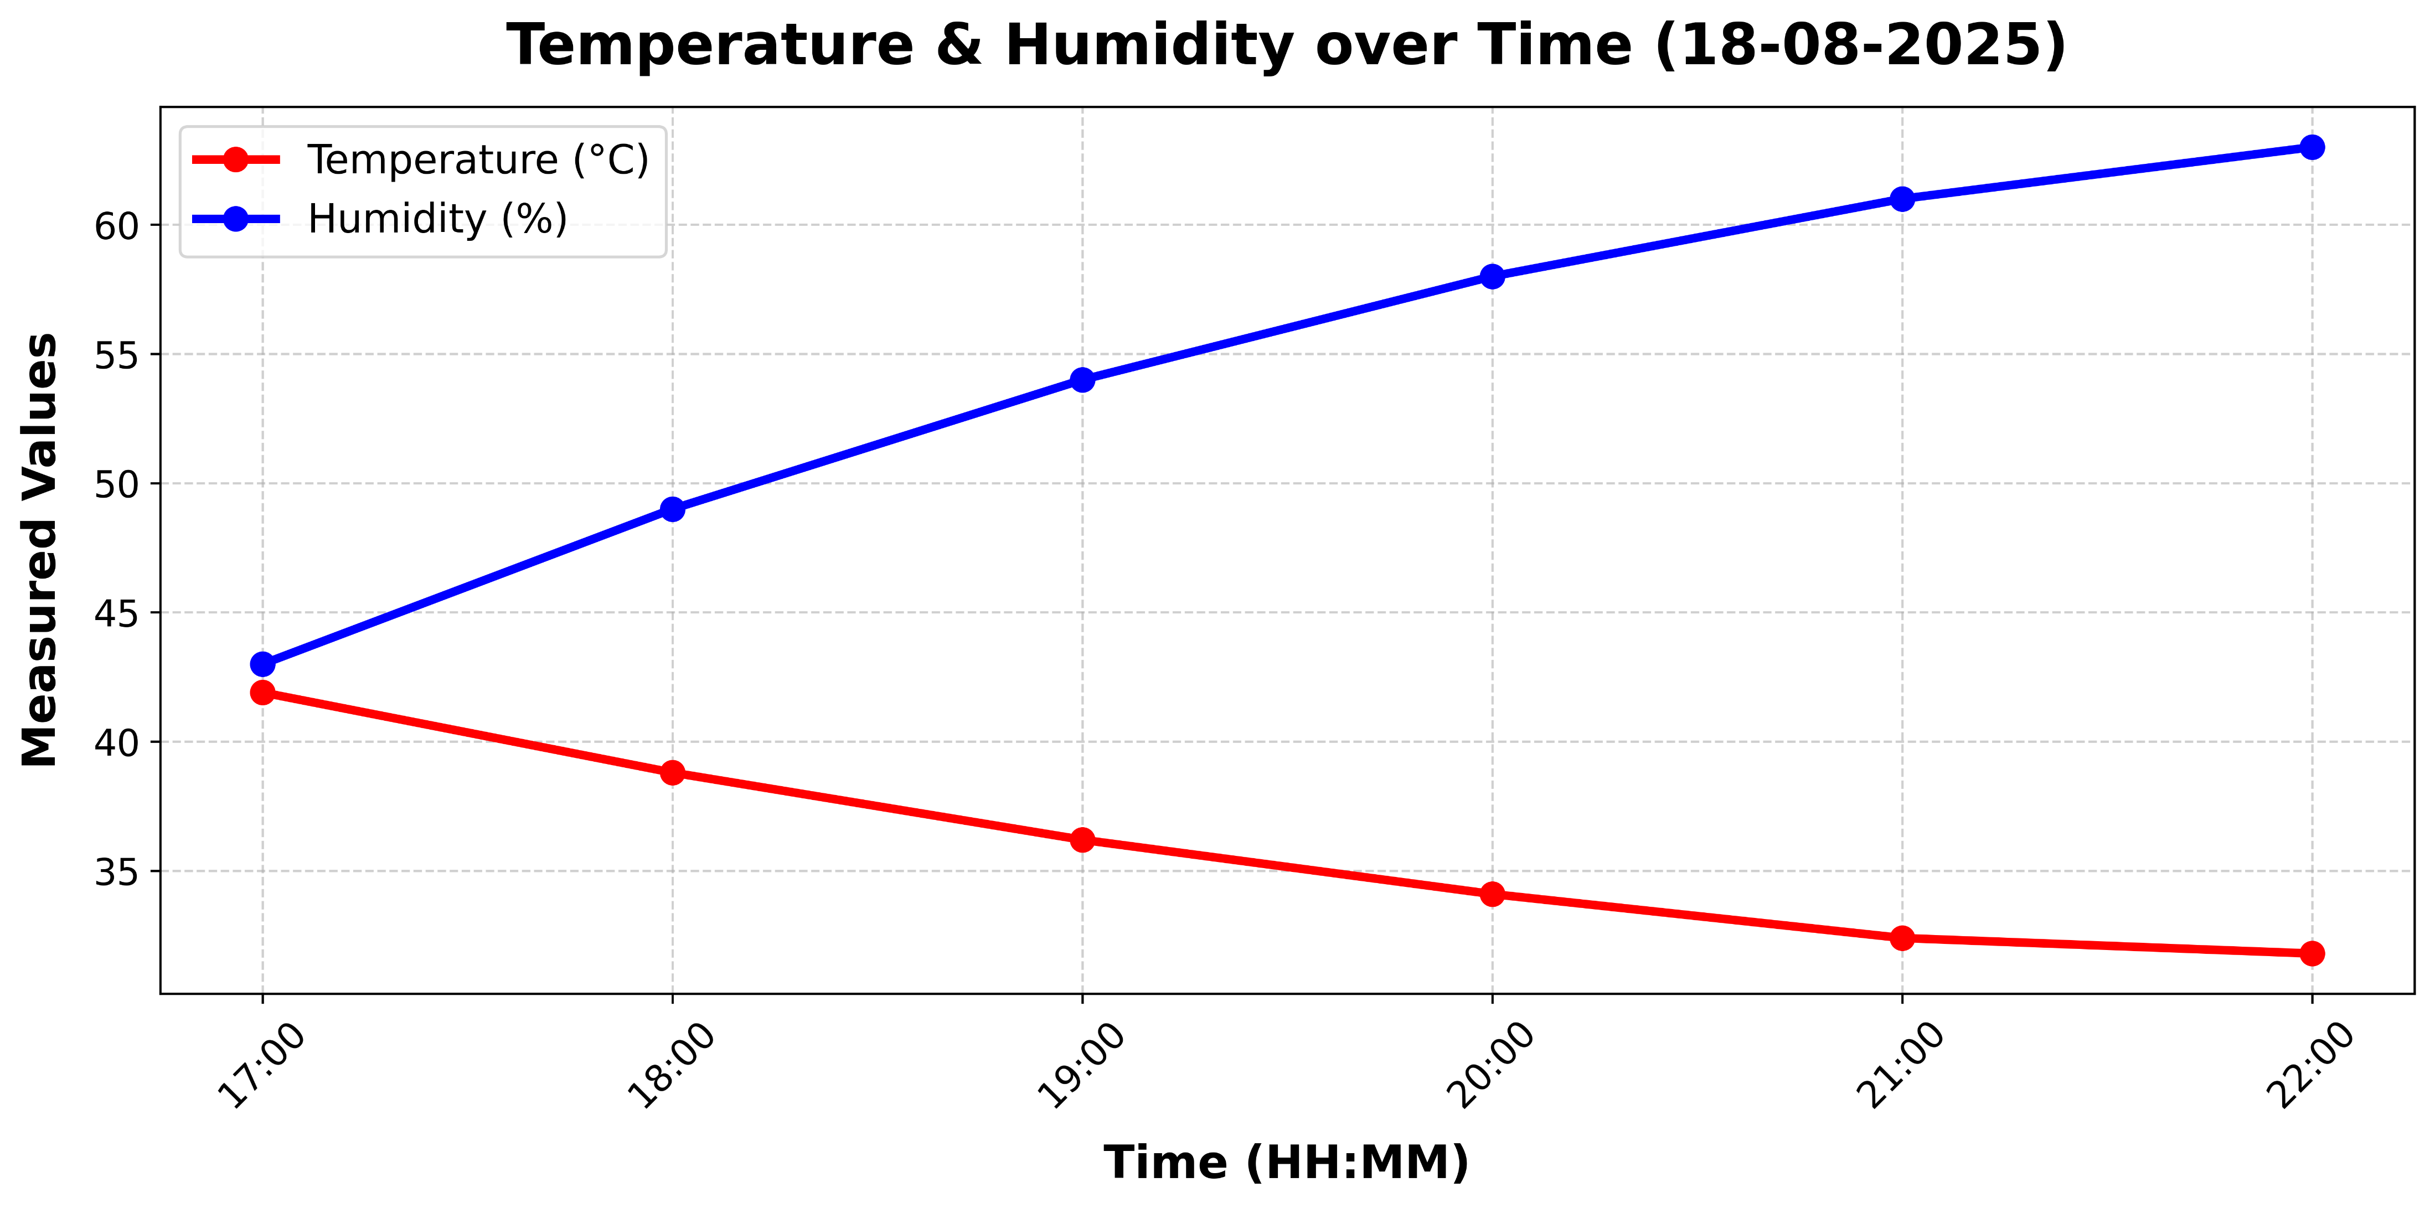
Dense Weather and Air Observation Network
Network of 300 weather stations
  40 turn-key stations
  260 stations built in-house

Slide 24

Aiming for a Rebound?
Modeling links between healthcare and other systems
  Land use and urban planning
  Climate Drivers
  All forms of access
Planning for future systems jointly considering uncertainty
Source: Eisenberg et al. (2025)

Slide 25
References
Aydin, O. (2023). Graph Neural Network Double Q-Learning for Road Network Resilience Planning Under Climate Change-Induced Flooding Events. In AGU Fall Meeting Abstracts (Vol. 2023, No. 7, pp. IN53D-07).
Aydin, O. (2023). Deep Q-Learning Framework for Quantitative Climate Change Adaptation Policy for Florida Road Network due to Extreme Precipitation.
Aydin, O., & Kanwar, V. (2024, December). Stochastic Superresolution Modeling of Urban Heat Islands Using Generative Diffusion Models Under Built Environment Constraints. In AGU Fall Meeting Abstracts (Vol. 2024, No. 3, pp. GC23D-03).
Eisenberg, Daniel A., Thomas P. Seager, and David L. Alderson. "The rebound curve is a poor model of resilience." PNAS nexus 4, no. 3 (2025): pgaf052.
Gasparrini, A., Guo, Y., Hashizume, M., et al. (2015). Mortality risk attributable to high and low ambient temperature: A multicountry observational study. The Lancet, 386(9991), 369-375. https://doi.org/10.1016/S0140-6736(14)62114-0

