Slide 1


Evidence to policy pathways:
How embeddedness has influenced policy & practice in Kenya
Science of Health Systems Conference
Jacinta Nzinga
29 Oct 2025

Slide 2
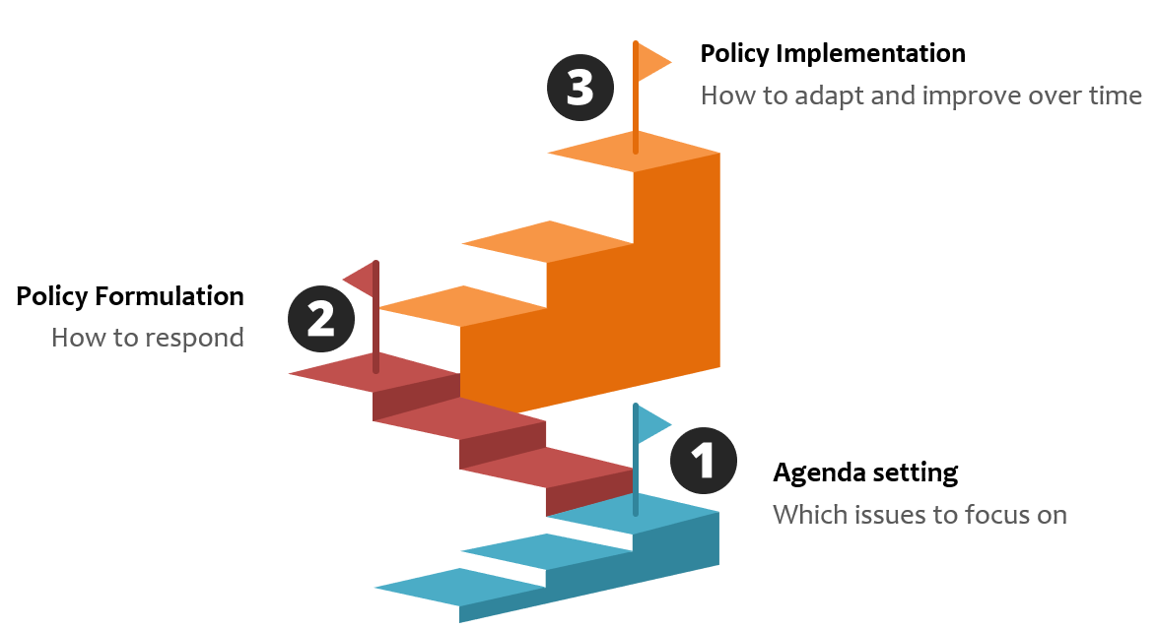
Policy Engagement Arenas
International Level
National Level
Sub-national level
Organizational level

Slide 3
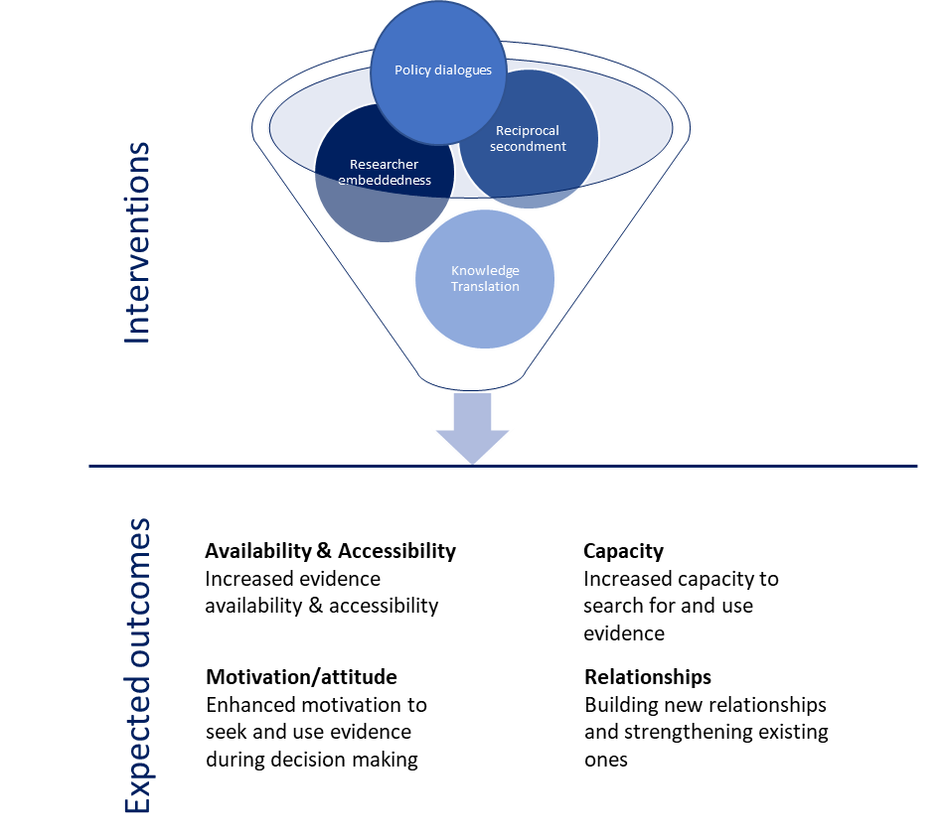

Slide 4
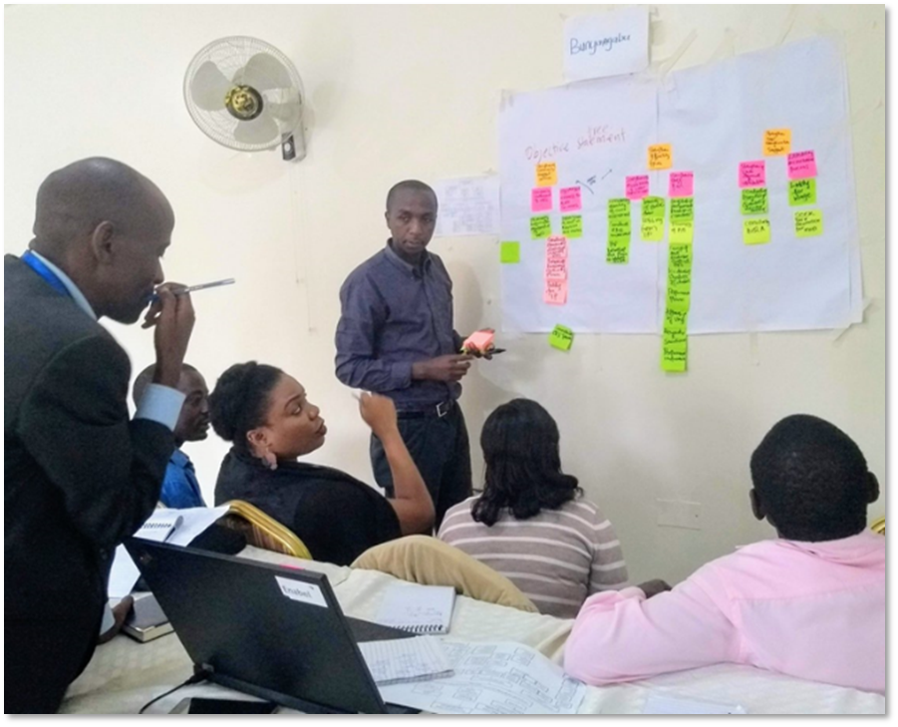
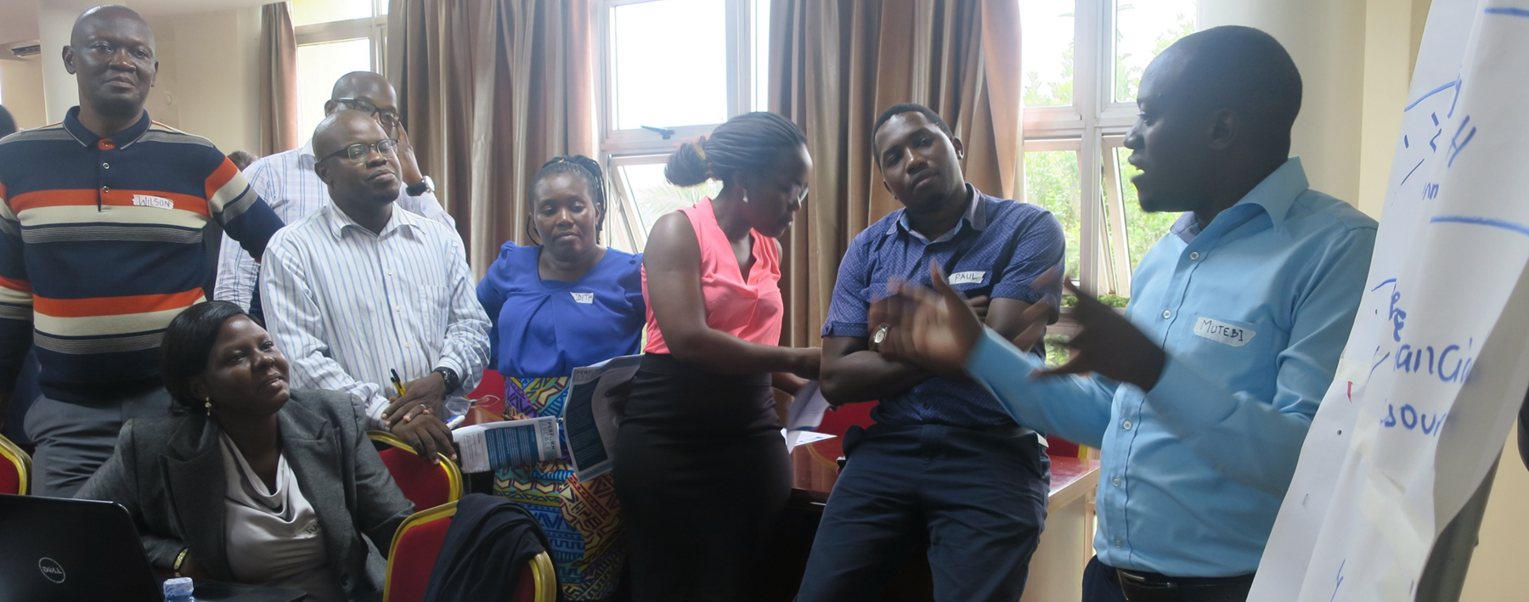
Embedded Across Levels of Health Care;
Co-creation of Research Questions
Notes:
A unique feature of our research, framed broadly as system thinking, is that we are embedded across the levels of health care in Kenya. Being such embedded provided unique for co-creating our research questions with health care managers and policy makers, and increasing the relevance of the research we do, and the potential for uptake as you will hear some of the presentations today.

Slide 6





Nurturing Relationships| Continuous Engagement
Policy-makers at global, national and sub-national level
Public/community
Clinicians
Researchers
Regulators, Unions, associations etc.
Media
Notes:
Funders, unions, partners

Slide 7







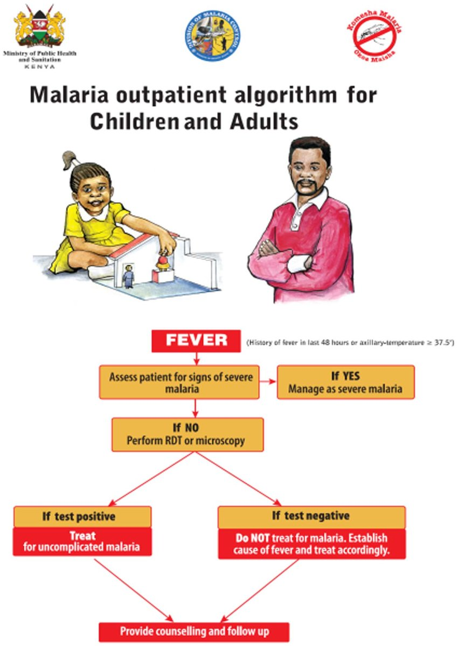
Influencing Clinical Practice
Impact on Policy and Practice

Slide 8
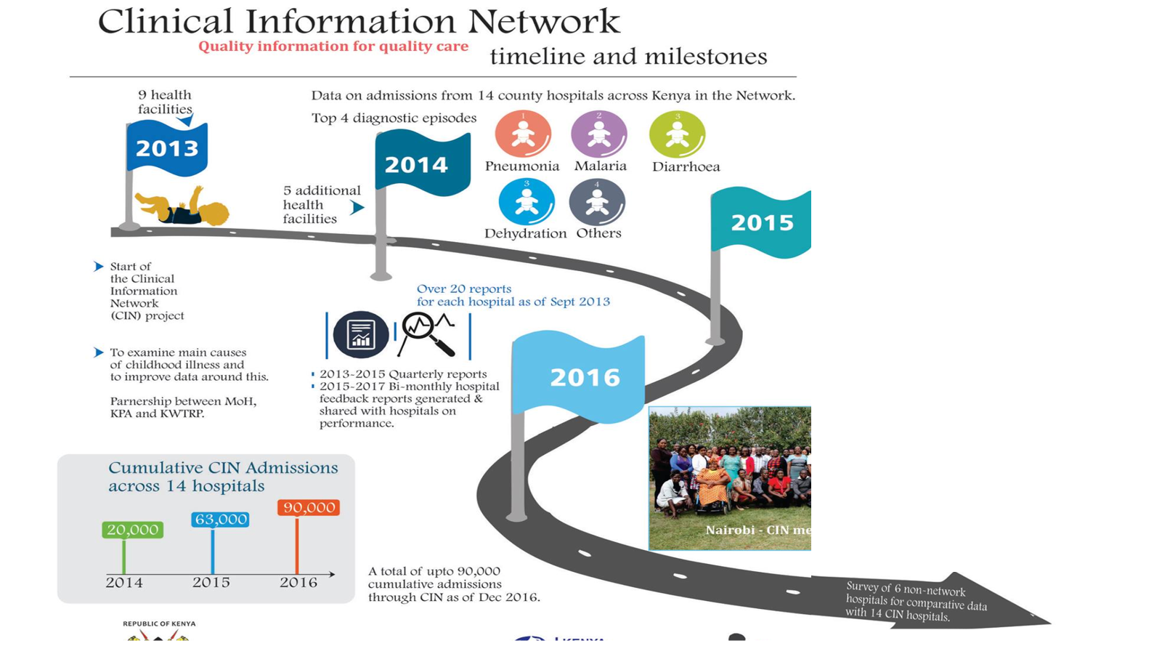

Slide 9
Influencing sub-national Policy & Practice

Slide 10


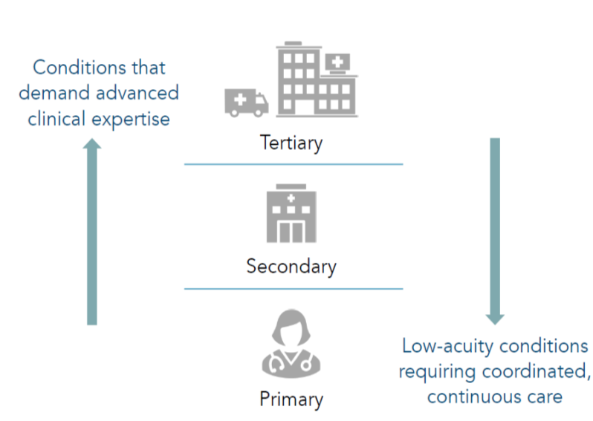
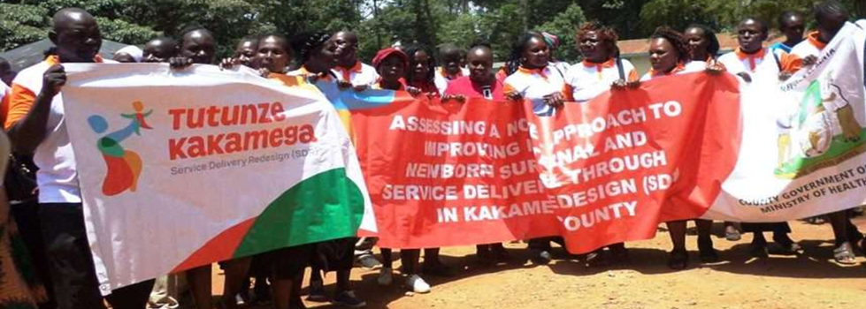

MNH redesign: Service Delivery Redesign in Kakamega Kenya

Slide 11
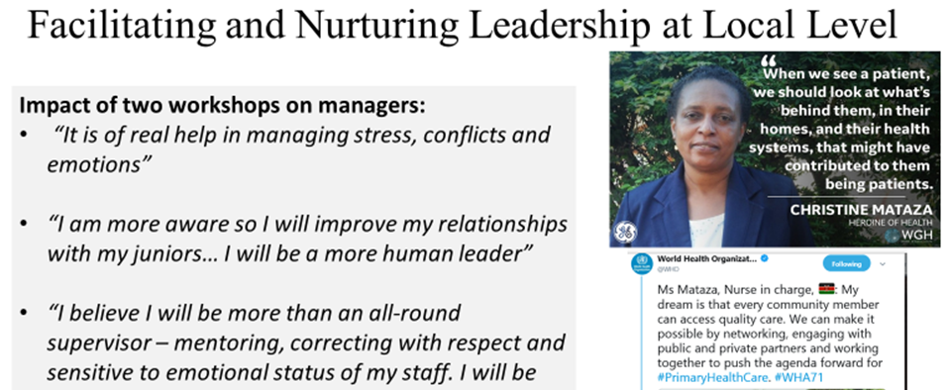
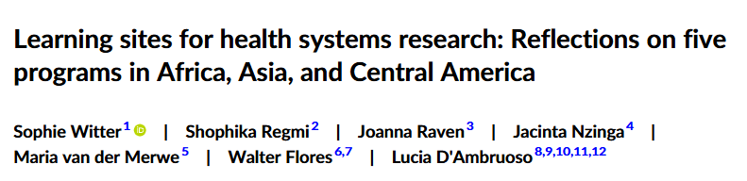
The Learning Sites Approach
Notes:
Required carefully preparation from research Team –had positive impact on team work at least at sub-county lelve but difficult to know; policy brief also used directly and indirectly in other levels/interactions as per embeddedness map

Slide 12

An Example of Impact:
Reforming the NHIF in Kenya

Slide 13
Informing the COVID-19 Response

Slide 14
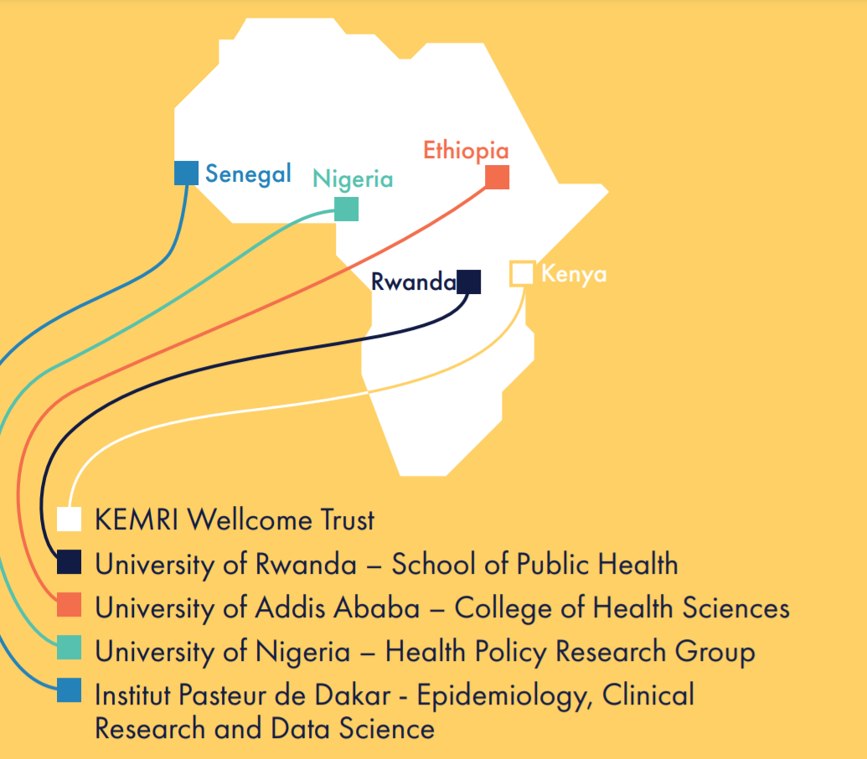
Knowledge Translation: Africa Health Observatory
https://ahop.aho.afro.who.int/

Slide 15
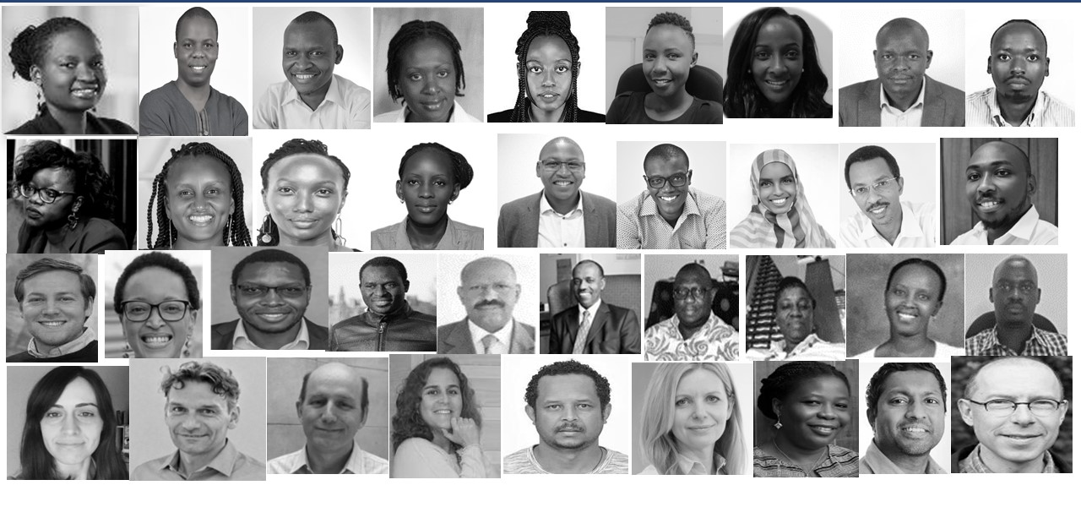
With the collaboration and support of …

