Slide 1
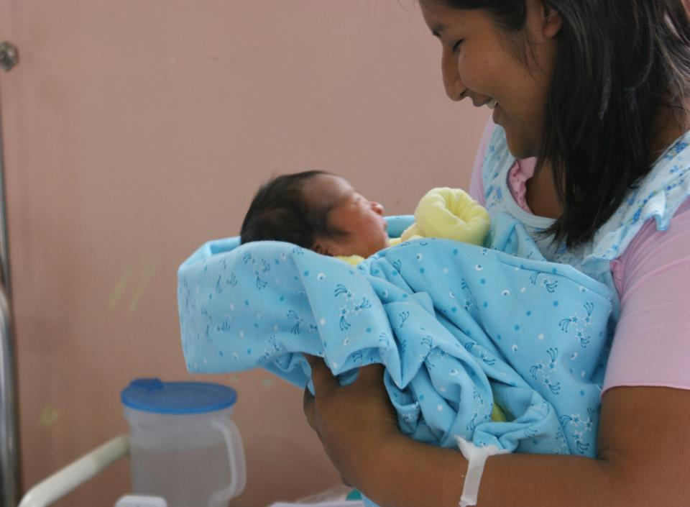
Maternal Health
In Peru :
-2000: 185 maternal deaths/100,000 live births
-Much higher in rural areas
-Use of care facilities was low
-What is wrong and what
could be done?

Slide 2
Institutional deliveries in rural áreas Peru
% of institutional deliveries in rural areas (per 100 000 live births)
23% Jungle

Slide 3
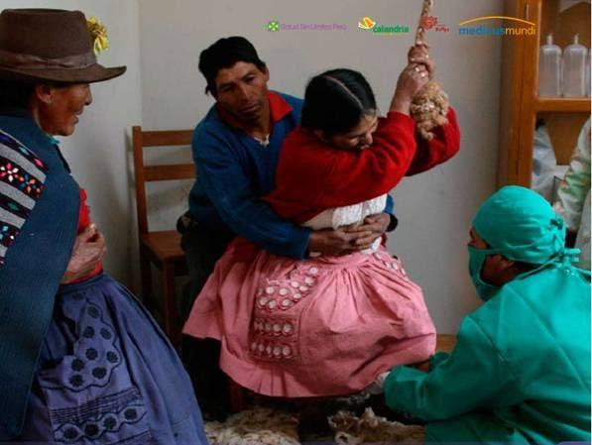
Vertical Delivery

Slide 4
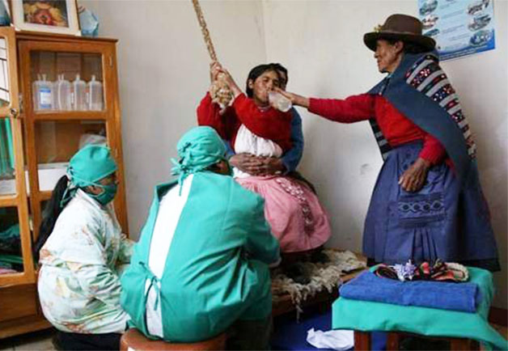
Cultural adaptation of birthing services: Vertical Delivery

Slide 5
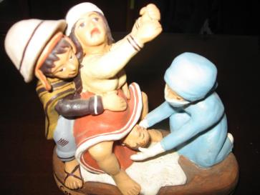
Institutional deliveries in rural áreas Peru
% of institutional deliveries in rural areas (per 100 000 live births)
National guidelines for cultural adaptation of birthing services: Vertical Delivery

Slide 6
Institutional deliveries in rural áreas Peru
% of institutional deliveries in rural areas (per 100 000 live births)
Cultural adaptation of birthing services: Vertical Delivery
Jungle
69 deaths/100,000

Slide 7
Why do we think we were able to go from research to policy, our top ten…
1.Engagement of stakeholders as peers, from the beginning and during all the study phases (ownership of the agenda!!!)
2.Sharing results, helping with interpretations and discuss together actions (at different levels)
3.Use clear but compelling messages
4.Identify champions
5.Train and offer technical assistance
6.Positive feedback: give and receive
7.Involve other partners (NGO’s, agencies, community)
8.Leverage results
9.Have a user friendly cost-effectiveness analysis
10.Keep motivation high!!!

