Slide 1
Digital health registries for maternal and child health
State of the science: innovations in measurement methods
Mahima Venkateswaran
30. October 2025

Slide 2
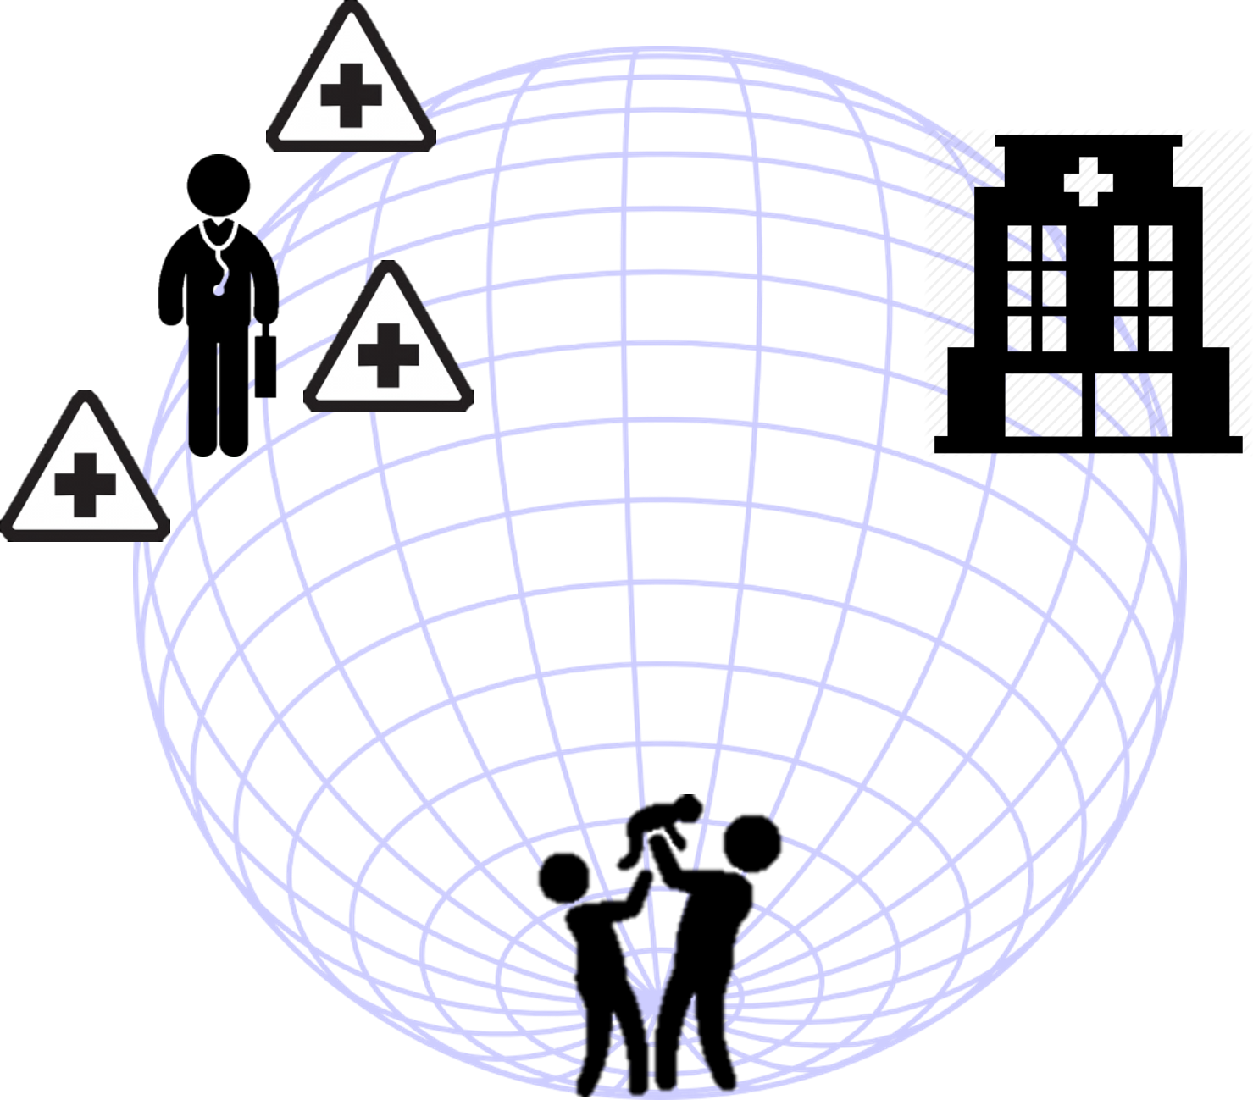
eRegistries
Digital health registries for maternal and child health
Uniform individual level longitudinal data, digitized at the point of generation,​​ exchanged seamlessly at all levels of the health system,​​ to support the care provider, the clients, and the routine reporting needs
eRegistries combine public health and digital health contexts
Frøen, J. F., et al. (2016). "eRegistries: Electronic registries for maternal and child health." BMC Pregnancy and Childbirth 16(1): 11.
Notes:
Public health and clinical care cannot be delivered safely, with high quality, and in a cost-effective manner, without seamless, sustainable, and secure data and information exchanges at all levels of the health system - WHO, World Bank, USAID 2015​
WHO guidelines recommendations on digital health interventions for health systems strengthening and WHO’s Digital Adaptation Kit for ANC

Slide 3
Background
Digital health registries for maternal and child health
The goal of the eRegistries initiative is to identify and test methods of establishing a registry of pregnancies in resource-limited settings
Simultaneously – address challenges in the health system and health information system:
  Poor guideline adherence → poor quality of care
  Paper-based records and repetitive documentation → inefficiency, poor data quality
  Limited integration of data with care workflows → overburdened health workers

Slide 4
Operationalizing eRegistries
Individual client-level data
A single digitized health record drives many digital health interventions
eRegistries: Digital Health Interventions for health system strengthening
For healthcare providers
Clinical decision support
Referral coordination
Client identification and registration
Clients
Targeted Client Communication
Health system managers
High-quality, actionable, real-time data
Policy makers
A system based on national policy, sound governance, data privacy, confidentiality

Slide 5
Case studies – cluster randomized controlled trials
cRCT of effectiveness of eRegistries
Bangladesh (eRegMat)
West Bank (eRegQual)
cRCT of effectiveness of interventions delivered through eRegistries
Uganda (eReg4ANC8)
Ethiopia (ENABLE)

Slide 6
Study setting and eRegistry implementation
Cluster-randomized controlled trials
Bangladesh
One district (n= 59 health facilities)
DHIS2 v2.29 + eReg web app + custom Android app
West Bank
5 districts (n= 120 health facilities)
DHIS2 branch v2.29 -> v2.34.6, + eReg web app
Uganda
One district (n= 34 health facilities)
DHIS2 Web v2.40.4.1 + Android v2. 9.1.1
Ethiopia
4 cities (n= 75 health facilities)
Improve existing EMR system in 1 city & DHIS2 Tracker in 3 cities
DHIS2 Web v2.41.3.1 + Android v2. 9.1.1

Slide 7
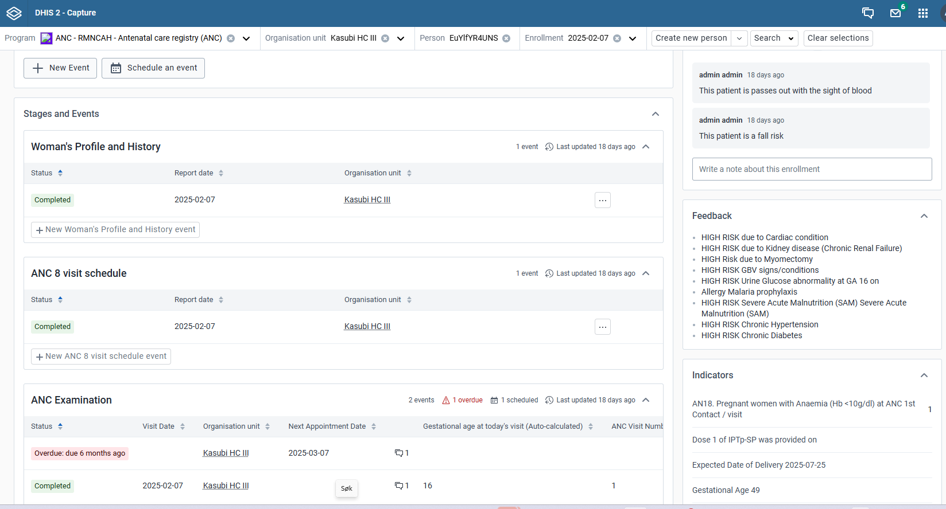

Slide 8
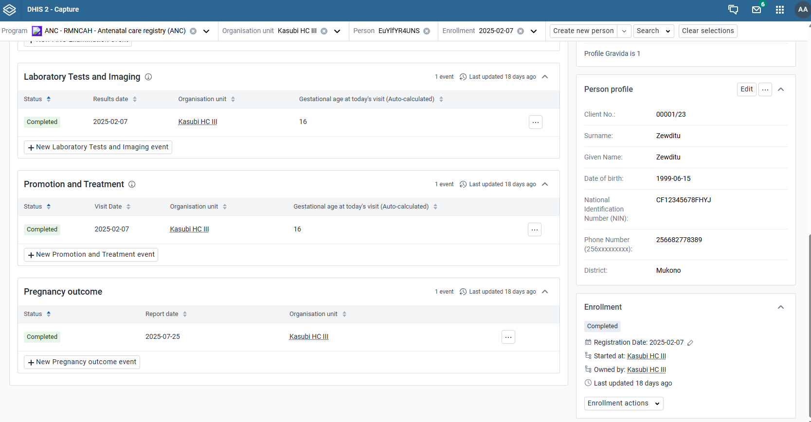

Slide 9
Population, Intervention, Comparator (PICO)
Population
  Pregnant women
Intervention and control
  West Bank:
    eRegistry with clinical decision support vs. Paper-based records
    eRegistry vs. eRegistry with SMS vs. eRegistry with feedback dashboards vs. eRegistry with both
  Bangladesh:
    eRegistry with digital health interventions (SMS, clinical decision support, feedback dashboards) vs. simple digital data collection tool

Slide 10
And Outcomes (PICO)
Quality of care/process outcomes
  Timely and appropriate screening and management of anemia, diabetes, hypertension during pregnancy
  For example: anemia screening at first ANC visit, at 24-28 weeks and 36 weeks, AND appropriate actions if anemia present
Health outcomes:
  Adverse pregnancy outcomes
All outcome data were derived from the health information system
A household survey was conducted only for those that were lost to follow-up

Slide 11
Results - eRegQual trial (West Bank)
Cluster randomized controlled trials
eRegistry clinics
Non-eRegistry clinics
Odds ratio (95% CI):
1.45 (1.14-1.83)
Odds ratio (95% CI):
0.99 (0.87-1.12)
Non-eRegistry clinics
21.9%
eRegistry clinics
21.7%
Odds ratio (95% CI):
1.88 (1.52-2.32)
Adverse pregnancy outcomes
Process outcomes of quality of care
Venkateswaran, M., et al. (2022). A digital health registry with clinical decision support for improving quality of antenatal care in Palestine (eRegQual): a pragmatic, cluster-randomised, controlled, superiority trial.
The Lancet Digital Health 4(2): e126-e136.

Slide 12
Results – eRegMat trial (Bangladesh)
Cluster randomized controlled trials
Outcome | Control group | Intervention group | Adj. RR | 95% Interval
Timely attendance at eligible ANC visit | 1022/2533 (40.3%) | 1158/2723 (42.5%) | 0.96 | [0.89 | 1.05]
Timely first ANC visit | 252/445 (56.6%) | 188/348 (54.0%) | 0.97 | [0.84 | 1.11]
Facility delivery | 93/124 (75.0%) | 61/77 (79.2%) | 0.95 | [0.82 | 1.11]
Perinatal mortality and severe perinatal morbidities | 136/934 (14.6%) | 131/874 (15.0%) | 0.74 | [0.58 | 0.96]
Venkateswaran, M., et al. (2024). "eRegMat – a digital registry for improved quality of antenatal care: a cluster-randomized trial in a rural area in Bangladesh." BMC Digital Health 2(1): 5.

Slide 13

Interventions delivered through eRegistries
Ethiopia (ENABLE)
  Goal: address NCD risk factors in pregnant women in urban Ethiopia through an eRegistry + implementation strategies
  Status: trial yet to start recruitment
Uganda (eReg4ANC8)
  Goal: double the number of ANC contacts through an eRegistry + implementation strategies
  Status: trial ongoing

Slide 14
Lessons learnt
Clinical trials can be conducted within health information systems
  Reduces cost and burden of data collection if all data collected within the health system
Provide evidence for optimizing care processes without lag time
Enables faster, scalable evidence generation
Requires large, up-front investments of resources and effort
Requires strong stakeholder buy-in
Integration in existing health information systems is critical for sustainable use, e.g., automated routine reporting

Slide 15



Thank You
University of Bergen
University of Oslo
Makerere University School of Public Health
Uganda National Institute of Public Health
Ethiopian Public Health Institute
Health Information System Programs (HISP)
Ministries of Health
can
Views and opinions expressed are however those of the author(s) only and do not necessarily reflect those of the European Union or the Health and Digital Executive Agency. Neither the European Union nor the granting authority can be held responsible for them.

