Slide 1







Improving health system performance at scale in Latin America:
Lessons from Salud Mesoamerica Initiative
Pedro Bernal
Senior Health Economist
Health, Nutrition and Population Division, IDB
Emma Margarita Iriarte
Principal Sector Specialist
Executive Secretary of SMI and RMEI Initiatives
Health, Nutrition and Population Division, IDB
Wolfgang Munar
Director, Gill-Lebovic Center for the Caribbean and Latin America and Associate Professor
George Washington University

Slide 2





In 2010 countries in Mesoamerica…
…had high coverage of maternal health services
Antenatal care
(regional average)
Institutional delivery
(regional average)
Country-level average
Country-level average
Coverage Antenatal care
Coverage Institutional delivery

Slide 3
In 2010 countries in Mesoamerica…
…yet the poorest municipalities were lagging behind
Antenatal care
(regional average)
Institutional delivery
(regional average)
Country-level average
Country-level average
1.8 million
women and children
Remote
Rural
Low-income
Indigenous
Coverage Antenatal care
Coverage Institutional delivery

Slide 4
In 2010 countries in Mesoamerica…
…yet the poorest municipalities were lagging behind
Antenatal care
(regional average)
Large gaps in coverage
Institutional delivery
(regional average)
Country-level average
Coverage gap
32 pp
Country-level average
Coverage gap
32 pp
Poorest
municipalities
Poorest
municipalities
Coverage Antenatal care
Coverage Institutional delivery

Slide 5
In 2010 countries in Mesoamerica…
…yet the poorest municipalities were lagging behind
Antenatal care
(regional average)
Large gaps in coverage
Institutional delivery
(regional average)
Low quality of care
Country-level average
Coverage gap
32 pp
Country-level average
Coverage gap
32 pp
Poorest
municipalities
?
?
Poorest
municipalities
Coverage Antenatal care
Quality
Antenatal care |
At least 1 visit
Coverage Institutional delivery

Slide 6


In 2010 countries in Mesoamerica…
…the poorest had worse health outcomes
2x more children died in the poorest regions relative to the regional average
1.4x higher maternal mortality in the poorest regions
These deaths are largely preventable

Slide 7


How can health systems provide quality care consistently and on time for the most vulnerable populations?
How to do this in multiple countries with distinct contexts and health systems?

Slide 8
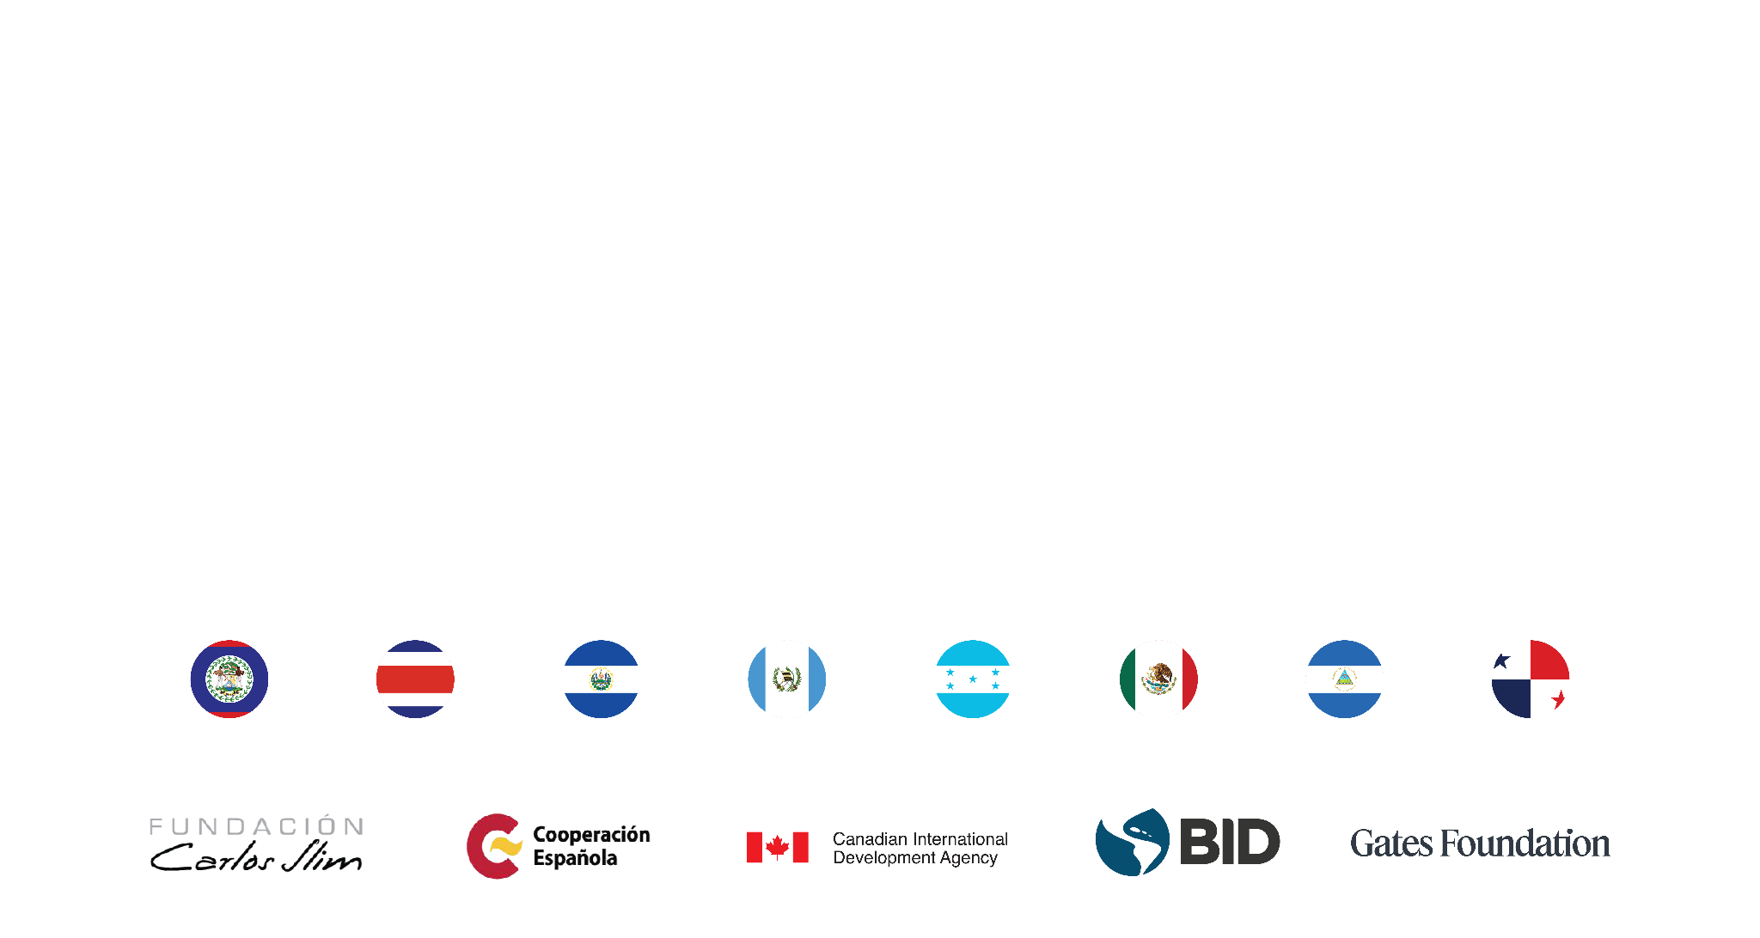
In 2010, Salud Mesoamerica Initiative is established
to reduce inequities in maternal and child health services
An innovative public-private partnership

Slide 9




Salud Mesoamerica / Key elements
Results-based financing for Ministers of Health (MoH)
A systems approach to implement cost-effective interventions
Collaborative rapid learning cycles at all levels
Equity lens focus on the 20% poorest municipalities

Slide 10






Salud Mesoamerica Initiative – Phases
System Readiness
1st Phase
Coverage & Quality
2nd Phase
Coverage & Quality
3rd Phase
Inputs
Clinical guidelines
Timeliness
Coverage
Quality
Timeliness
Coverage
Quality
2012
2015
2018
2022
2025
COVID-19
Baseline surveys*
1st Follow-up surveys*
2nd Follow-up surveys*
3rd Follow-up surveys*
4 countries
GU, MX, CR, PN
4 countries
BZ, ES, HO, NI
*
Countries with comparison group in surveys
Household surveys
Medical record review
Facility Surveys

Slide 11

After more than 10 years…
…countries have improved the coverage and quality of key maternal and neonatal health services among the poorest in Mesoamerica
…with a relatively modest investment
150 million in 10 years for 8 countries
(<1.5% of public health budgets)
NORC (2025)-Final Evaluation of SMI

Slide 12





Sources of evidence
Population coverage
Adherence to guidelines
Progress
51,000
24,000
3 rounds of independent measurement over 10 years
8 countries
Household surveys
Medical records
Attribution
3 impact evaluations of SMI model in 6 countries (DID)
4 impact evaluations of innovations in 3 countries (3 RCTs & 1 DID)
Contribution
264
Need to go beyond impact…to understand mechanisms
4 theory-based process evaluation covering distinct phases in 6 countries
Interviews

Slide 13
Average progress in SMI targeted areas
En base a encuesta de hogares en países con grupo de comparación
Progress
Average in SMI targeted areas at baseline and last phase
Based on household surveys and medical record reviews in countries with comparison group
Antenatal care
63%
86%
Country average
Baseline
Last phase
Gaps in coverage were reduced
| at least 1 visit
53%
65%
Country average
Coverage institutional delivery
Baseline
Last phase
Quality care for common
neonatal complications
Notes: NORC (2025). Final Evaluation of the Salud Mesoamerica Initiative. All estimates based on data from household surveys except quality of care of neonatal complications which are based on medical record reviews. Average are across the 4 countries with a comparison group by design (GU, MX, HO, NI) in SMI targeted municipalities. GU and MX had just two phases, whereas HO and NI had three phases, the end point in the graph represents the average of the last phase in each country.

Slide 14
Progress
Average in SMI targeted areas at baseline and last phase
Based on household surveys and medical record reviews in countries with comparison group
Antenatal care
63%
86%
Country average
Gaps in coverage were reduced
56%
69%
Baseline
Last phase
Quality of care increased
| at least 1 visit
53%
65%
Country average
Coverage institutional delivery
Quality care for common
neonatal complications
22%
46%
Baseline
Last phase
Notes: NORC (2025). Final Evaluation of the Salud Mesoamerica Initiative. All estimates based on data from household surveys except quality of care of neonatal complications which are based on medical record reviews. Average are across the 4 countries with a comparison group by design (GU, MX, HO, NI) in SMI targeted municipalities. GU and MX had just two phases, whereas HO and NI had three phases, the end point in the graph represents the average of the last phase in each country.

Slide 15
Impact in coverage and quality
Average SMI effect at end of 2nd phase
Based on household surveys and medical record reviews in countries with comparison group
Antenatal care
Coverage antenatal care
Baseline average
SMI effect
SMI had effects on both coverage and quality of care
Quality antenatal care
| at least 1 visit
Institutional delivery
Quality of care for common neonatal complications
Notes: NORC (2025). Final Evaluation of the Salud Mesoamerica Initiative. All estimates based on DID using data for household surveys. Estimates for quality of neonatal complications are based on medical record reviews. The estimates are the average effect across the 4 countries with a comparison group by design (GU, MX, HO, NI).

Slide 16

Impact in coverage and quality
Average quality of care for common neonatal complications in SMI targeted facilities
Based on medical record reviews in countries with three phases
Despite COVID-19, countries overall maintained or improved quality of care
NORC (2025)-Final Evaluation of SMI
COVID-19
Notes: NORC. 2025. Final Evaluation of the Salud Mesoamerica Initiative. Data based on medical record reviews on countries with three phases, which are NI, HO and BZ.

Slide 17

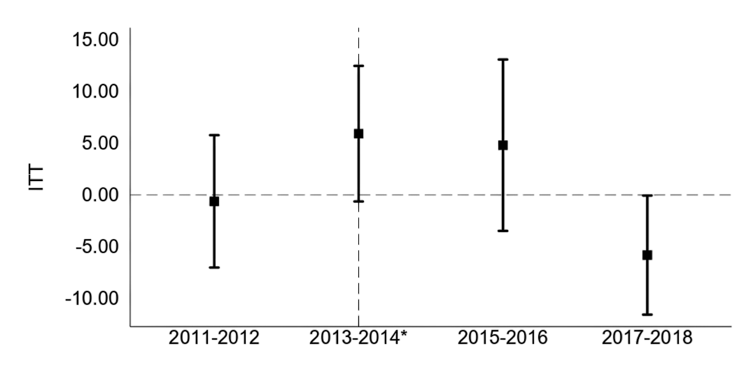
Impact in health
Isolated interventions are not enough to improve health
In Nicaragua neonatal mortality was reduced in remote areas by addressing supply and demand issues
Effect of transportation vouchers
on neonatal mortality
Based on a RCT in Nicaragua
Transportation vouchers for institutional delivery and maternal care
In-facility neonatal quality of care improved
Notes: Bancalari et al. 2024. Using Subsidies to Enhance Access to Maternal and Newborn Health Care in Remote Villages.

Slide 18
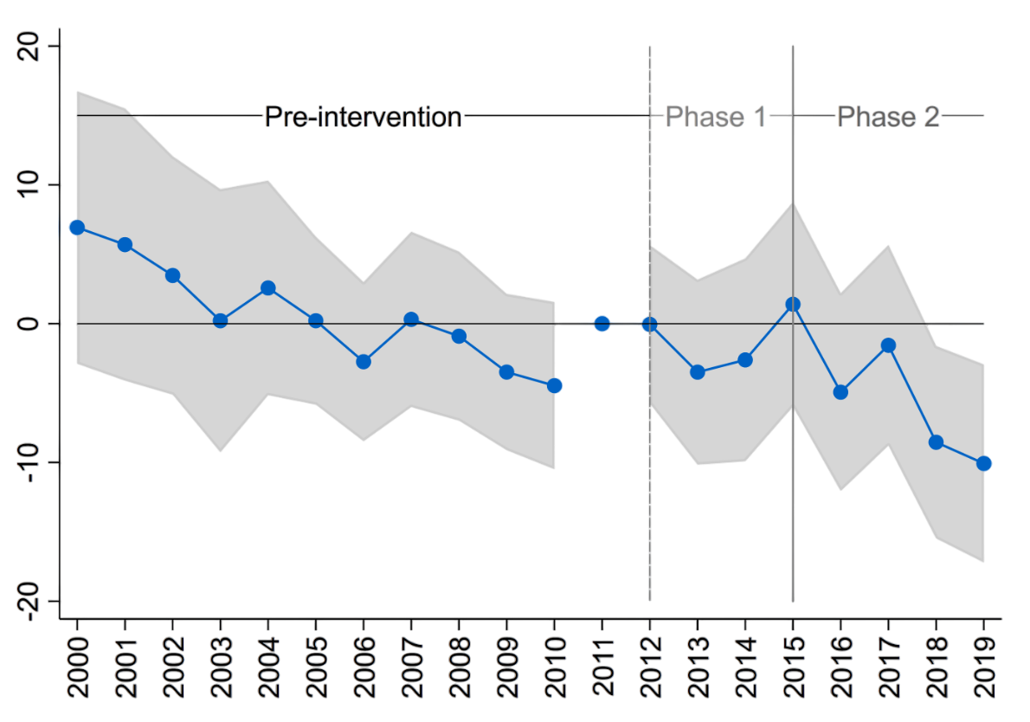
Impact in health
Effect of SMI on adolescent fertility in Costa Rica
Estimates based on a DID impact evaluation using administrative data
With SMI Costa Rica reduced adolescent fertility by 11.3% in the poorest districts
Co-creating and implementing a comprehensive intersectoral model of care
Pre-trends p-value=[0.57]
Avg. effect
-2.17
p-value=[0.36]
Avg. effect
-5.14*
p-value=[0.07]
Notes: Bernal et al 2024. This figure plots the coefficients of the interaction between each year and an indicator for treatment status. The shaded area around each coefficient is the 95% confidence interval. The reference year is 2011, the last pre-intervention year. Since it is the reference year, it is normalized to zero and no confidence intervals can be calculated for this year. The comparison group is composed of districts with similar poverty levels outside the treated regions. The pre-trends p-value refers to an F-test of joint significance of all pre-treatment interactions. Adolescents’ fertility refers to that of women 10 to 19 years old.

Slide 19



Key mechanisms for results based on process evaluations
Getting the system ready was crucial to create foundational structures
NORC (2025), Eichler et al (2015)
RBF incentives played a crucial role for buy-in and coordination,
but sense of accomplishment and reputation became primary drivers as SMI progressed
NORC (2025), El Bcheraoui et al (2016), Munar et al (2017)
A distinct technical assistance was key to transform targets into results
NORC (2025), El Bcheraoui et al (2016)
The democratization of learning and accountability were key to transform national incentives into local results
NORC (2025), Munar et al (2017), Aranda et al (2023)

Slide 20
How did SMI achieve these results…
…with the existing system and teams?
…with the existing conditions?
…with modest investment?

Slide 21
How did SMI achieve these results…
…with the existing system and teams?
…with the existing conditions?
…with modest investment?
By changing the way of thinking and doing…
…using a systems approach towards results

Slide 22

Three questions
What is the systems approach towards results we used?
What roadmap we used to operationalize it?
What are the lessons for our work?

Slide 23

Systems approach towards results

Slide 24

To address population needs, we need a systems approach
If I arrive, will I be attended quickly and treated well?
Will they fix my problem?
Quality of Care
Better Health Outcomes- Impact
What will I do if they charge me?
Efficiency
Use and Coverage
Will I be able to get to the hospital?

Slide 25
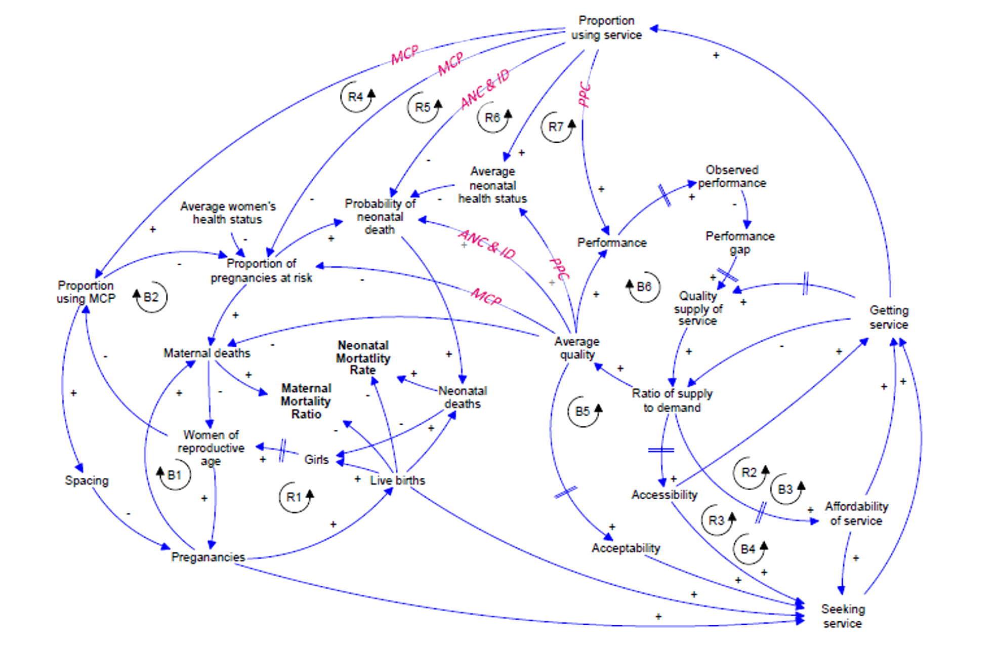
Traditional approach Vs. Systems approach
Linear cause-effect thinking
Systems thinking
Where are the key leverage points for results?
What are the key feedback mechanisms?
Access to Care
Proportion using MCP
Women’s Health Status
Maternal Deaths
Access to Health Services
Quality of Supply
Accessibility

Slide 26


To achieve results, program theory needs to go beyond inputs to focus on processes, management and culture
Health system inputs
Health system processes
Health system performance indicators
individual changes
Service delivery and interventions
Leadership and governance
Commodities
Financing
Information
Human resources
Community
Management practices
Healthcare quality
Better health outcomes
>Efficiency
Organizational Culture
System performance
Motivation
Healthcare coverage
Processes, flows and procedures
Individual needs and values
collective & changes
Black Box
How does the system produce impact?
SMI Catalysts
RBF model
Measurement
Learning and adapting

Slide 27

Roadmap
Systems approach towards results

Slide 28










1
3
5
BUILDING A SHARED VISION
REDESIGN AND OPTIMIZE SERVICE DELIVERY
SUSTAIN POLICIES, FINANCING, AND CAPACITIES
Systems approach
towards results
The Roadmap
Align all stakeholders around common goals
Redesign service delivery, organization, and management to achieve results
Develop capacity to scale and sustain
2
4
GOVERNANCE
IMPLEMENT, ITERATE, LEARN, AND SCALE
Leadership to share the vision and mutual accountability
Data and organizational structures to iterate, learn and adapt at different levels

Slide 29


1
3
5
BUILDING A SHARED VISION
REDESIGN AND OPTIMIZE SERVICE DELIVERY
SUSTAIN POLICIES, FINANCING, AND CAPACITIES
Systems approach
towards results
The Roadmap
Align all stakeholders around common goals
Redesign service delivery, organization, and management to achieve results
Develop capacity to scale and sustain
2
4
GOVERNANCE
IMPLEMENT, ITERATE, LEARN, AND SCALE
Leadership to share the vision and mutual accountability
Data and organizational structures to iterate, learn and adapt at different levels

Slide 30

Salud Mesoamerica Performance Framework
1
SHARED VISION
Impact
Neonatal Deaths
Newborns with complications (prematurity, low birth weight, asphyxia, or sepsis) managed according to quality standards
Quality
Women who received their first prenatal check-up before 12 weeks of gestation
Use and Coverage

Slide 31
Salud Mesoamerica Planning and the chain of effects
1
SHARED VISION
Direction of the planning process
SUPPLIES
ACTIVITIES
PRODUCTS
RESULTS
Impact
Direction of the chain of effects

Slide 32

1
Salud Mesoamerica Results-based financing model
SHARED VISION
Operations Funding
Incentive
Donation Funds
National incentive (not provider)
Outcome level targets
10 years - 3 independent target verifications
Country meets targets
50%
50%
Donation Funds
Country Funds
*50%
Donation: US$132m, leveraging US$44m in domestic funds
* 50% of the funds initially
contributed by the country

Slide 33


1
3
5
BUILDING A SHARED VISION
REDESIGN AND OPTIMIZE SERVICE DELIVERY
SUSTAIN POLICIES, FINANCING, AND CAPACITIES
Systems approach
towards results
The Roadmap
Align all stakeholders around common goals
Redesign service delivery, organization, and management to achieve results
Develop capacity to scale and sustain
2
4
GOVERNANCE
IMPLEMENT, ITERATE, LEARN, AND SCALE
Leadership to share the vision and mutual accountability
Data and organizational structures to iterate, learn and adapt at different levels

Slide 34





2
Salud Mesoamerica
Governance
GOVERNANCE
Vision
Clarity on goals
What constitutes success
System perspective
What does it take?
Leadership
Sets direction
Empowers and supports teams
Ensure financial and technical support
Accountability for implementation to the best of everyone’s ability
M&E for learning and adapting

Slide 35


1
3
5
BUILDING A SHARED VISION
REDESIGN AND OPTIMIZE SERVICE DELIVERY
SUSTAIN POLICIES, FINANCING, AND CAPACITIES
Systems approach
towards results
The Roadmap
Align all stakeholders around common goals
Redesign service delivery, organization, and management to achieve results
Develop capacity to scale and sustain
2
4
GOVERNANCE
IMPLEMENT, ITERATE, LEARN, AND SCALE
Leadership to share the vision and mutual accountability
Data and organizational structures to iterate, learn and adapt at different levels

Slide 36
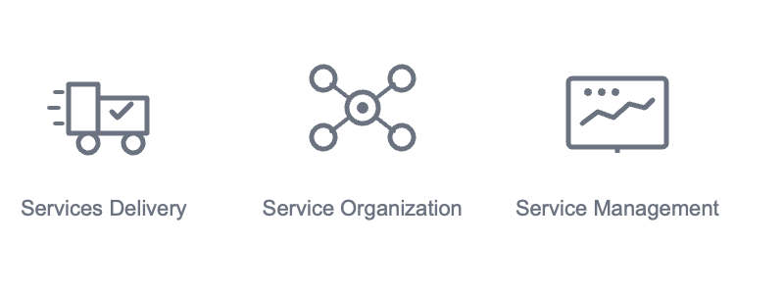
3
Salud Mesoamerica
Redesign of services
SERVICE REDESIGN
Service Delivery
Service Organization
Service Management
What services are provided by level of resolution
How and where care is provided at the point of contact
How services are structured across different levels, locations, and providers
How services are planned, governed, and improved

Slide 37


1
3
5
BUILDING A SHARED VISION
REDESIGN AND OPTIMIZE SERVICE DELIVERY
SUSTAIN POLICIES, FINANCING, AND CAPACITIES
Systems approach
towards results
The Roadmap
Align all stakeholders around common goals
Redesign service delivery, organization, and management to achieve results
Develop capacity to scale and sustain
2
4
GOVERNANCE
IMPLEMENT, ITERATE, LEARN, AND SCALE
Leadership to share the vision and mutual accountability
Data and organizational structures to iterate, learn and adapt at different levels

Slide 38






4
SMI embeds learning and adaptation – Turning evidence into continuous improvement and policy
LEARNING
Measure and verify
Review Diagnose
Rapid Feedback Loops
Joint Performance Reviews Operational Flexibility
Institutionalize
Adapt and implement
Continuous Knowledge Exchange
Share and scale
Learning Informing Policy

Slide 39


1
3
5
BUILDING A SHARED VISION
REDESIGN AND OPTIMIZE SERVICE DELIVERY
SUSTAIN POLICIES, FINANCING, AND CAPACITIES
Systems approach
towards results
The Roadmap
Align all stakeholders around common goals
Redesign service delivery, organization, and management to achieve results
Develop capacity to scale and sustain
2
4
GOVERNANCE
IMPLEMENT, ITERATE, LEARN, AND SCALE
Leadership to share the vision and mutual accountability
Data and organizational structures to iterate, learn and adapt at different levels

Slide 40

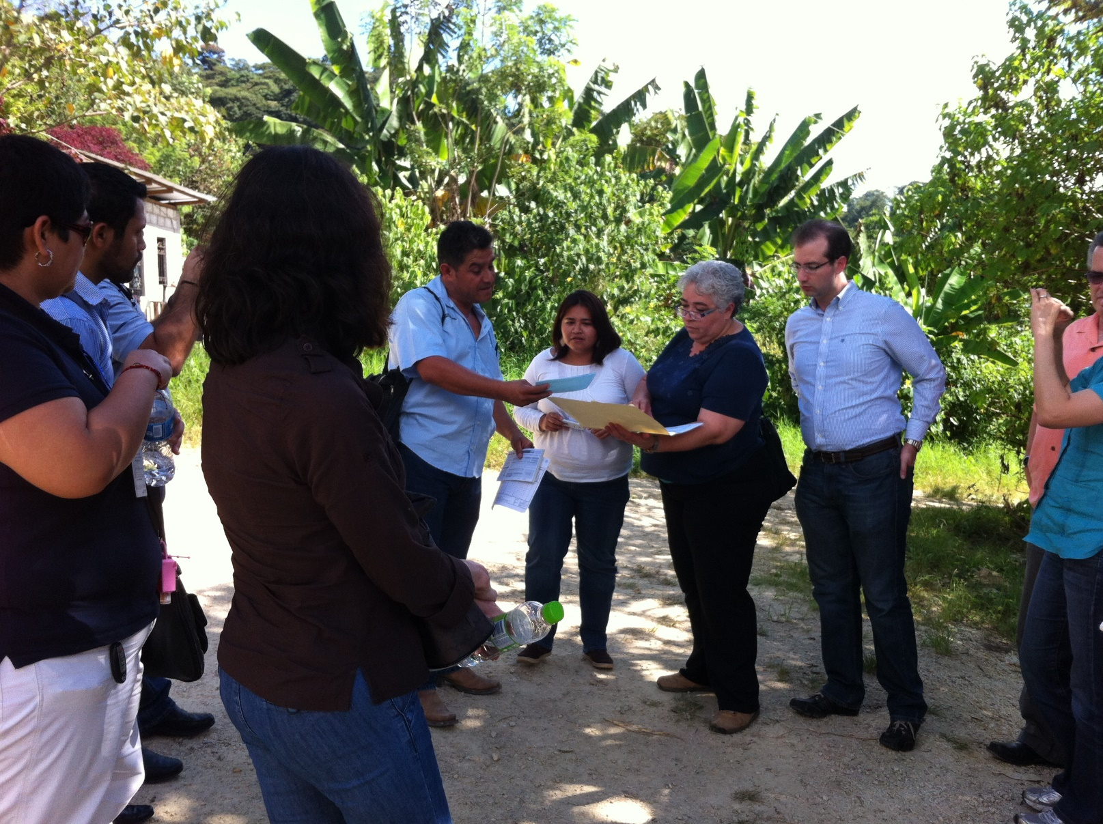
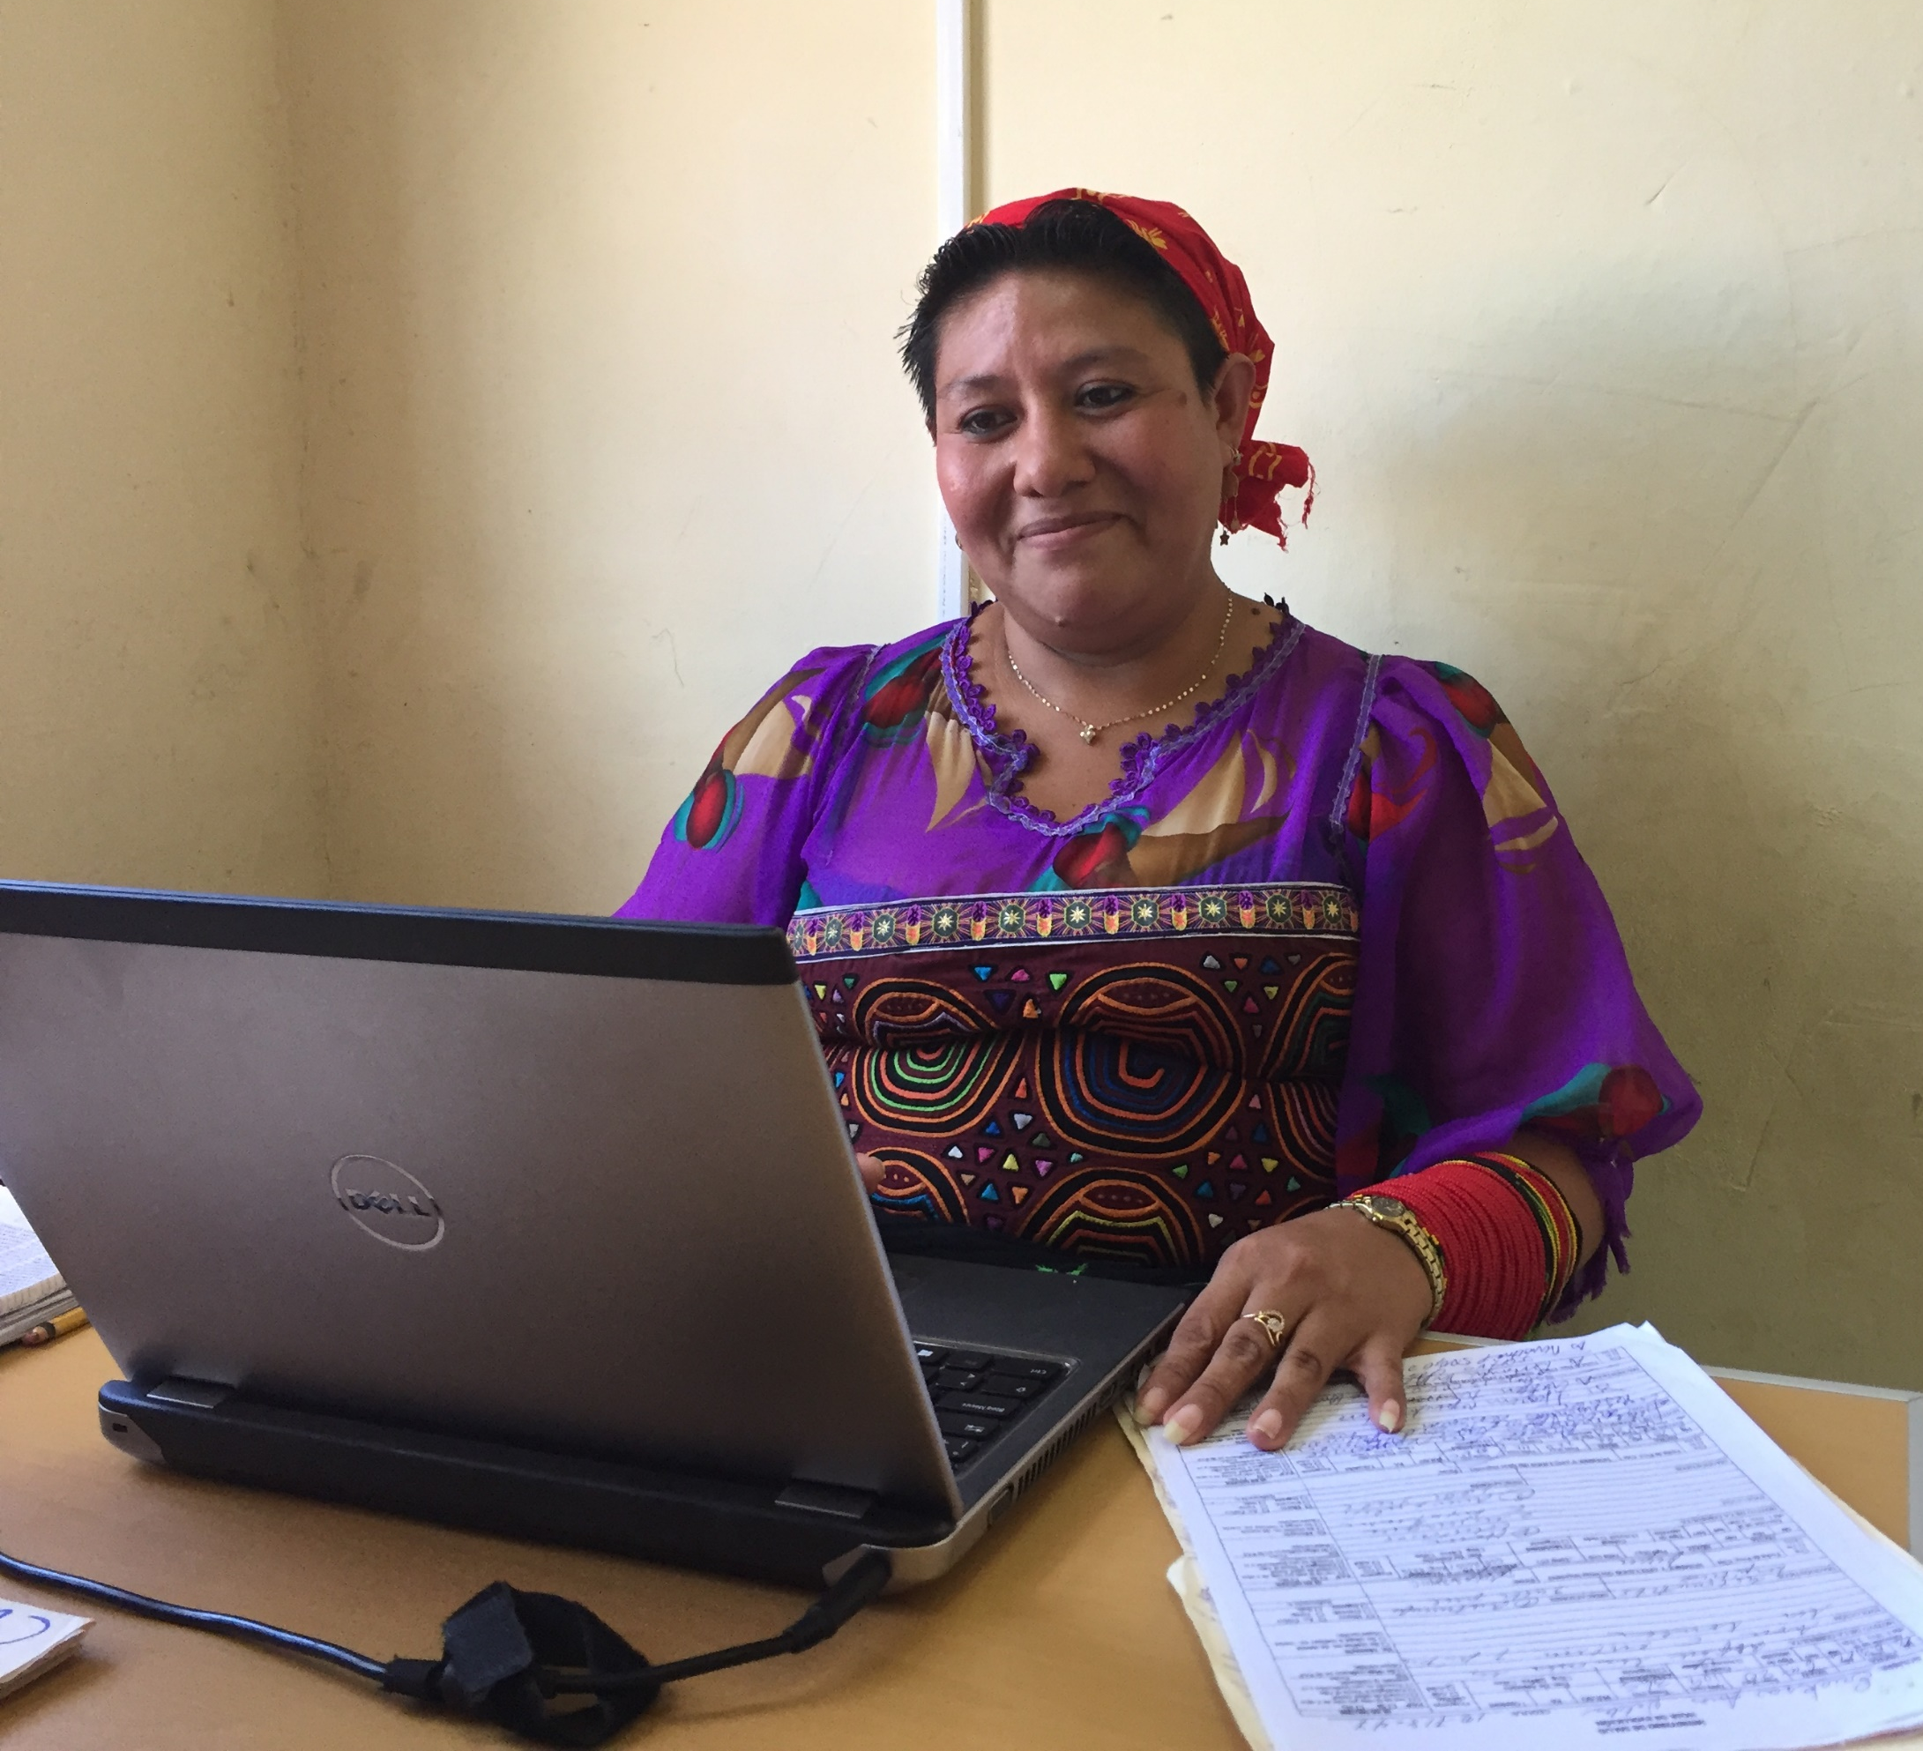


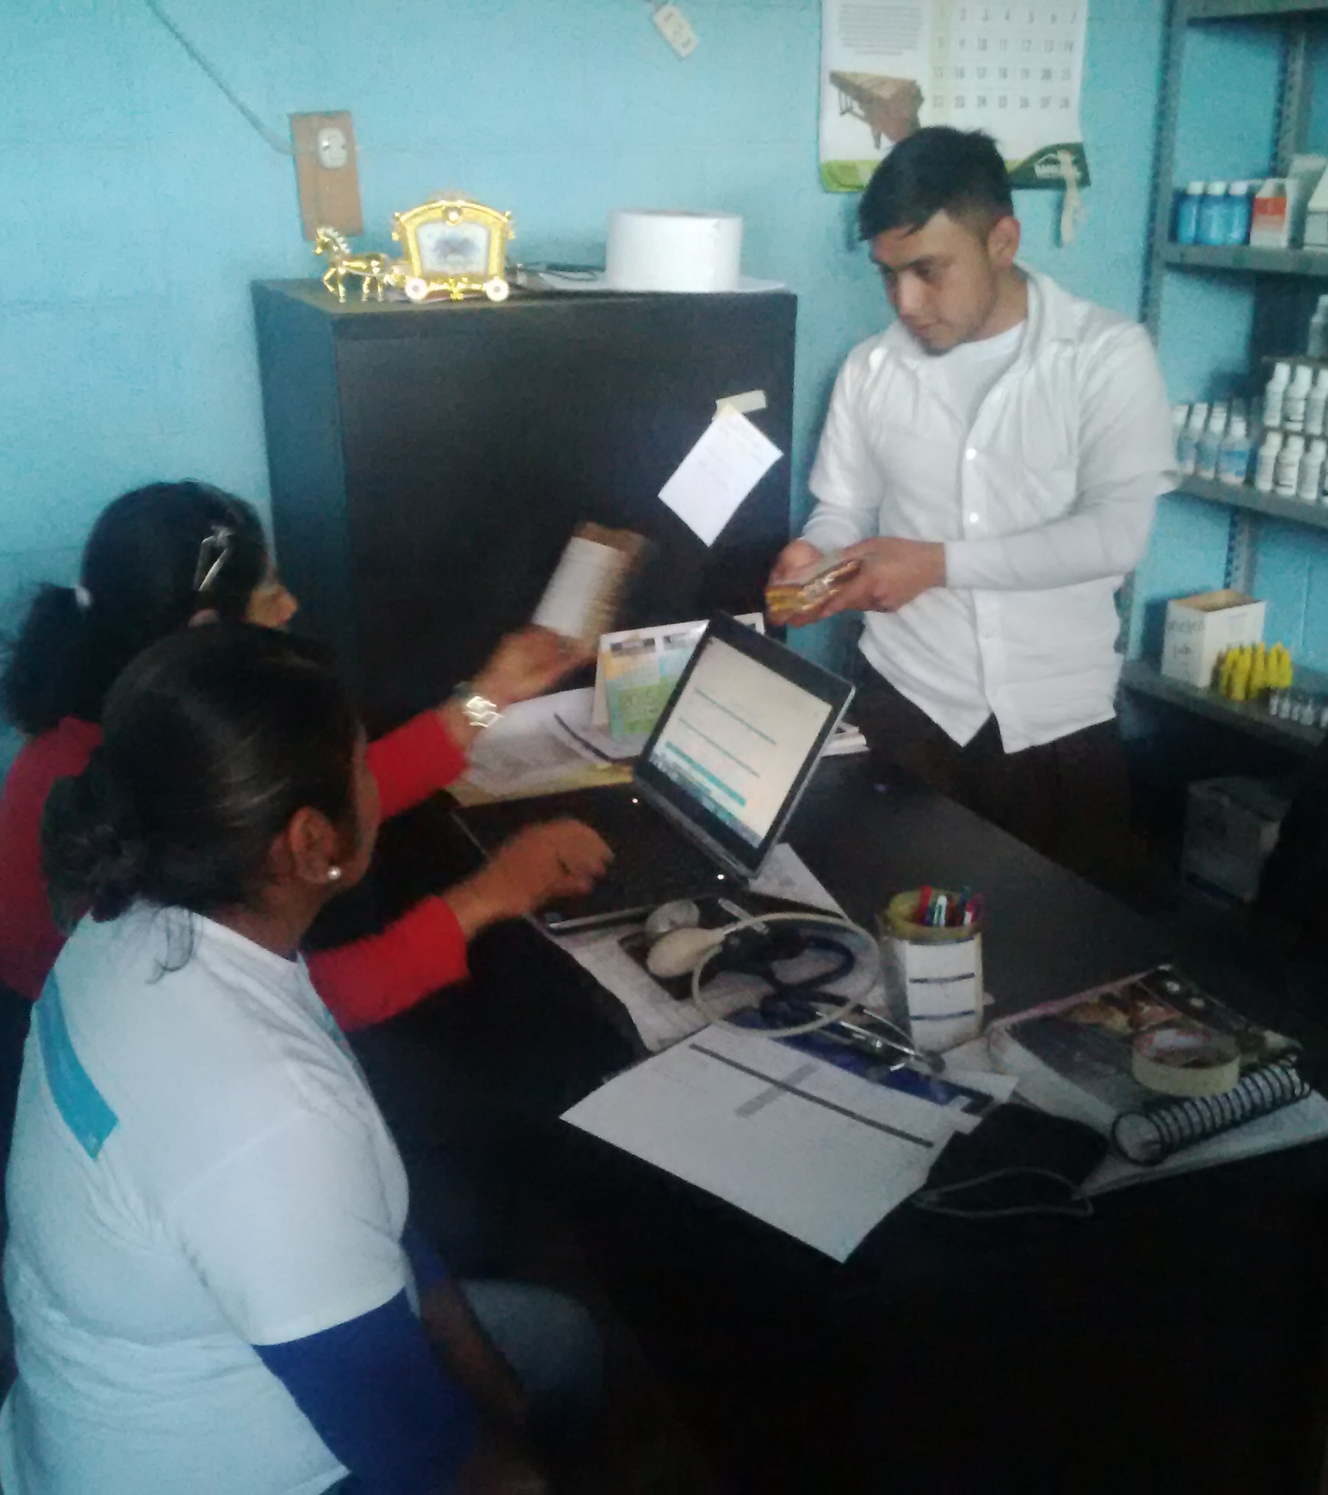
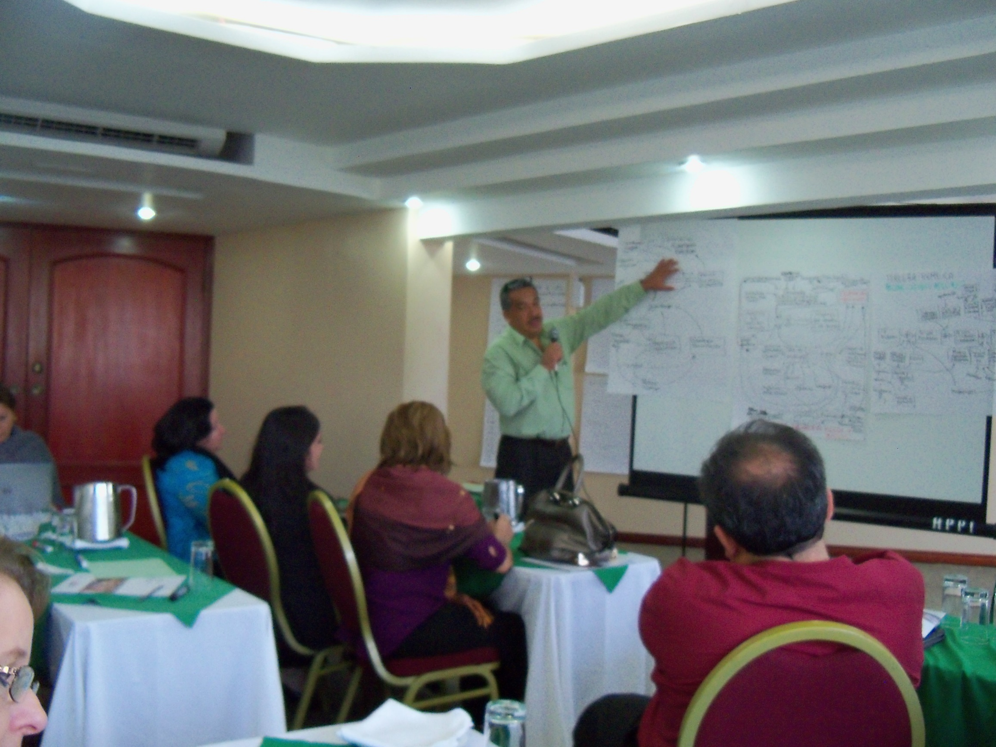


Develop countries’ capacities to implement at scale & sustain the gains
4
SUSTAINABILITY
Leadership
Focus on results and continuous improvement
Subnational and local decisions
Intense supervision, coaching and mentoring
Harvest locally generated innovations-scalability

Slide 41
Lessons for our work

Slide 42

The path towards results required transitioning…
from
to
measuring productivity
measuring outcome-level results, with quality as a core metric
country accountability only
mutual accountability and shared responsibility in execution
supervision focus on reporting
intensive, problem-solving collaboratives focused on results

Slide 43
The path towards results required transitioning…
from
to
consultancy-based technical assistance by components
shoulder-to-shoulder technical support tailored to needs
project-based implementation (PEPs and pilots)
system-oriented implementation designed for learning, adaptation, and scale from the start
combining financing instruments strategically to drive systemic results
relying on siloed financing

Slide 44
Challenges/tensions to implement this approach
Tension between disbursements vs. results
Speed vs. quality
Alignment of incentives
Institutional flexibility
Results and institutionalization
Intentionality on sustainability

Slide 45
Salud Mesoamerica Initiative
Transforming systems to achieve better results and equity in health
Pedro Bernal
Senior Health Economist
Health, Nutrition and Population Division, IDB
Emma Margarita Iriarte
Principal Sector Specialist
Executive Secretary of SMI and RMEI Initiatives
Health, Nutrition and Population Division, IDB

