Slide 1

Climate change & nutrition: research at the nexus of food & health systems
Lora Iannotti, PhD
Science for Health Systems Conference
October 30, 2025

Slide 2
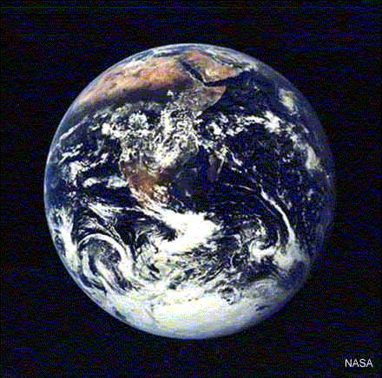
E3 Nutrition Lab
Research on maternal and young child nutrition, testing innovative interdisciplinary solutions that embrace the 3 E’s:
Equity
Evolution
Environment
Ecuador, Haiti, Madagascar, US (St. Louis)
Global (WHO, FAO, UN Nutrition)

Slide 3
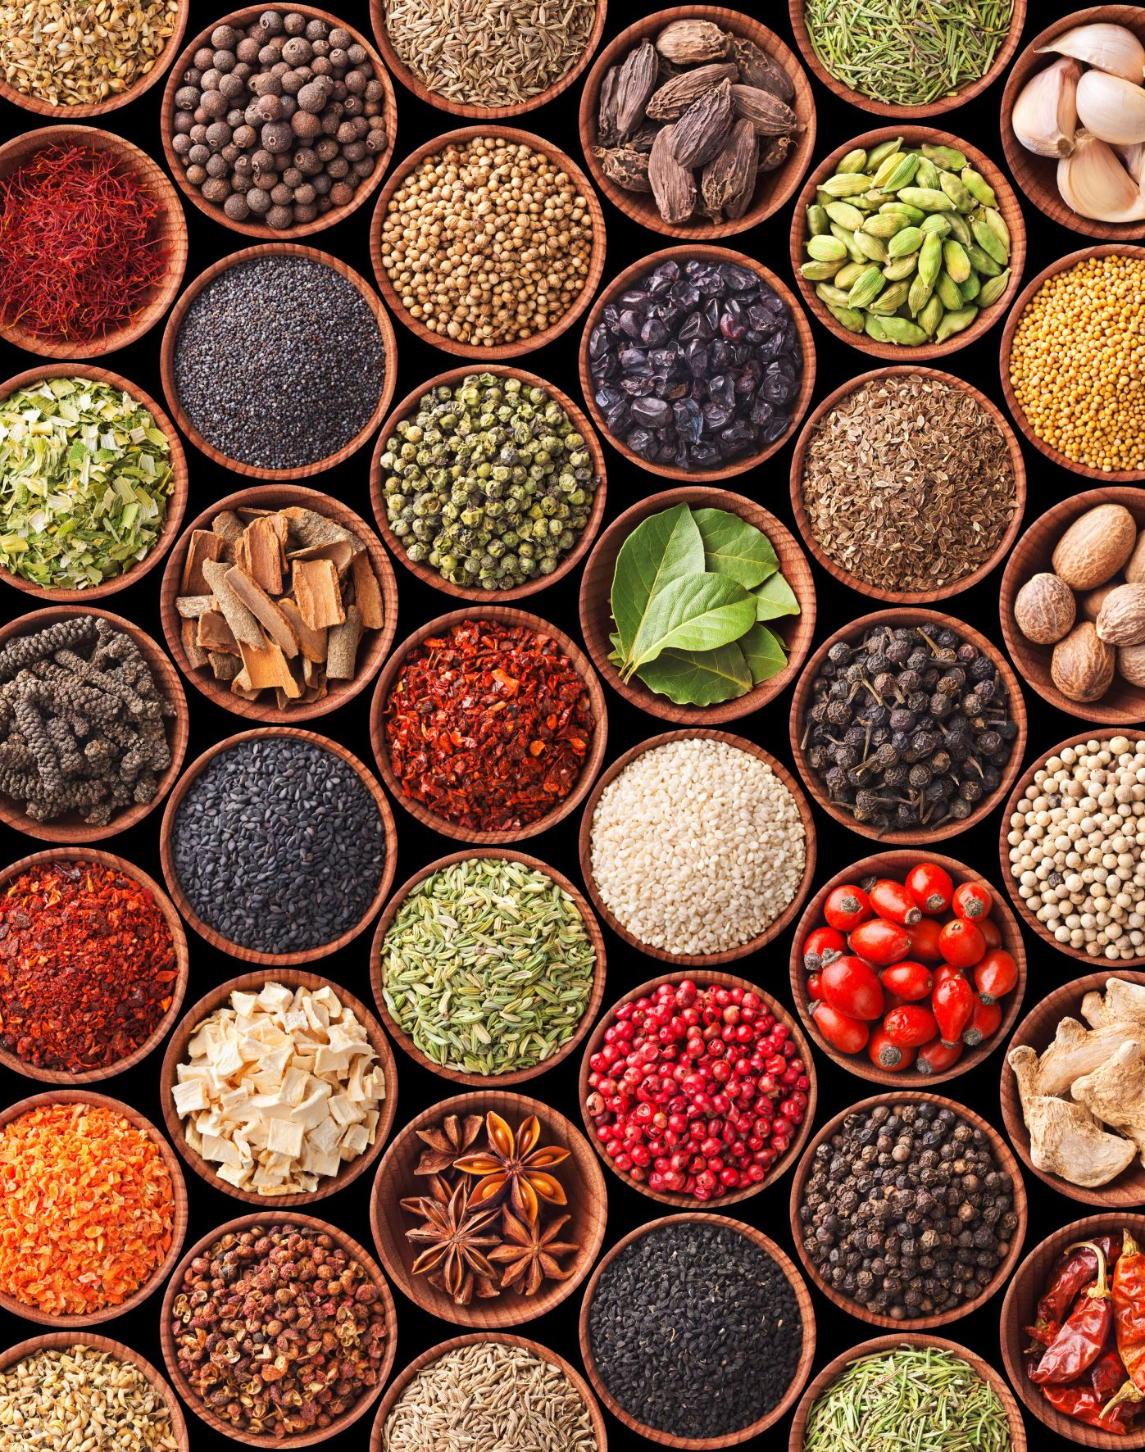
Presentation Outline
Introduction
Maternal & child nutrition
Food systems & planetary boundaries
Case studies
Haiti: Grandi Byen “grow well”
Ecuador: Mikhuna “nourish”
Madagascar: climate change, hunger, & wild foods
Conclusion
Public sector research
Global policy and guidelines

Slide 4
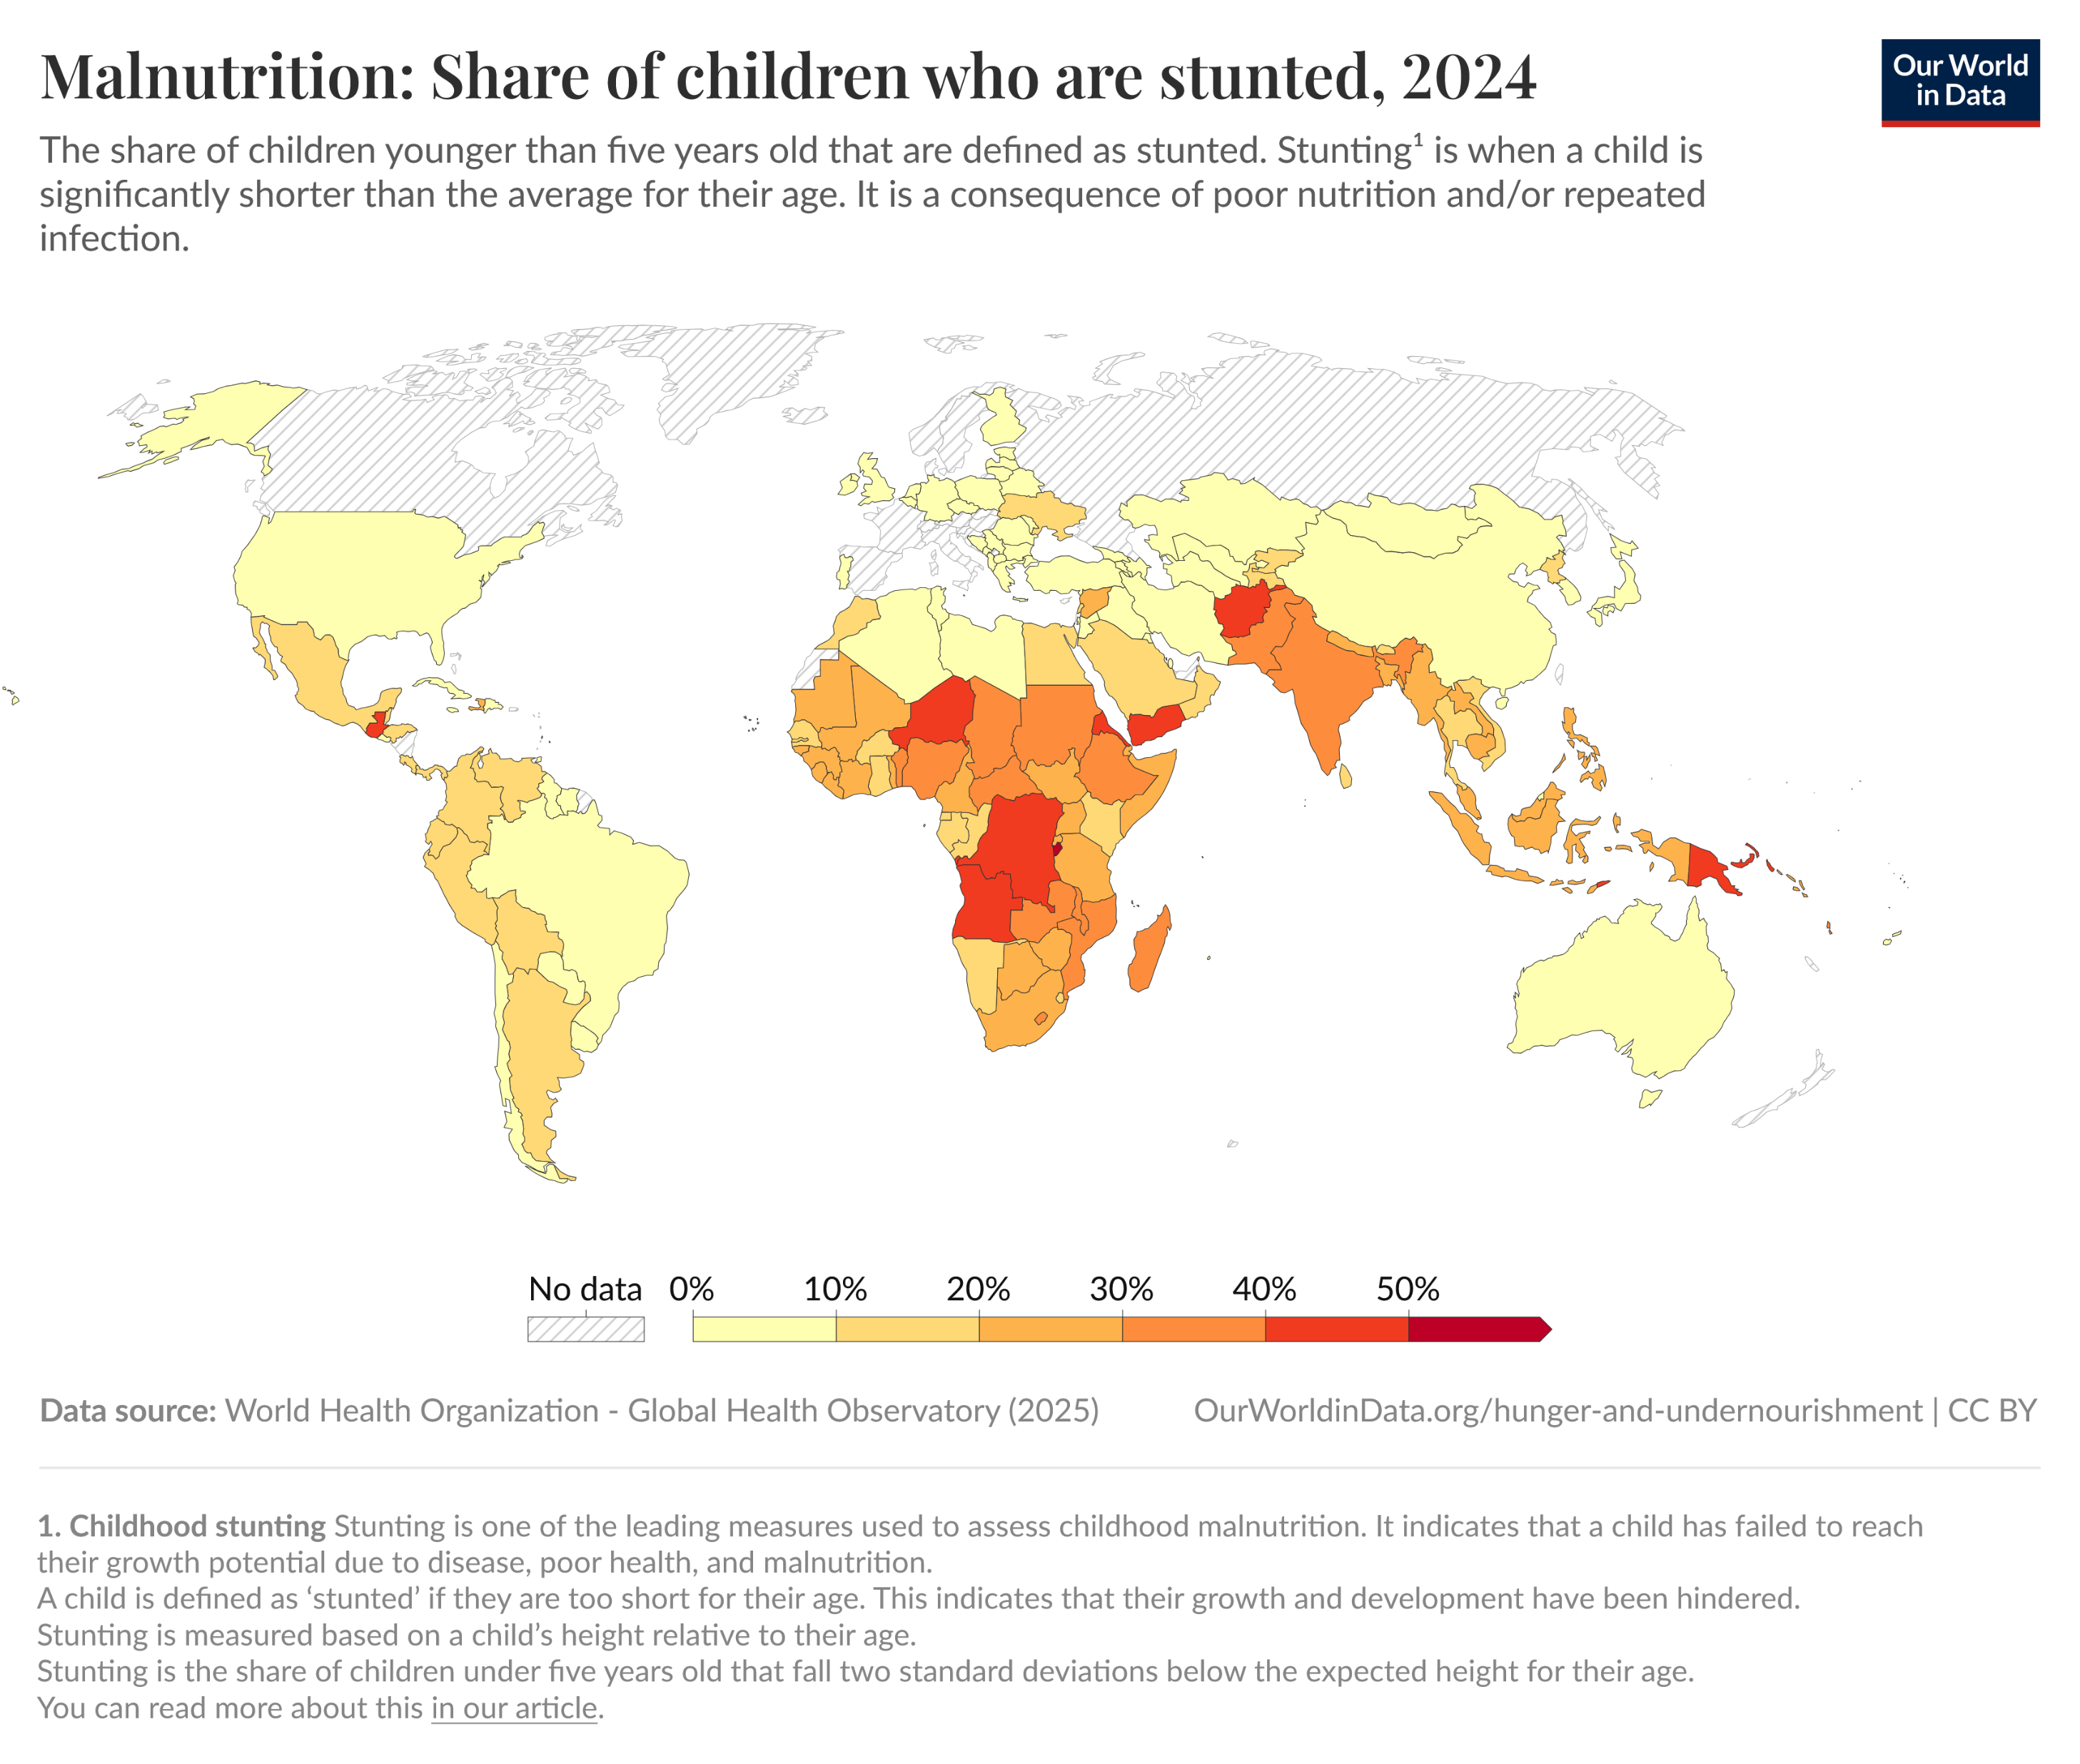
Rationale: global nutrition disparities
148.1 million (22.3%) with stunted growth; 250 million stunted development; 45 million (6.8%) wasted;
Hidden hunger: 56% children; 69% women
Stunting (HAZ<-2SD) form of chronic malnutrition arising from poor quality diets, poverty, and disease:
↑ mortality
↑ infectious disease
↓ brain development
↓ schooling and earning potential
Intergenerational effects on reproductive health and offspring development

Slide 5
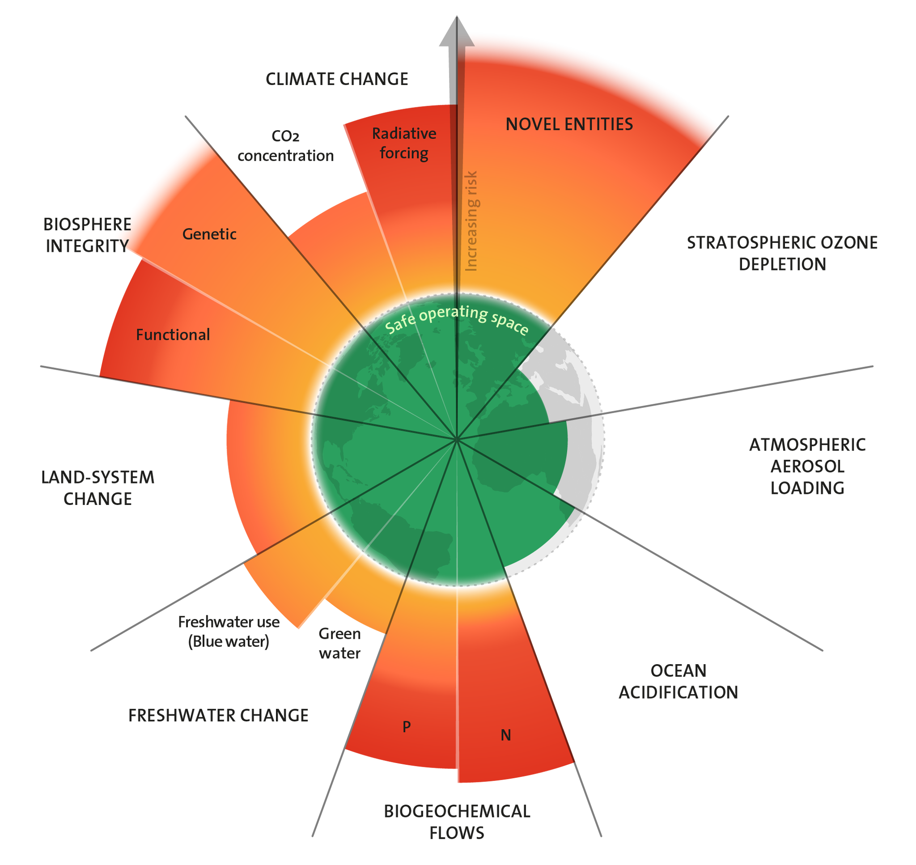
Planetary boundaries & food systems
6/9 boundaries crossed; food systems play an outsized role
Food production
30% of greenhouse gas emissions
70% of freshwater withdrawals
40% of land use (Clark PNAS 2019)
Food waste
31% of food produced wasted
Produces 8-10% of GHG ~4.4 GtCO2 eq, costing US$411 billion (FAO)
Biodiversity & diet diversity
12 crops, 5 animals →75% of food supply (FAO 2017)
Increasing homogenization of food supplies
Source: “Azote for Stockholm Resilience Centre, based on analysis in Richardson et al 2023

Slide 6
Country case studies

Slide 7
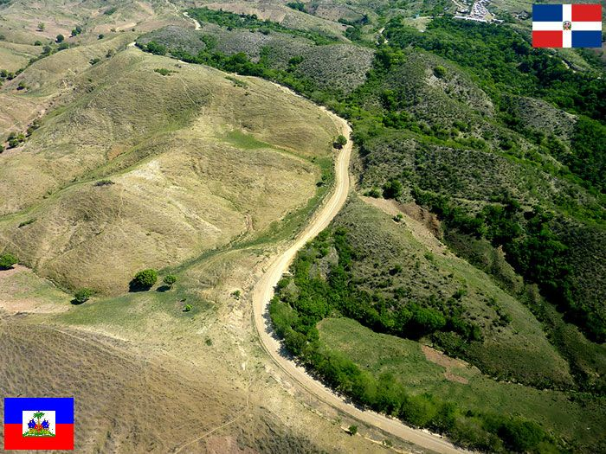
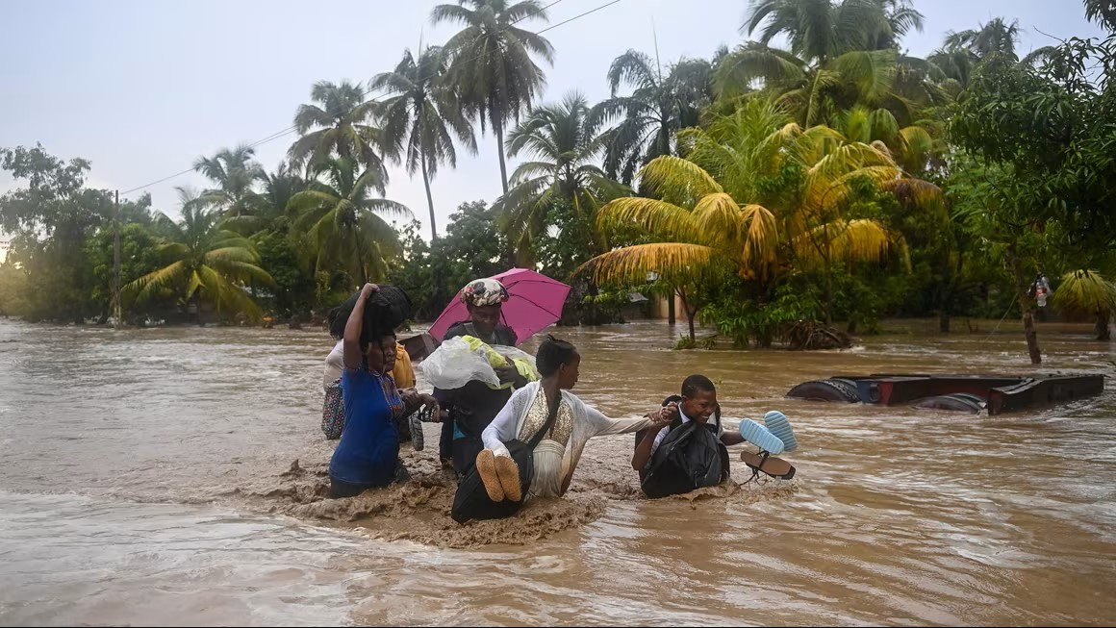
Case #1 Haiti: climate change, occupation, and food insecurity
Natural disasters – hurricanes, floods, drought – wrought by climate change have ravaged the country
Haiti is among the most deforested countries globally with < 1% of primary forest remaining (Blair Hedges et al. 2018)
Half the population (5.7 million) are food insecure; 22% of young children stunted growth (WFP, EMMUS )
Haiti is also overrun or “occupied” by NGOs working outside the healthcare system
Source X
Source: CNN World
Notes:
2 million of the 5.7 in acute hunger are considered in “emergency levels of hunger” - large food consumption gaps alongside very high acute malnutrition rates and excess deaths, or are able to overcome food consumption gaps only by selling off the few assets they have left. Loss of income at this stage is irreversible, and between 15 and 30 percent of the population is acutely malnourished. People have access to three or fewer food groups like fruits, grains and vegetables, and take in less than 2,100 calories per day.

Slide 8

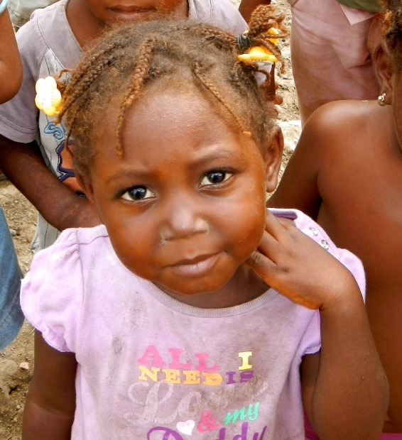
Grandi Byen
Population: urban poor, young children in Cap-Haïtien
Design: 3-arm longitudinal RCT 1) control; 2) egg; 3) Grandi Byen (parenting + egg)(n=600)
Aims
1) Demonstrate reproducibility and feasibility of egg intervention on stunting and development
2) Investigate incremental benefit of Grandi Byen parenting intervention
3) Explore impact pathways biological (nutrient biomarkers, bone age, and enteric disease), psychosocial (cognition, responsive parenting), and environmental (hygiene, sanitation) factors
Team science: public health nutrition, child development, social work, pediatric radiology, infectious disease epidemiology/medicine
Funding: PAR-18-480 NICHD R01-Clinical Trial
Photo: Barbara Evans

Slide 9
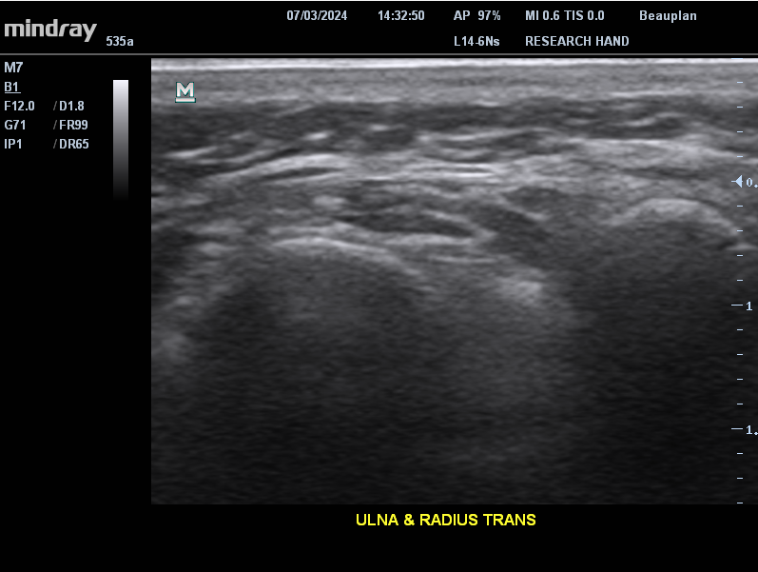
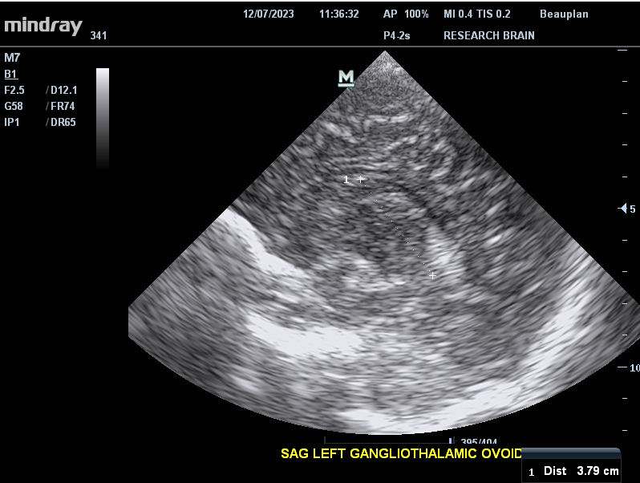
Ultrasound imaging: public health innovation
Nicholas et al. Radiology 2020
Dillman and Ayyala Radiology 2020

Slide 10
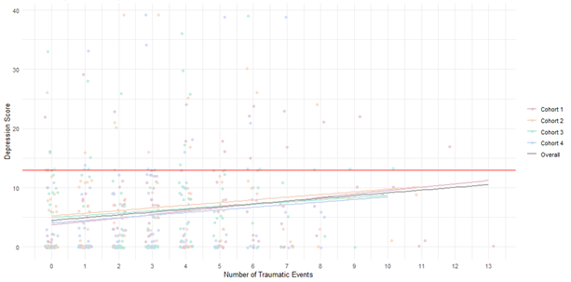
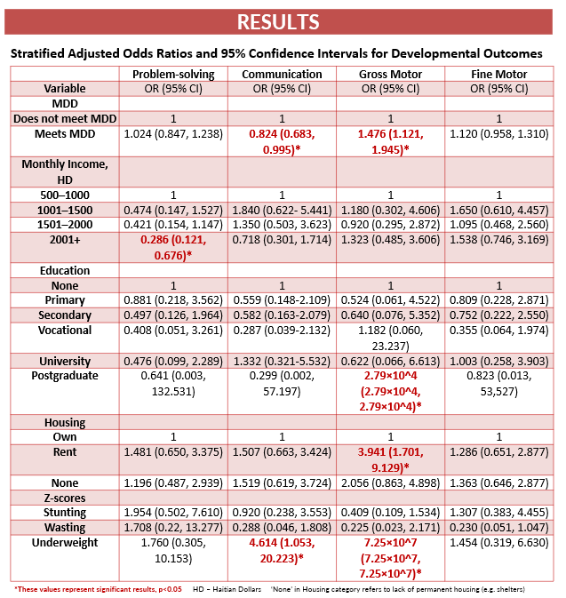
Baseline findings
Maternal Trauma and Depression
Diet diversity & child development
Child diet diversity associated with increased odds of attaining gross motor milestones (Aboagye-Mensah et al. ASN 2025)
Cohort-based analysis showing positive association number of trauma events and maternal depression (Galvin et al. Global Mental Health under review)

Slide 11
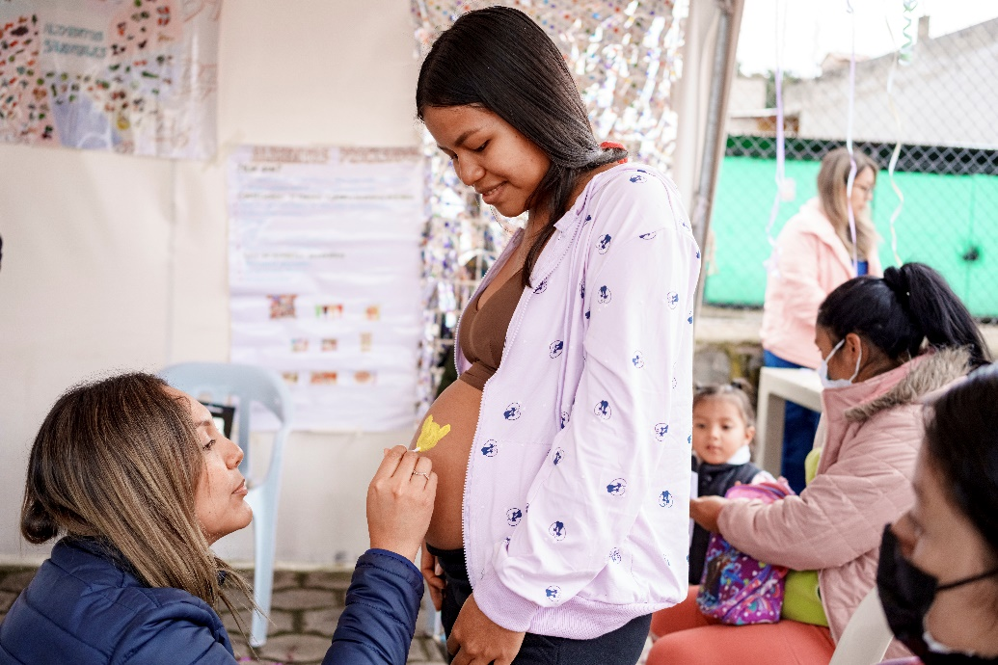
Case #2. Ecuador Mikhuna
Nutrition disparities among marginalized Indigenous communities most acutely affect by climate change
RCT – longitudinal study (n=200)
Mixed-Indigenous communities of peri-urban Quito
Intervention during 2nd & 3rd trimesters of pregnancy: Ecuadorian healthy dietary pattern (modeled on evolutionary dietary patterns) + social behavior change communication
Partnership with USFQ & WashU, funded by CDI

Slide 12
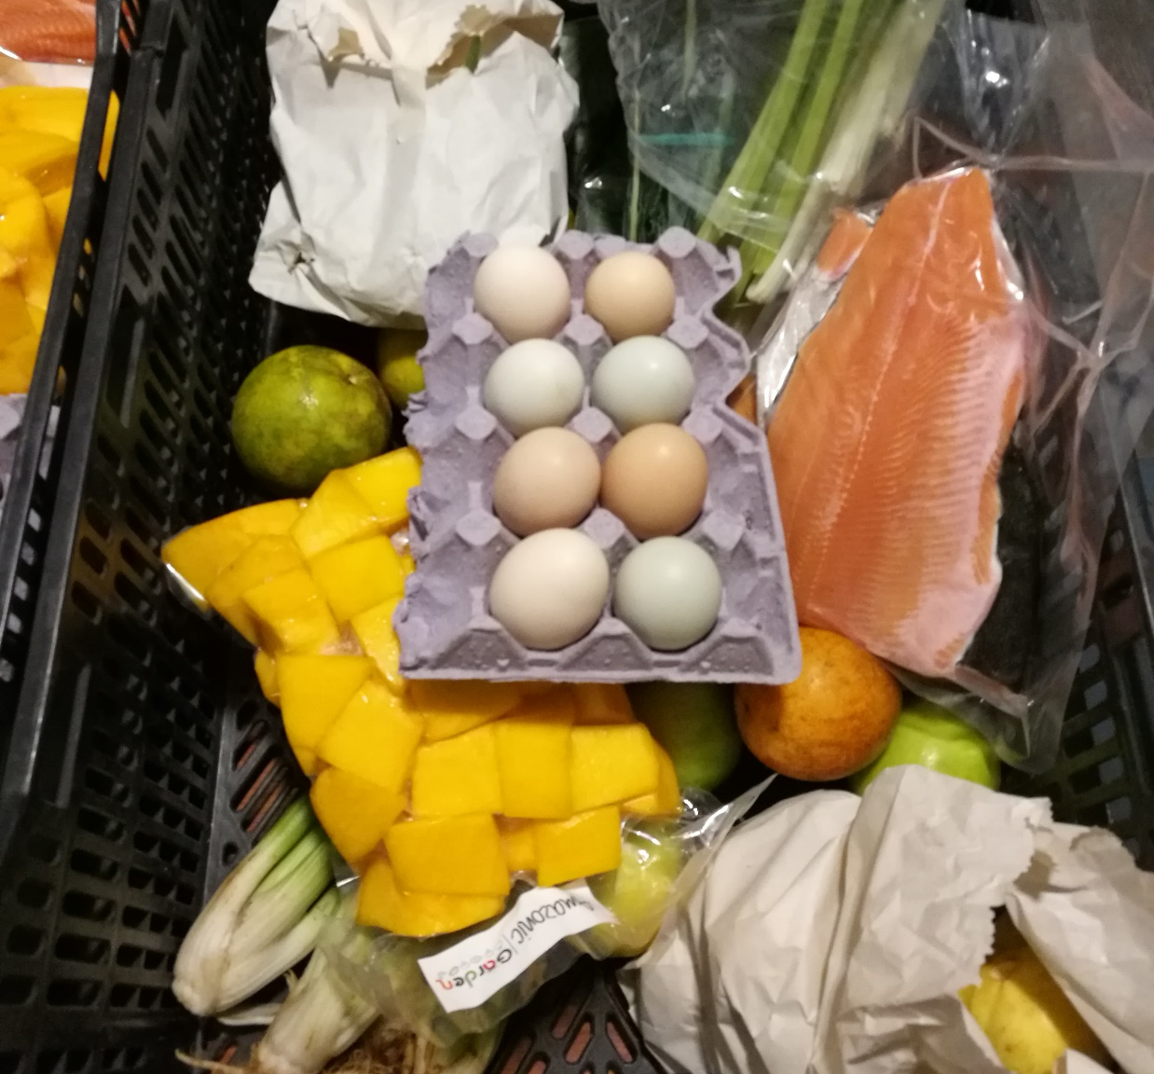
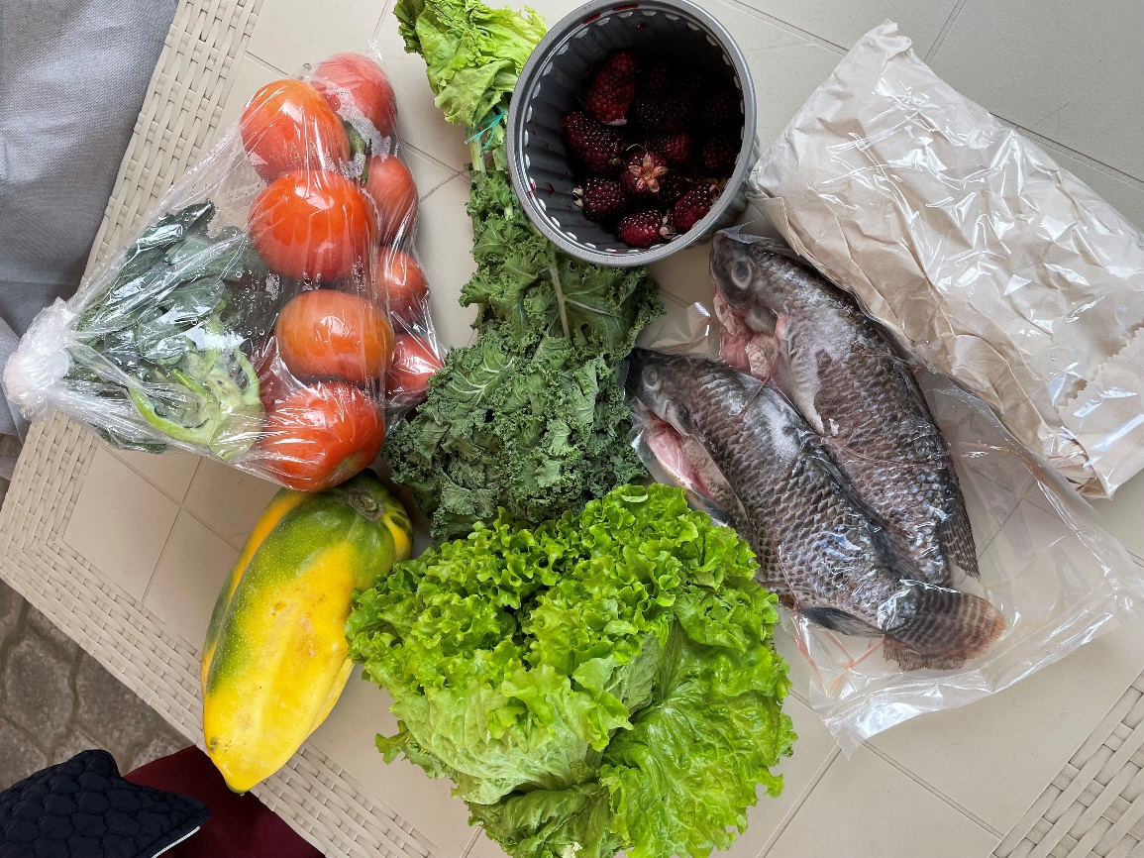
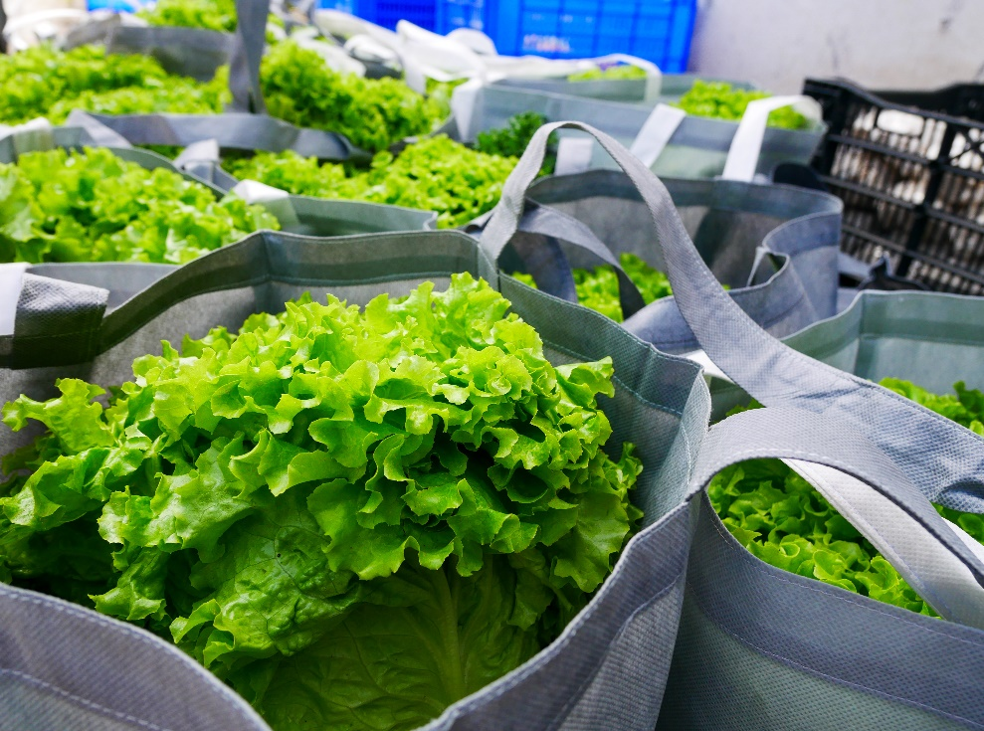

Slide 13
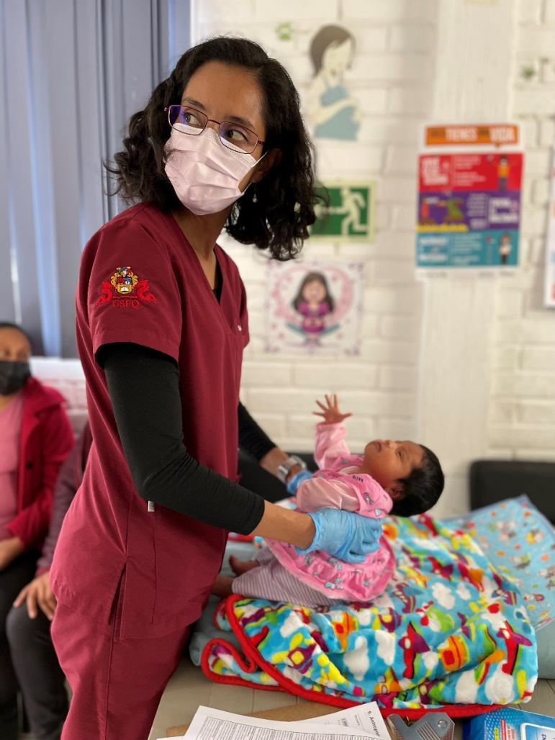
Methods
Longitudinal data collection → 12, 21, & 35w gestation, 2w postnatal
Fetal and newborn ultrasound: standard + novel measures (Mindray M7)
Maternal nutrition and morbidities: dietary intakes (FFQ), height, weight gain, blood pressure, and morbidities
Maternal blood biomarkers: choline, betaine, methionine, DHA, LA, and ALA (LC-MS/MS), minerals/metals (ICP-MS, ICP-OES)
Newborn anthropometry: length, weight, and head circumference
Hammersmith Neonatal Neurological Exam: tone, motor development, reflexes, visual and auditory attention, behavior

Slide 14
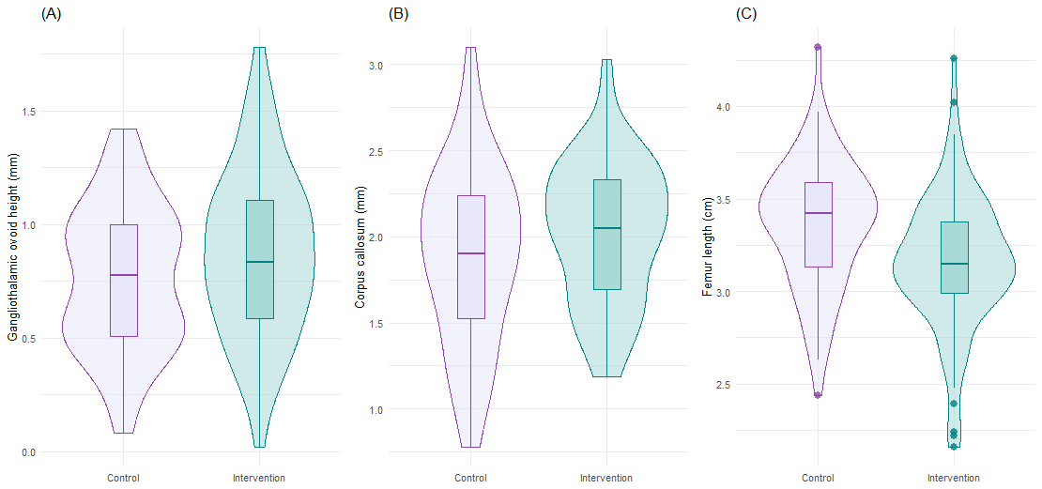
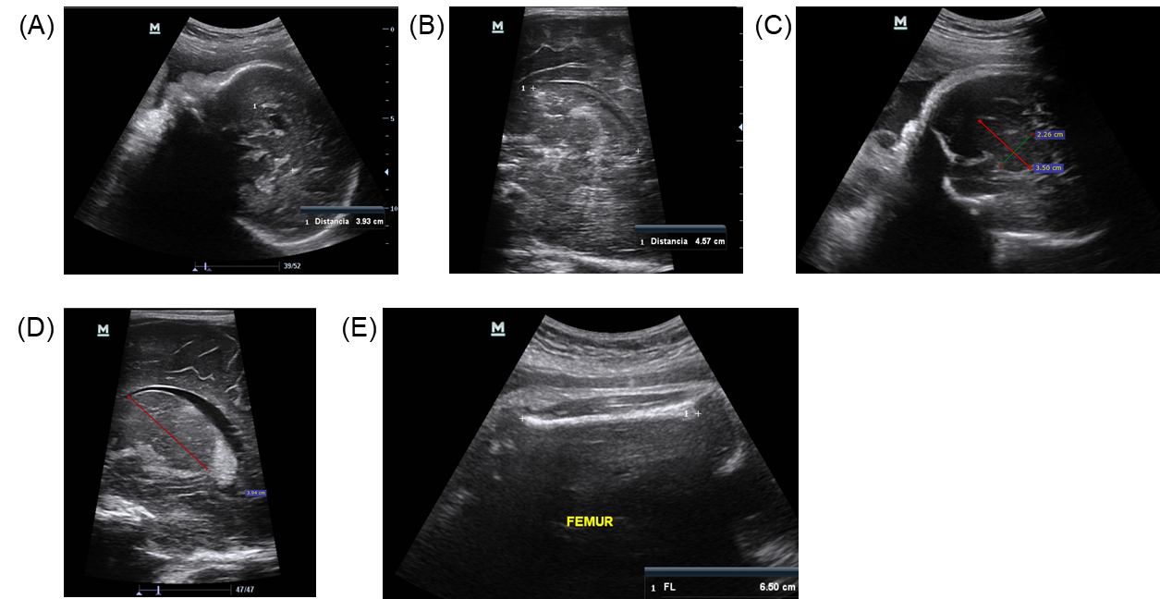
Results: fetal brain & bone growth
Growth from 21w to 35w (GLM models adjusted for gestational age & same parameter at 21w):
↑ Gangliothalamic ovoid (0.15 cm, 95% CI 0.03-0.26)
↑ Corpus callosum (0.19 cm, 95% CI 0.02-0.35) & Z score (0.56, 95% CI 0.03-1.09)
↓ Femur length (-0.10 cm, 95% CI -0.19, -0.02) & Z score (-0.21, 95% CI -0.42-0.00)
Notes:
Cronbach’s alpha

Slide 15
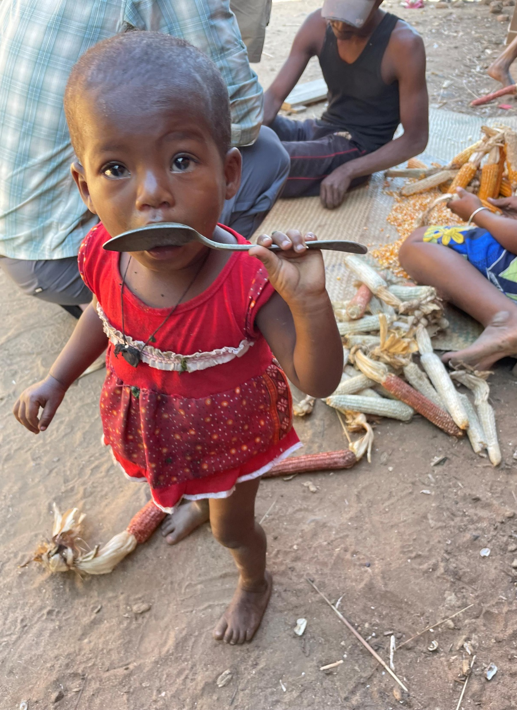
Case #3. Madagascar
Madagascar one of the world’s most important biodiversity hotspots globally
Paradoxically, low diet diversity and severe malnutrition - 39.8% children stunted and 7.7 wasted
Over 80% of population live in rural areas, relying on subsistence, rain-fed agriculture, exacerbated by climate change

Slide 16
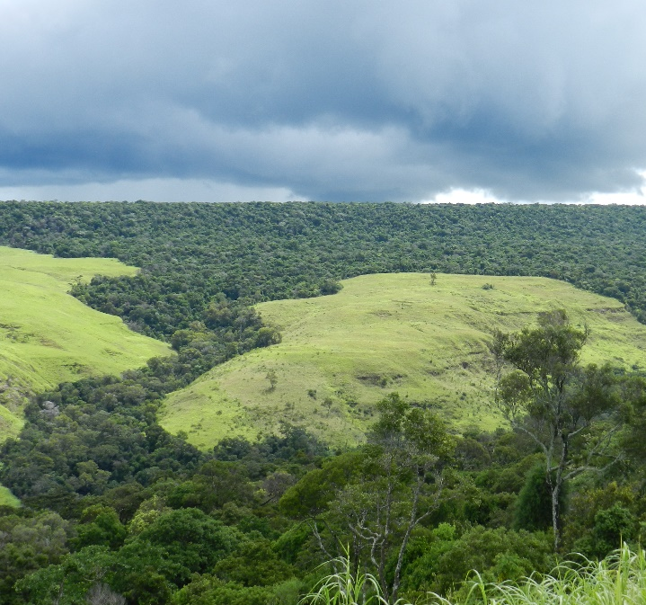

Design & Hypotheses
Study Aim
Characterize the nutrition situation of vulnerable communities in the protected forest and conservation status and nutritional value of wild plant and animal species consumed during hunger season
Methods
Team science: public health nutrition, infectious disease epi, botany/ethnobotany, agroforestry, ecology
Data collection: SES surveys, 24-hr dietary intakes, child anthropometry, linear transect, nutritional composition of tubers and foods - Kjeldahl’s gravimetric/enzymatic methods and USDA food composition database
Data analyses: dietary diversity, species richness, WHO Z scores, truncated Poisson regression, and GLM

Slide 17
Child dietary intakes of wild and non-wild foods (%)
Diets largely comprised of rice & cassava
27 wild plant taxa (native & nonnative); abundant and only 1 IUCN “vulnerable”
Wild foods significantly increased child diet diversity & growth
Iannotti et al. Current Developments in Nutrition 2024

Slide 18
Conclusion

Slide 19


Achieving climate-resilience: at the nexus of food & health systems
By working within the public systems, our research has had broader impacts:
Haiti
Healthcare system → National Director of Nutrition, Justinien Teaching Hospital, and Fort Saint Michel
Education system → Vita Mamba in school feeding programs
Ecuador
Lulun → policy to recommend earlier introduction of eggs
Mikhuna → national pregnancy food basket program and public-private sector partnership group, Minga
In disconnected food and health systems, populations at great risk
Madagascar → introducing health behavior change, wells, into remote communities; support to CHWs

Slide 20
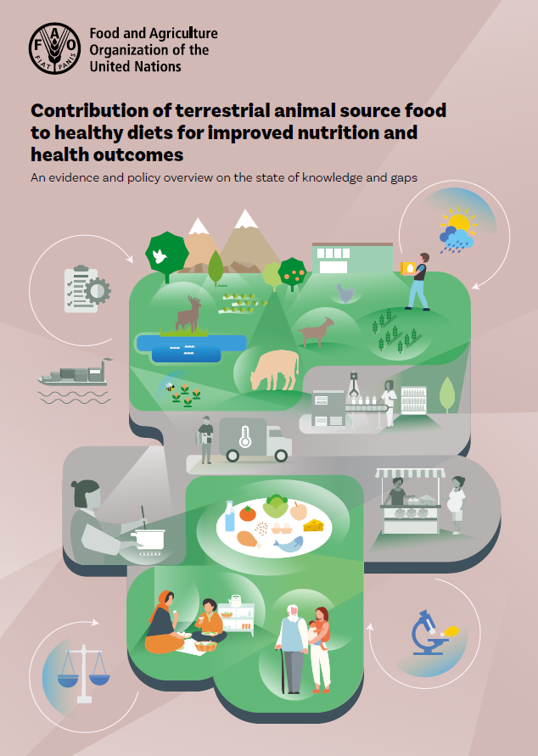
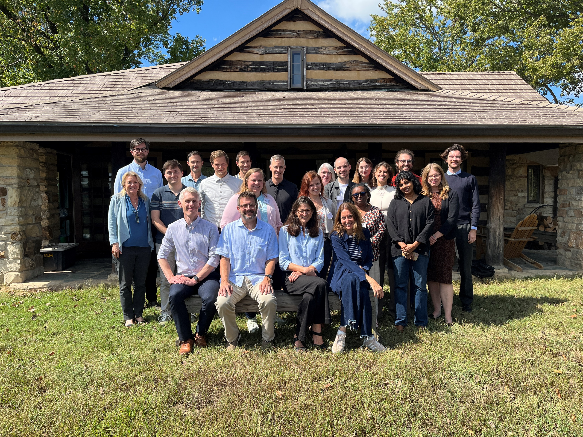
Global level
Global guidelines and reports may influence both food and health systems to achieve climate resilience
TASF for sustainable, healthy diets
WHO Guidelines for Complementary Feeding
Ozark Expert Convening on biodiversity and human diets

Slide 21








Acknowledgements
E3 Nutrition Lab
Lora Iannotti
Elizabeth Hahn
Michelle Dorce
Rachel Zimmerman
Gifty Aboagye-Mensah
Najjuwah Walden
Emily Evers
Jemima Adepehin
Ferdous Akther
Sofia Then
Ethan Fudge
Noor Noor Ul Ain
Grandi Byen
Patricia Kohl
F. Matthew Kuhlmann
Jay Turner
Sherlie Jean-Louis Dulience
Emmanuel Gyimah
Jenna Diaz
Fithi Embaye
Derek S. Brown
Shenyang Guo
Joan L. Luby
Jennifer L. Nicholas
Joseline Marhone Pierre
Jacques Boncy
Rony St. Fleur
Maureen M. Black
Mikhuna
Jennifer L. Nicholas
Patricia Lacy Gandor
William Waters
Ivan Palacios
William Waters
Gabriela Vintimilla
Shirley Tipanquiza
Pamela Camana
Karla Yugcha
Carlos Andres Gallegos Riofrio
Klever Sáenz
Manu Goyal
Maicus Raichel
Madagascar
Armand Randrianasolo
Robbie Hart
Tabita Randrianarivony
Fortunat Rakotoarivony
Tefy Andriamihajarivo
Kate Farley
Mia LaBrier

