Slide 1


Advancing International Health System Comparisons with Micro-data
Irene Papanicolas
Oct 29, 2025
Science for Health Systems Meeting
St Louis, MO

Slide 2

Background
International comparisons are nothing new
But their nature is changing
New data/analytics/regulation
There are unique challenges in this space with many collaboratives grappling with different approaches and solutions
Data access/use
Gaps in knowledge/know-how
Data Standardization and Harmonization
Funding
This session aims to highlight some existing collaboratives and their experiences

Slide 3
Why do we compare health systems?

Slide 4



Health systems around the world face similar challenges.
An Aging Population
Increasing Chronic Disease & Multimorbidity
Growing Health Spending

Slide 5
Governance
Financing
Yet all health systems are organized differently.
Outcomes
Resource generation
Service
delivery

Slide 6
How do we leverage these differences to understand what works and where it works?

Slide 7

Using micro data across countries
More
Data Linkage
Can we use detailed patient level data from within countries to understand more about care delivery across countries?
Improved Data Sharing

Slide 8




There are large barriers to comparing health systems.
Comparability of services
Harmonization of data
Incorporating different values
Requires an understanding of different
trajectories of care / practice variation /
organizational structures
Requires the creation of detailed cross-walks and guides to ensure ‘apples to apples’
Requires an understanding of local policy/ values/ perceptions/ status-quo differs

Slide 9
65% say too long
79% say too long
66% say too long
61% say too long
Notes:
Sources OECD health at a glance 2023, and IPSOS healthcare 2023
https://www.ipsos.com/sites/default/files/ct/news/documents/2023-07/ipsos-global-perceptions-of-healthcare-2023.pdf

Slide 10
Frequency of consultations across countries

Slide 11
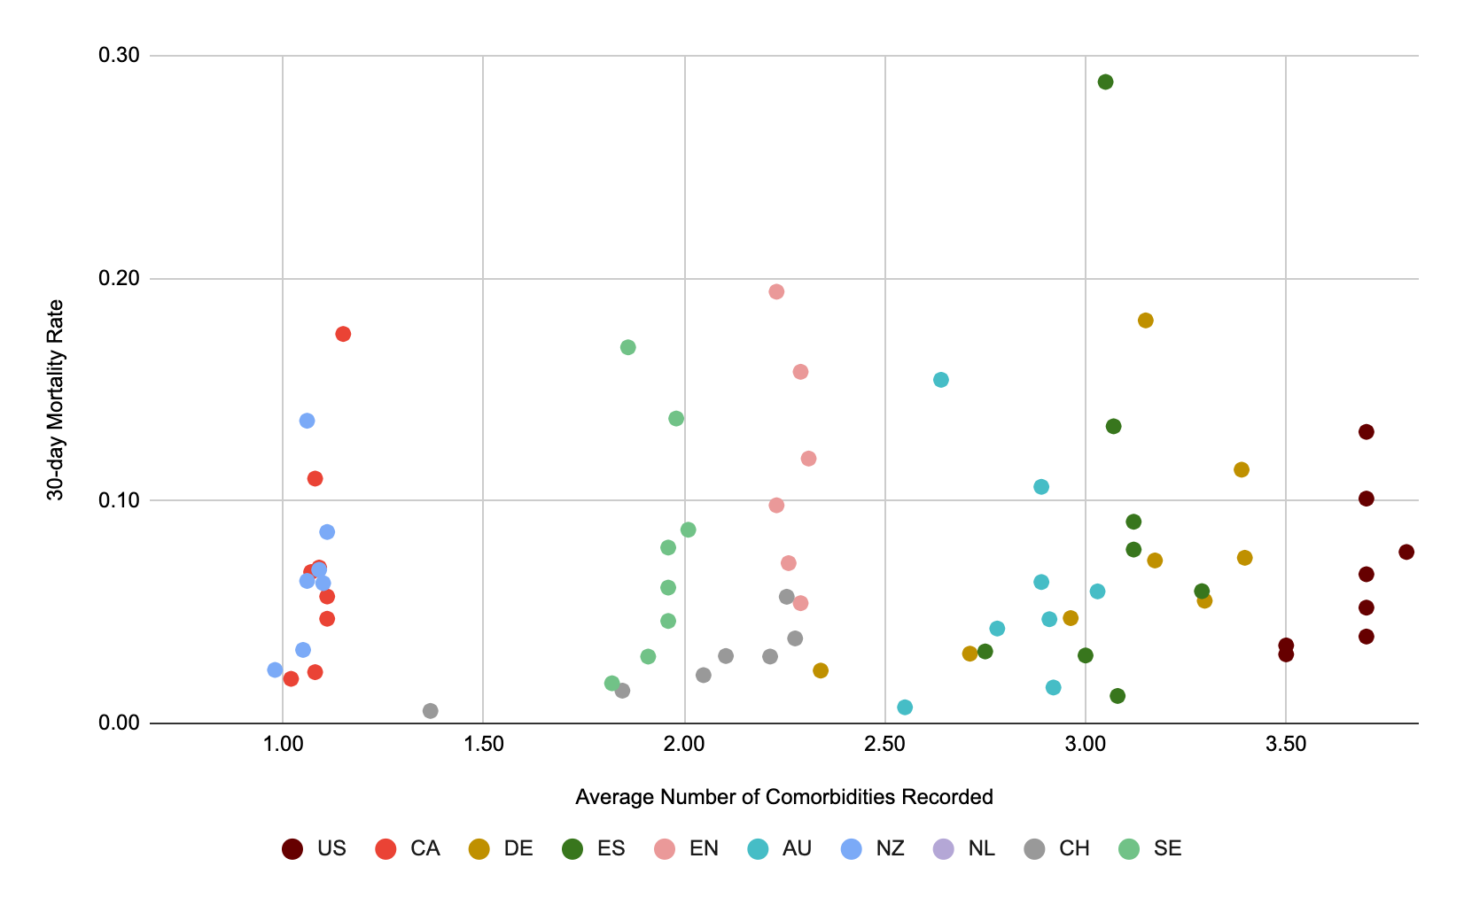
30-day in Hip Fracture Mortality by Comorbidities

Slide 12
Today’s speakers
Jose Figueroa MD MPH: Associate Professor of Health Policy and Management, Havard T.H. Chan School of Public Health
International Collaborative on Costs outcomes and Needs in Care (ICCONIC)
Joe Dieleman PhD: Professor of Health Metrics Sciences,University of Washington, Institute for Healthcare Metrics (IHME)
INCORE and International Comparisons of Disease Expenditures
Dave Knapp PhD: Senior Economist, University of Southern California,
Global Gateway to Aging

Slide 13
Thank you irene_papanicolas@brown.edu

