Slide 1
INCORE and international comparisons using disease expenditure studies
Joseph Dieleman, PhD
dieleman@uw.edu

Slide 2
Outline
Introduce US disease expenditure project
Highlight use cases of disease expenditure projects
INCORE and other countries completing similar studies

Slide 3
Outline
Introduce US disease expenditure project
Highlight use cases of disease expenditure projects
INCORE and other countries completing similar studies

Slide 4
Disease Expenditure (DEX) research project
Health care spending
Demographic Framework – 38 age/sex groups
Type of Care Framework – 7 delivery modalities
Geographic Framework – 3110 US counties
Disease Framework – 148 health conditions
Payer Framework – 4 payer categories
Micro
Macro
Strengths:
Comprehensive but detailed perspective
Can connect these estimates of population health outcomes
Many stakeholders think in terms of diseases
Can estimate health care productivity
Estimate spending and utilization, over time

Slide 5
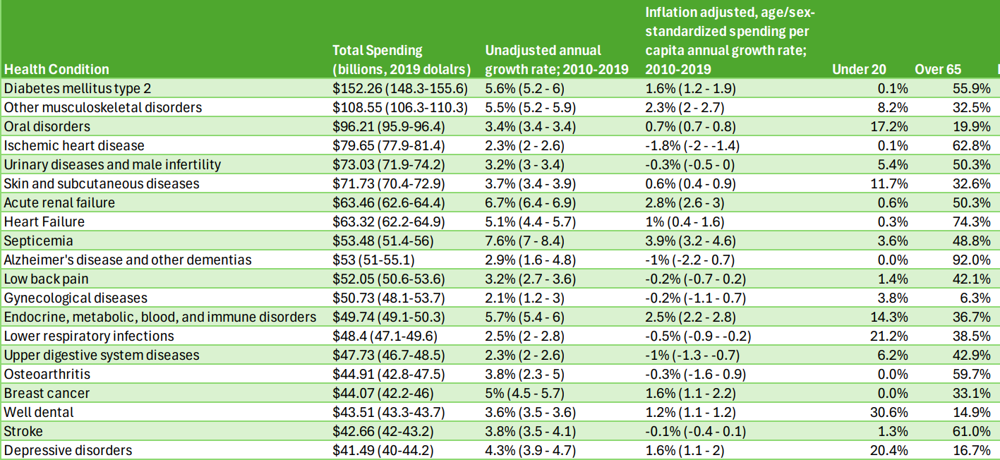
Health conditions with the most spending in the US, 2019
UPDATE

Slide 6
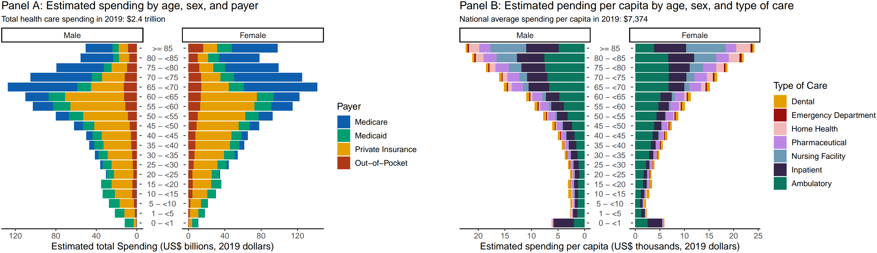
Health spending by age and sex, 2019

Slide 7
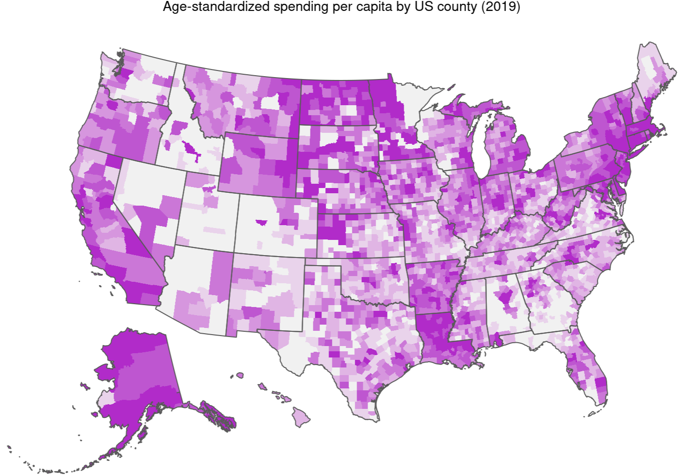
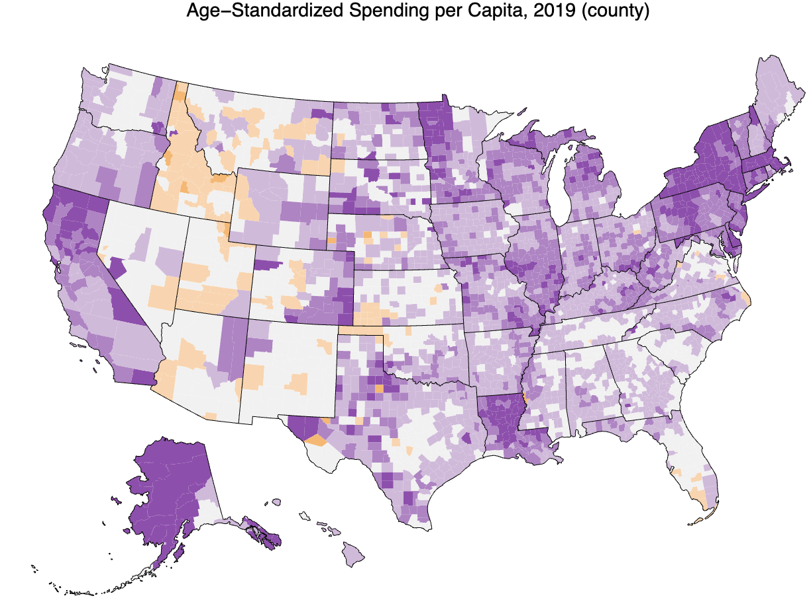
Health care spending across US counties

Slide 8
Outline
Introduce US disease expenditure project
Highlight use cases of disease expenditure projects
INCORE and other countries completing similar studies

Slide 9
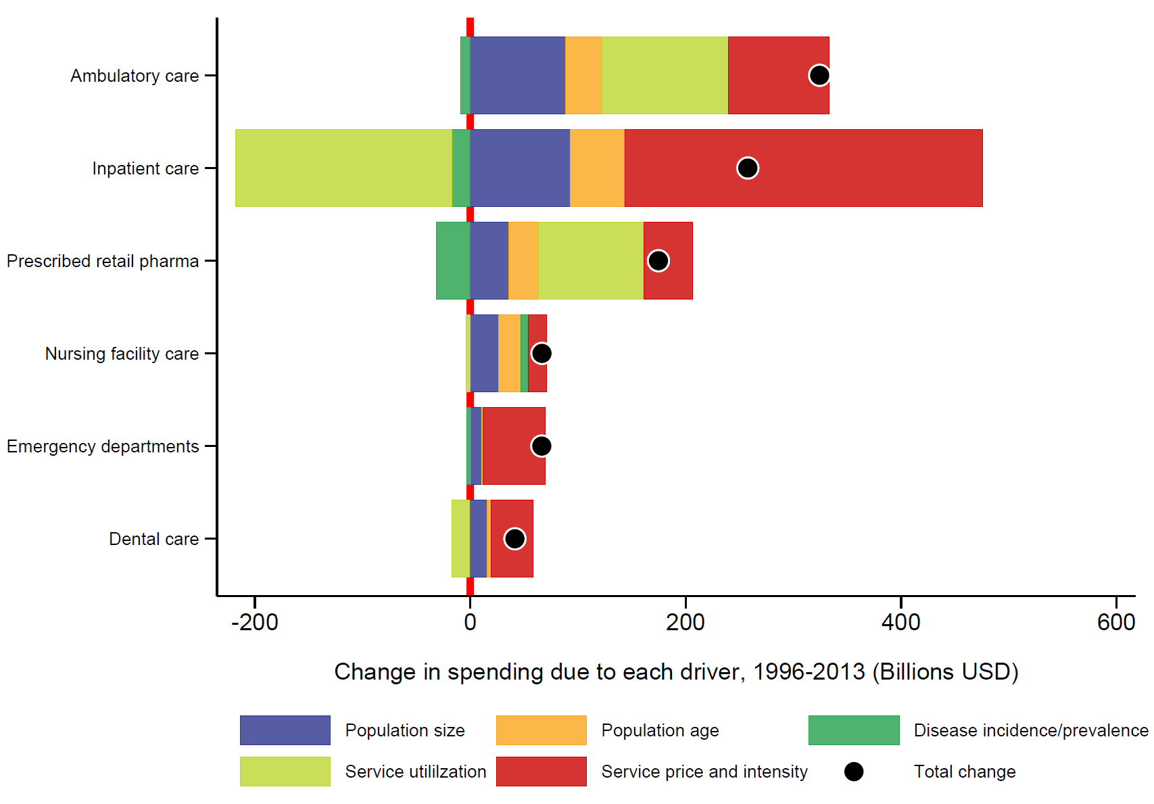
1. Measuring drivers of health care spending increases
Ambulatory care
Inpatient care
Prescribed pharmaceuticals
Nursing facility care
Emergency department care
Dental care
Total US health spending 1996-2013

Slide 10
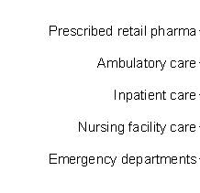
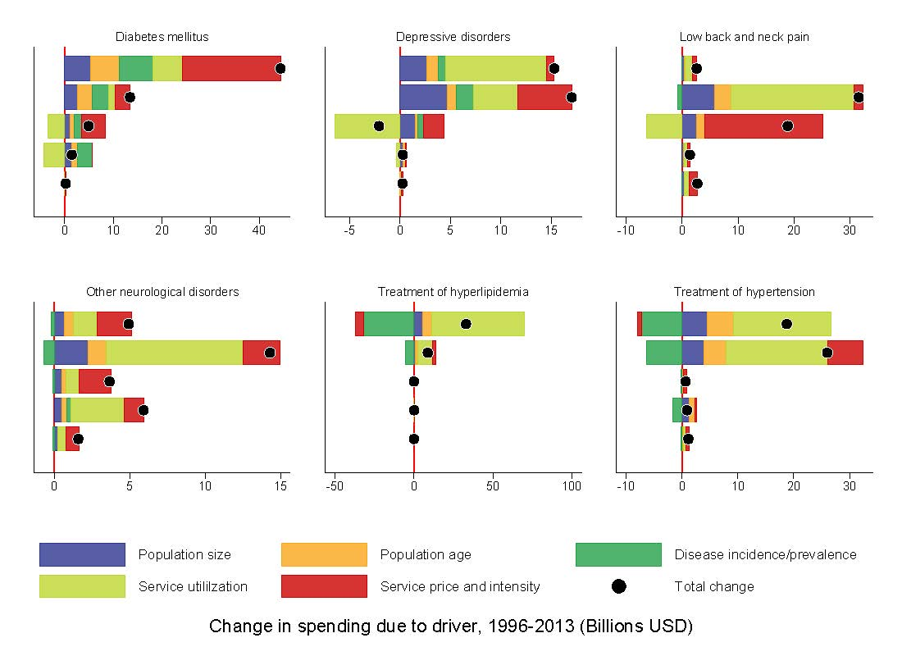
1. Measuring drivers of health care spending increases
Diabetes mellitus
Depressive disorders
Low back and neck pain
Prescribed pharmaceuticals
Ambulatory care
Inpatient care
Nursing facility care
Emergency department care
Other neurological
Hyperlipidemia
Hypertension
Prescribed pharmaceuticals
Ambulatory care
Inpatient care
Nursing facility care
Emergency department care

Slide 11
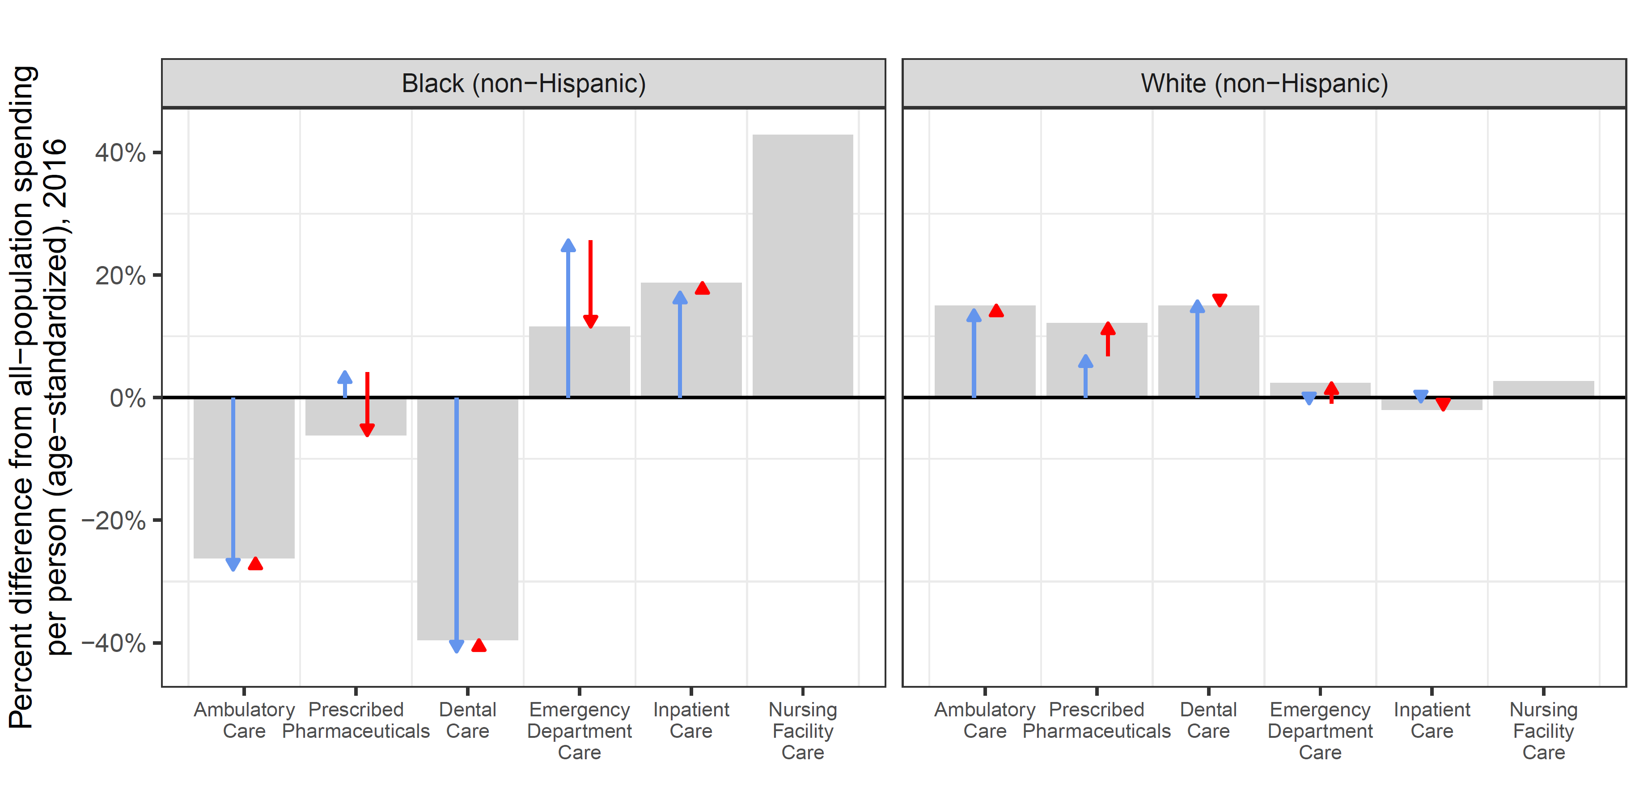
2. Estimating spending for six race/ethnicity groups

Slide 12
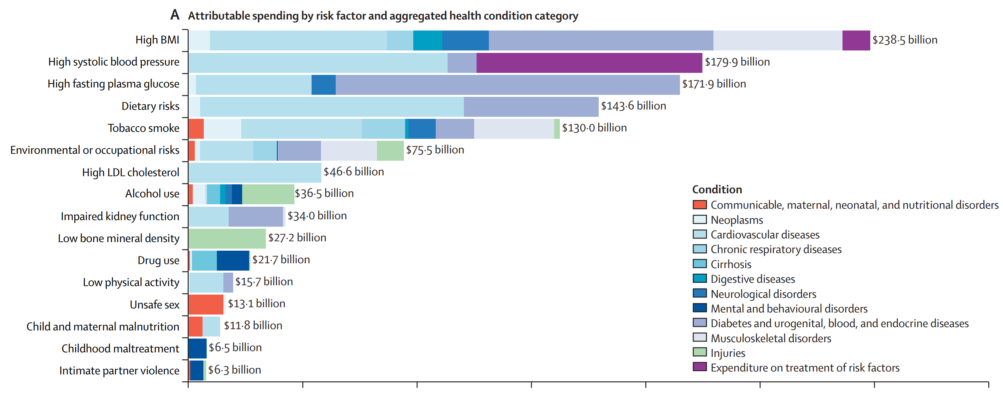
3. Health spending attributable to risk factors

Slide 13
Outline
Introduce US disease expenditure project
Highlight use cases of disease expenditure projects
INCORE and other countries completing similar studies

Slide 14

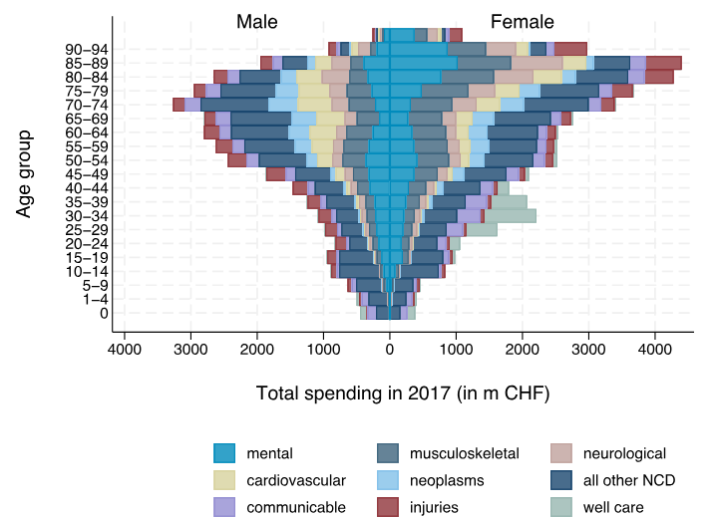
Similar research in Switzerland

Slide 15

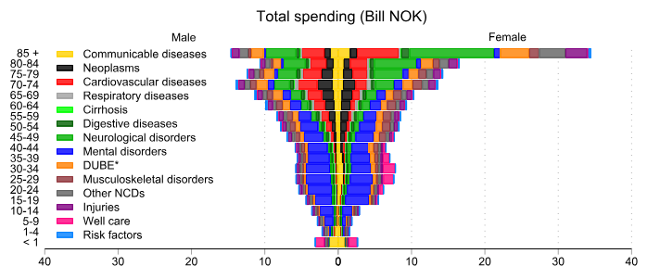
Similar research in Norway

Slide 16
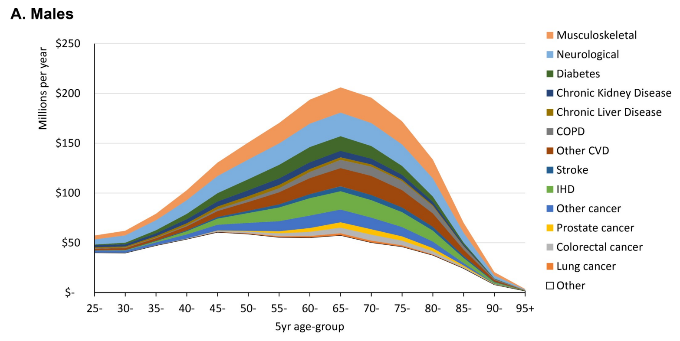

Similar research in New Zealand

Slide 17

INCORE
International Network on COmparative REsource Use
Objectives:
Estimate the health care spending by type of care, sex, age, and disease.
Assess the changes in age- and disease-specific expenditures within countries over time.
Compare the age- and disease-specific expenditures across countries and calculate an age-standardised healthcare expenditure measure.
Collaborating countries:
Australia, Denmark, England, Hong Kong, Norway, Scotland, Singapore, South Korea, Switzerland, and the United States.

Slide 18
Phase One Objectives
Begin simple, then add layers of complexity
Use a federated analysis system
Phase One:
Estimate the average length of stay in hospital for admitted patients by sex, age, and disease using claims or hospital administrative data.
Analyse the changes in length of stay in hospital within countries over time.
Compare age- and disease-specific length of stay across countries.

Slide 19
Next Steps, Phase Two, and Beyond
Phase two and beyond
Multi-year multi-phase project
Many further steps before we estimate age- and disease-specific health expenditures and utilization across types of care
Expanding the network
Create comparable statistics for a wider group of countries:
Increases usefulness of statistics.
Ensures wider harmonisation so that statistics can be more widely adopted.

Slide 20

Expanding INCORE
Interested in joining INCORE?
Scan the QR code and complete the short form
Alternatively, if you have questions, feel free to email me dieleman@uw.edu

