Slide 1

Public health policy research from an implementation science vantage
Science of Health Systems Conference
October 29, 2025
Ross C. Brownson
School of Public Health
Washington University in St. Louis
Notes:
Hard to know where to start, so much to cover!!
Big picture, poli sci studies of policy implementation around since the 1970s but the nexus between D&I research and policy research is much younger, probably a teenager: sometimes a little lost, often changing, rebellious
Mine is a public health focus
Nearly an open training field, many opportunities for conducting research that will have impacts on population health and equity

Slide 2
Big picture beginnings
Various forms of policy D&I research
Formative audience research studies
Audience segmentation studies
Dissemination effectiveness studies
Studies of research use in policymaking
Policy diffusion studies
The paradox of policy, the inverse evidence law
We have more, “weaker” evidence (using conventional hierarchies/metrics) about many of the wider social, economic, and environmental determinants of health (policies) that have the greatest impact on health
Notes:
As covered by Jonathan,…
I’ll give a few examples of the first two types of policy D&I research
A paradox
e.g., Large taxes on alcohol and cigarettes, modal shift in transport: how to get people to walk and cycle more, mitigation policies for COVID-19
BUT…different methods or designs doesn’t necessarily lead to weaker evidence, just more real world

Slide 3
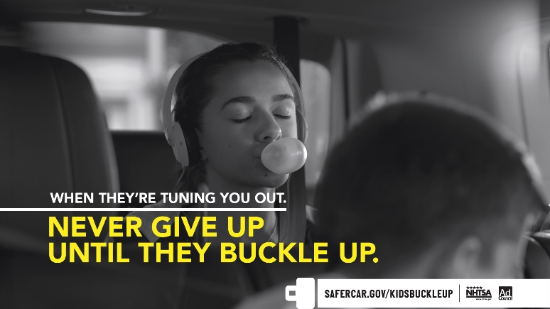
Top 10 Public Health Achievements (global)
Examples
Vaccination
Road and vehicle safety
Safer water and sanitation
Control of neglected tropical diseases
Tobacco control
Each of these advances involved policy (+ something else)

Slide 4
Design options
Actual
Retrospective
Reliance on secondary data and recall for primary data
Observational (longitudinal or cross-sectional)
Primary and secondary data
Experimental or quasi-experimental
Primary and secondary data
Hybrid
Blend effectiveness and implementation outcomes
Modeling/Simulation
Agent-based modeling
System dynamics modeling
Social network analysis
It’s not a hierarchy,
it’s an ecosystem
Case Study
Detailed contextual analysis of a real-life study
Mazzucca S, Tabak RG, Pilar M, et al. Variation in Research Designs Used to Test the Effectiveness of Dissemination and Implementation Strategies: A Review. Front Public Health. 2018;6:32.
Notes:
Typology of designs, there are many design options for your policy-related studies; types of designs and gaps are summarized in Mazzucca et al.
The sweet spot here is the strongest design for your research question, often triangulating various types of evidence

Slide 5
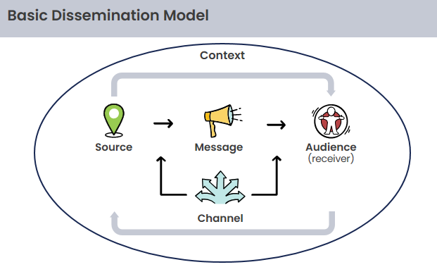
Framing matters
The role of framing
Derived from communication science
May address deep values or beliefs (including ideology)
Enhanced when messages are framed in ways that evoke emotion, interest, usefulness
Enhanced when all parts of the dissemination process are addressed
Brownson RC, et al. Getting the word out: new approaches for disseminating public health science. J Public Health Manag Pract. 2018;24(2):102.
Notes:
Framing is often used in policy advocacy.
Death tax vs wealth tax
For example, health taxes (e.g., on tobacco, alcohol, sugar-sweetened beverages) are an effective strategy to improve health and generate government revenue.⁶⁵ As one might anticipate, the most common frame in support of health taxes involves health gains and revenue generation. Arguments against taxes are that they are regressive and can potentially damage the economy, eliminate jobs, or promote illicit trade.⁶⁵ Framing can occur at multiple levels.
- At the macro-level, the focus is on big ideas and themes such as freedom, justice, community building, responsibility, or kindness to others (e.g., we want to live in a nurturing society for youth).
- At the intermediate or meso-level, a scientific advancement might connect with the bigger theme (e.g., diseases like childhood cancer can be cured).
- And at the micro-level, a specific policy can be linked with the health issue (e.g., insurance should be required to cover proven treatments for childhood cancer).
Here’s the basic communication model: Source, message, channel, receiver. It’s from 1949 by Shannon and Weaver, so it’s been around for over 70 years.
Really simplistic mechanically, but the blue boxes are still relevant, even today.
While there are lots of ways to communicate with others or to get information, especially in today’s media, and social environment, there still is a source of that information, there’s the message and the channel through which that information is shared, and there’s an audience or receiver of that message.
Now that we know about the source, message, channel, and receiver, there are certain aspects of these that are important for us in health communication. As we develop any given health message, what is our main goal?
That we are able to persuade the audience or receiver into paying attention to the message and to act upon that message.
NOTE: the process is non-linear, iterative. Must consider source, message, audience, channel all at the same time—one will influence the other.
For example, the policy goal you want to achieve may determine your audience; but if your audience is fixed, that may inform what policy goals are achievable.
All of the parts of the model interact – so while we’re going to be talking today about a step-by-step approach, the order of these steps may change. For example, you may be called on to address a particular audience and then are faced with crafting a message for that audience. Or, you might have the message and be looking for an audience, etc.

Slide 6
A few examples
Formative audience research
How attributes of policymakers inform design and distribution of policy-related materials
Audience segmentation studies
How dissemination materials might be tailored/framed for different types of policymakers
Modeling small p policy
How to address mis-implementation in public health settings
Purtle J, et al. Policy dissemination and implementation research. In: Brownson R, Colditz G, Proctor E, eds. Dissemination and Implementation Research in Health: Translating Science to Practice. 3rd ed. Oxford University Press; 2023.

Slide 7
Example 1: formative research
Importance of tailored materials
Sample study on material development
RCT of 331 local policy makers in the United States
Evidence-informed approaches for addressing equity in policy approaches
2 X 2 factorial design, random allocation of policy briefs
Measured a set of “decisionistic” variables (understanding, source credibility, use, policy context)
 |  | Risk-framing communication
 |  | No | Yes
Narrative communication | No | 1. Usual care Traditional for health experts | 3. Risk framing Use decision sciences to frame data in meaningful and accessible ways
 | Yes | 2. Narrative Story connecting characters to events | 4. Combination Both narrative and risk framing communication
Notes:
1/2
Still much we don’t know, for the most effective materials: format, content/framing, public health issue, policy maker attributes?
Policies such as innovative city planning
Outcomes derived in part from the early work of Carol Weiss + our previous work with state legislators/staffers. (decisionistic variables: significant predictors of movement toward evidence-based policy)
four parts: understanding, policy context, use, and source credibility.
Some preliminary findings: All briefs performed relatively well.
Differences for cognitive vs. affective understanding
The strongest predictors by far appears to be the use of local data in the brief, ironically not one of our four cells.

Slide 8
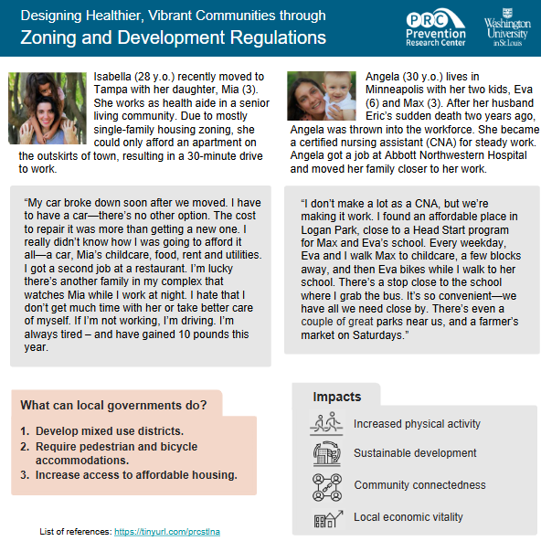
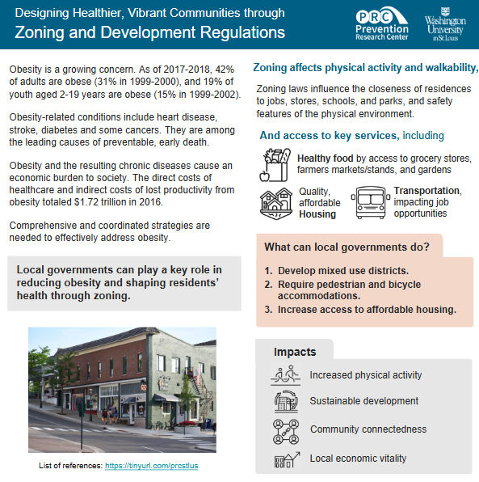
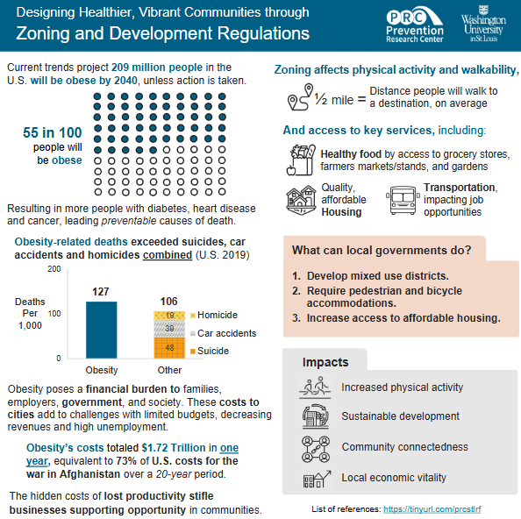

Slide 9
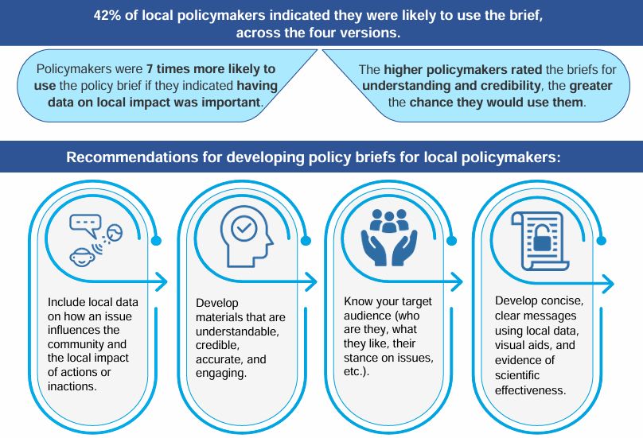
Key findings
Dodson E, et al. Effectively communicating with local policymakers: a randomized trial of policy brief dissemination to address obesity. Front Public Health. 2024;12

Slide 10
Example 2: audience segmentation (framing)
One size does NOT fit all
In general
The more conservative legislators trust industry more
Fiscally liberal legislator have a preference for evidence-informed stories
Study on effective dissemination
Cross-sectional data on 862 state legislators
High preference for data as
Understandable
Unbiased
Timely
Four segments based on latent class analysis
Pragmatic consumers (36%)
Uninterested skeptics (30%)
Highly-informed supporters (25%)
Constituent-oriented decision makers (9%)
Smith NR, et al. Opportunities to improve policy dissemination by tailoring communication materials to the research priorities of legislators. Implement Sci Commun. Mar 4 2022;3(1):24.
Notes:
As you consider your audience, remember to keep ideology in mind, as it can drive dissemination preferences. The bullets give examples of possible motivations for various segments among policy audiences.
Demographic separation approaches involve stratifying a population of policymakers according to demographic variables and assessing differences in dissemination preferences, knowledge, attitudes, and behaviors across strata.
Empirical clustering approaches to audience segmentation use statistical techniques such as latent class analysis and k-means clustering to identify patterns in relationships between multiple, and typically non-demographic, variables.
Legislators were grouped using latent class analysis based on how they prioritized 12 different characteristics of research (e.g., research is unbiased, presents data on cost-effectiveness, policy options are feasible)
(46% response rate)
Natalie Smith analysis of one of our national surveys… This works builds on similar research that Jonathan in behavioral and mental health.
Pragmatic consumers (36%) prioritized research that was brief and concise, provided cost-effectiveness analyses, and was understandably written.
Uninterested skeptics (30%) generally did not place a high priority on any of the research characteristics.
Conversely, one-quarter of legislators (25%) belonged to the Highly Informed Supporters group that placed a high priority on most characteristics of research.
Finally, Constituent-Oriented Decision Makers (9%) prioritized research that was relevant to their constituents, delivered by someone they knew or trusted, available at the time decisions were made, and dealt with an issue that they felt was a priority for state legislative action.

Slide 11
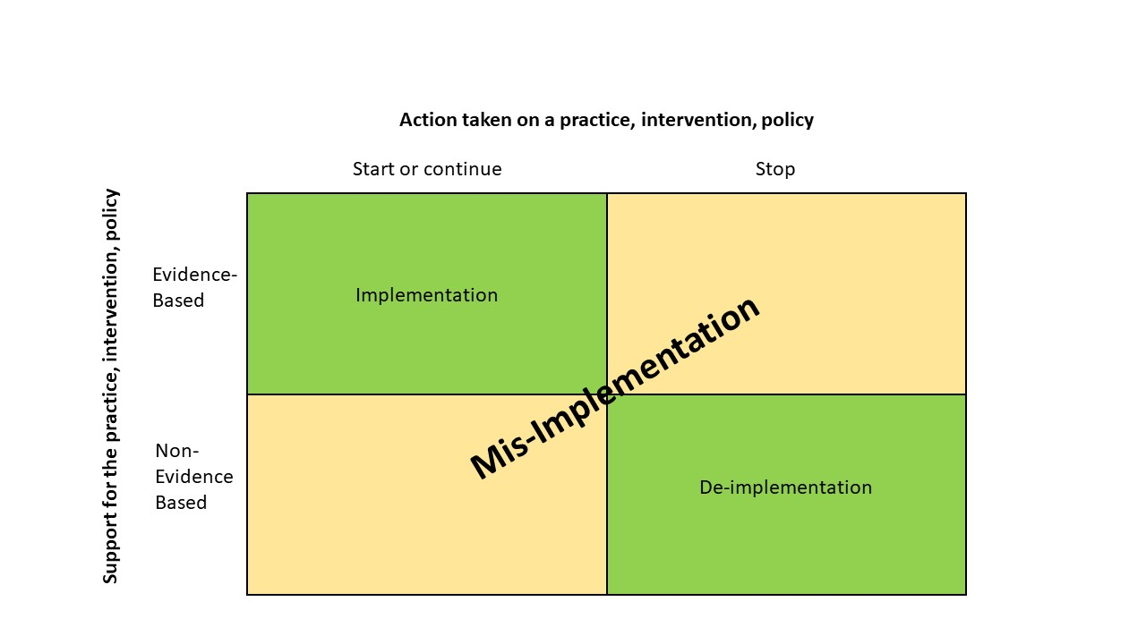
Example 3: diffusion of small p policy
Mis-termination
Mis-continuation
Kasman M, Hammond RA, Purcell R, et al. Understanding Misimplementation in U.S. State Health Departments: An Agent-Based Model. Am J Prev Med. Apr 2023;64(4):525-534.
https://prcstl.wustl.edu/items/public-health-in-action/
Notes:
In a U.S. study (Brownson et al., 2014):
36.5% of state health department employees reported that programs often or always end that should have continued
24.7% of respondents reported programs often or always continue when they should have ended
Higher for obesity, physical activity, nutrition; lower for cancer programs
Higher in local PH than in state PH
Always involve funding decisions, which is small p policy.

Slide 12
Methods and findings
Intra-organizational dynamics
Benefit: actionable
Challenges: employees’ affecting one another and changing over time
Very difficult to analyze with traditional statistical approaches
Agent-based modeling (ABM)
Explicitly represents individuals situated within an environment as well as their interactions with one another over time
Can handle interdependence, adaptation, heterogeneity
Evidence that plausible intra-organizational processes can explain observed mis-implementation patterns
Who has information
Who shares information with whom
How information is used to make decisions
Notes:
A computational simulation method in which individual entities (e.g., employees), their behaviors, and the environments in which they operate are explicitly (and typically, stochastically) modeled over time (36 months)
Results were surprising!
Some of findings from cross sectional survey data were different in ABM (org layers)
Several key findings from ABM:
increasing either organizational evidence-based decision-making capacity (org climate/culture: innovation, participatory decision making, ability to take risks)
or information sharing could reduce misimplementation (better communication)
Shifting leadership priorities to emphasize effectiveness resulted in the largest reduction
A priori, reasons to think that organizational restructuring would have large effects
Distributed decision-making in other contexts
Relationships observed in cross-sectional analyses (Padek et al., 2021)
Shifting organizational structure, capacity, culture much less effective than leadership decision-making process

Slide 13
Big picture endings
We likely need some new framing in the current political environment
Equity, disparities, social justice versus fairness, access, economic benefits
High likelihood of multiple types of mis-implementation
Greater need for policy termination
Many gaps in our knowledge of dissemination and implementation of policy
Look to a broad range of funders
Stay the course!!
Notes:
Funding climate
Role of policy implementation (policy termination); policy mis-implementation; We need you more than ever before
Stay the course
Re-frame some issues (buzzwords, rural, PH issues with common ground, economic benefits of research)

Slide 14
