Slide 1

The political economy of priority-setting: A synthesis of frameworks for the prioritization of universal health coverage in low- and middle-income countries
Ashley Fox (afox3@albany.edu)
Science of Health Systems Conference
St Louis, Missouri
Oct 29, 2025

Slide 2

Background: Investing in Health Program (IIHP)
As part of its health financing work, the World Bank is undertaking a large project that aims to strengthen the evidence-base for investing in health (the Investing in Health Program or IIHP).
The IIHP program is working across 5 “Pillars” that aim to address health financing challenges including:
Elevating health as a government investment priority.
Prioritizing health in budget allocations.
Making social health insurance work for UHC.
Aligning government funding with health priorities.
Leveraging development assistance for government funding of health.
Notes:
Elevating health as a government investment priority. Making health a top investment priority, along with ensuring financial protection against health-related costs, is essential for significant improvements in physical and mental well-being. Achieving and sustaining these advancements poses profound challenges and is often only realized over short periods. So, what factors contribute to making progress feasible and enduring? Is it driven by citizen demands, the momentum of social movements, consensus among key stakeholders, acknowledgement of economic and social benefits, or broader macro-fiscal conditions? And how can these conducive conditions be effectively established and maintained?

Slide 3
Elevating health as a government investment priority
Interest in incorporating political economy perspectives and public opinion
Interest in taking insights from global health priority setting and applying them to domestic health agenda setting
Not a ton of research on domestic priority setting (our impression) in LMICs compared with global priority setting
Our task:
When and why do governments invest in health?
Operational definition of invest in health/health priority setting:
Reforms that aim to “universalize” health services and coverage and improve health equity by legislatively/statutorily adopting concrete and identifiable policies or programs that credibly commits a government to action and recurrent financing of the health sector via public, tax-financed contributions.

Slide 4

What we were asked to do and what we did
Conduct a scoping/narrative literature review of conceptual and analytical frameworks for assessing priority setting in government policy.
Synthesize frameworks from different subfields of political science (international relations, comparative politics, public administration, public policy)
Support the development of an analytical framework to understand the determinants and mechanisms that emerge from cases where health has been placed high on the political agenda.

Slide 5
Literature Review
Two approaches
“Systematic” rapid review of the priority-setting & political economy literature
Narrative literature review of the political economy literature
Narrative Literature Review
Drew from our own knowledge of the political economy literature
PE literature on the welfare state, developed in high-income countries
How applicable to LMICs?
Search Terms for the “systematic” review
Supplemented with a more targeted search of Google Scholar and supplemented with our own knowledge.
Table 1: Search Terms
Google Scholar & Dimentions.ai

Slide 6
Summary of Identified Frameworks
The largest share of studies used no identified frameworks
Single greatest identified framework= Shiffman & Smith (2007)
Process oriented frameworks (a fair process makes the outcome fair):
Accountability for Reasonableness (A4R) [Norm Daniels]
Kapiri & Martin
Definitions of Priority-Setting:
Politically oriented work
Aim to explain why a specific health issue (e.g., mental health, breastfeeding, non-communicable diseases, tobacco, neonatal mortality, etc.) received attention (or not) above other issues
Economically oriented work
Finance and budget focused articles identified specific approaches to health sector financing such as performance-based financing, health technology assessment, user fees or, universal health coverage
Why ‘evidence’ was used, or not, in priority-setting processes
Notes:
Accountability for Reasonableness (A4R) [Norm Daniels] Framework is a process-oriented framework that aims to manage health priority-setting by developing a “fair process” by which actors can arrive at a consensus on fundamental principles guiding the decision-making process.

Slide 7
Narrative Literature Review: Classic Agenda Setting Frameworks
Reviewed Several “Classic” Agenda Setting/Policy frameworks as well
Important concepts:
Key individuals (policy entrepreneurs/brokers)
“Shocks” (punctuation; focusing events; constraints and opportunities)
Strategic Framing and Ideational Factors (policy images; rhetoric and symbolism)

Slide 8
Narrative Review of the Political Economy of Welfare States and Applications to Health Financing Reform
Resource-based explanations
The welfare state is a natural outgrowth of rising GDP per capita and the demands of capitalist democracy.
Critiques:
Class- and Partisan based explanations
Power-resources theory
Cross-class compromise
Institutions-based explanations
Change is constrained by past policy commitments and the ‘rules of the game’
Veto points
Agenda Setting Theory
Justification for lack of explicit investment in health
Non-democratic settings?
Overly structuralist/ functionalist account
Working class mobilization and strength of left parties
Critiques:
Low class consciousness and unionization in LMICs
Higher salience of ethnic divisions (reduce redistributive demands)
Unionized workers often oppose health reform
Dearth of “programmatic parties” in LMICs
Differences among parliamentary/presidential systems, etc.
Critiques:
Overly structuralist
Weak and changing institutions in LMICs
Patronage and clientelistic relations and weak administrative capacity
How policymakers decide which of the many potential investments they could make with public resources to focus their attention on.
More ideational/agentic than other explanations.
Critiques:
Heavy influence of external actors (i.e., donors) in LMICs
Non-democratic character of countries, low press freedom, low civil society participation can hamper issue emergence

Slide 9
Synthesis
Commonality across literature= non-incremental change occurs when…
Exogenous shock
+
Concerted long term effort by interested parties
Conducie Structural/Institutional Factors
+
Ideational Factors
[Successful exploitation of “windows of opportunity”]
+
[Structure & Agency aligning]

Slide 10
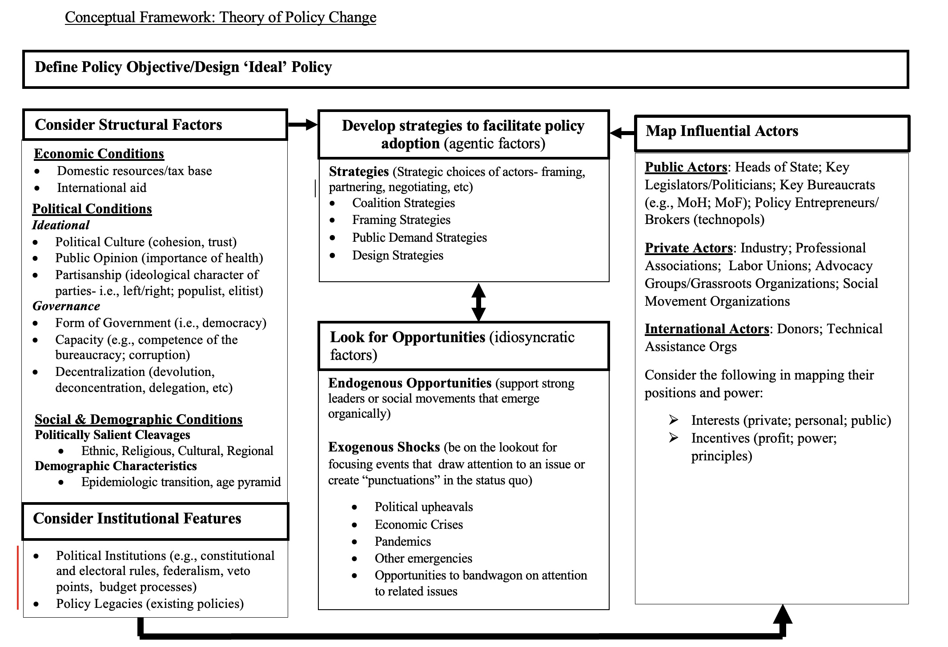
Political Economy of Health Financing Reform Framework
What’s new here:
The importance of long-term strategic efforts that build over time combining with exogenous shocks at the right moment

Slide 11
Summary
State of the literature on agenda/priority setting ➔ a little disappointing
Relevance of wider political economy/welfare state literature to health sector agenda setting in LMICs?➔ OK, but also lacking
Some combination of a window of opportunity + long term efforts by policy entrepreneurs must combine

Slide 12

Questions/Comments

Slide 13
Actors
Interests (basis of support/opposition)
private pecuniary benefit/detriment
personal gains/losses (e.g., political advantage)
Concerns for the public welfare
Incentives (what ‘currency’ actors seek/respond to)
profit-seeking (especially if private sector),
power (extending one’s influence) or
principles (advancing the moral righteousness of a cause or values of the individual/organization) in order to inform strategy building.
Can assist in predicting how they will respond and in developing appropriate anticipatory strategies to move actors’ positions.
Notes:
Even in the absence of full knowledge of actors’ positions, understanding the basis of their support/opposition and the “currency” in which they operate (money, influence, virtue) can assist in predicting how they will respond and in developing appropriate anticipatory strategies to move actors’ positions.

Slide 14
Strategies
Coalition strategies involve bringing together various interested actors (elected and agency officials, interest group leaders, researchers) with shared goals and values to advance a policy issue.
Framing strategies involve positioning issues in ways that resonate with key actors (Entman 1993).
‘30 baht scheme,’ slogan Thailand
Equality and universal rights used by civil society in Indonesia
Public demand strategies. Actors can capitalize on emerging changes in public demand for enhanced health spending or can try to induce public demand through effective framing strategies.
Policy design strategies. Policy design should be an ongoing process of figuring out which specific configuration of a policy can balance the wide variety of structural conditions and pressures from interested actors in a manner that allows progress without too much compromise in substance.

Slide 15
Case Studies
Thailand
Mexico
Endogenous Opportunities
Long term coalition building and advancing policy entrepreneurs in key bureaucratic offices was able to build an insurgent movement over time.
1980s- Rural Doctor’s Society formed comprised of doctors who served villagers and the poor for their residencies.
They entered the Ministry of Public Health, rising through bureaucratic ranks still guided by progressive values.
In 1986, they founded the Sampran (Rose Garden) Forum to discuss and promote health reform ideas in the Ministry, building a reformist network.
Members of this group eventually attained senior leadership positions (e.g., Deputy Permanent Secretary, department heads), giving them institutional influence to advance reform.
Exogenous Opportunities
East Asian Financial Crisis
In 1998, Thaksin founded the Thai Rak Thai party, shifting towards a pro-poor populist agenda to quell the rural masses.
Endogenous Opportunities
“Insurgent technocrats” within the bureaucracy—a small, reform-minded “change team”—drove the creation of Seguro Popular.
The team operated semi-independently (“insurgently”) from the wider bureaucracy, avoiding obstruction by working around resistant officials in the health and finance ministries.
The reform was “technocratic”—led by highly educated, appointed bureaucrats rather than partisan politicians.
These leaders acted as policy entrepreneurs, using technical expertise and strategic collaboration to promote the national health insurance reform.
Exogenous Opportunities
Structural economic shifts causing worse adverse societal consequences from deficient healthcare spending than had existed in eras of healthcare policy stasis;
Short-term exogenous economic shocks creating rapid growth in the number of people who were uninsured and unable to pay for healthcare;
Politically destabilizing effects of the aforementioned economic shocks on political coalitions;
Notes:
In the mid-1980s, members of the Rural Doctors Society entered the Ministry of Public Health, rising through bureaucratic ranks while guided by progressive beliefs in universal, equitable health care.
Their firsthand experience in rural areas shaped their commitment to improving health outcomes for villagers and the poor.
In 1986, they founded the Sampran (Rose Garden) Forum to discuss and promote health reform ideas within the Ministry, which helped build an internal reformist network.
Over time, members of this group attained senior leadership positions (e.g., Deputy Permanent Secretary, department heads), giving them institutional influence to advance reform.
Harris (2015, 2017a, 2017b) similarly attributes Thailand’s adoption of its Universal Coverage scheme to the strategic actions of insurgent bureaucrats within the MoH, grounded in a broader professional movement. The professional movement was composed of activist physicians, who, in the 1970s began advocating for major health reforms in opposition to the broader medical profession. The professional movement was comprised of an agglomeration of unusually progressive doctors that occupied leadership positions within Thailand’s Ministry of Public Health. This small group of public service–minded doctors, who had graduated at the top of their class from Thailand’s leading medical schools led the charge for universal health coverage in the country. They strategically mobilized resources in the bureaucracy, political parties, civil society, and international organizations to push for the adoption of universal health care that went against the broad interests of their profession and in the face of political opposition, and international pressure that was trending in the opposite direction at the time. While some scholars have suggested that electoral rule changes brought about by democratization provided political parties with new incentives to offer substantive political platforms (Hicken 2006; Selway 2011), Harris argues that this cannot explain how or why universal health care was chosen over other competing policy priorities at a time when the budget was already strained, following the Asian financial crisis. He places more decisive emphasis on the role of a progressive bureaucrats and the professional movement they built.

Slide 16
Key Design Choices
 | Key Design Choices
Financing Politics | Mix of taxes and their progressivity/ regressivity Keep or do away with user fees/cost sharing Charge a premium/ enrollment fee or keep free at point of service
Benefit Package Politics | How comprehensive/ essential should the benefit package be? How to incorporate existing public and private benefit plans (i.e., that public employees receive) into the new benefit plan.
Pooling politics | Allow or forbid supplemental coverage? Means-testing & targeting to the poor or bring everyone under the same umbrella. Design of “exemptions” from premium payments.
Payment Politics | How will providers be reimbursed/compensated?

Slide 17
Motivation for the Investing in Health Report
Fiscal constraints, competing priorities and charged geopolitical environments are likely to force health investments to take a backseat.
Rising Polycrisis:
Inflation
Tight monetary policies,
Climate changed induced disasters
Large-scale armed conflicts,
Significant increases in migratory flows,
Deepening geopolitical divisions, and a
Rise in nationalist populism.
Stagnating or shrinking fiscal resources.
Shift in developmental priorities (greater focus on securitization?):
Ensuring safety and security
Pandemic preparedness
Prioritizing border defense,
Ensuring food security,
Bolstering supply chain,
Climate-proofing infrastructure

Slide 18
Defining what it means to “invest in health”
Our task: When and why do governments invest in health?
First order question: How do we measure/operationalize governmental health investments?
Intersectoral allocations (i.e., among education, infrastructure, etc) versus Intrasectoral (within the health sector)
Most global health agenda setting literature has focused on the latter
Budgetary commitments to health?
Size of the budget line??
Policy Commitments to health➔ Should be outlined in statute
Focus on investments in the health system itself as opposed programs outside the health sector that (inadvertently) benefit health
Other pillars cover intrasectoral investments and non-health sectors impacts on health

